Slide 1
CS 6000 Research Methods
Terrance E. Boult
El Pomar Prof. of Innovation and Security

Slide 2
The objectives of this course are for you to gain an understanding of :
Some basic CS publishing/development tools (LaTex, Git etc..)
How to effectively read CS research papers
How to effectively write a research paper
How to effectively present research papers
How to develop a thesis proposal

Slide 3
The objectives of this course are for you to gain an understanding of :
How to design an experiment and the statistical analysis of the resulting experimental data.
Basic usage of cloud computing for CS research.
and appreciation for and understanding of different subfields of CS and their approaches to CS research,

Slide 4
Course Ground Rules
Try to understand
Don’t be afraid to ask (email okay)
Don’t be afraid to comment
Be constructive
Be polite
Don’t be afraid to criticize (constructively!)
Be prepared & do the work on time
Notes:
<number>

Slide 5
Grading
Writing assignments/Paper 30%
Oral Presentation 15%
Class participation and/or online discussion 15%
Weekly journal 20%,
Experimental Design Assignment 10%,
Cloud assignment 10%

Slide 6
In This Course
We will give you many research papers to read and hear many research talks
If the paper is published, free to discuss anywhere even online.
If the paper is unpublished (it has been submitted and is currently under review)
Treat it as confidential
Do not show it to anyone outside of this class
Be ready to put yourself in the mind of a reviewer, author, researcher.. as you’ll need to be each
Notes:
<number>

Slide 7
First Assignment
Week 1 journal is to be done in latex, and you are to upload the pdf which will include a link to your git repo.
The document should have a title/author.
The first section should be 200-300 words on your goals for this course, what you hope to learn, which degree you are studying and something personal plus your photo as a figure. This same content should be in your canvas profile.
The second section should be about where to find your source code and your learning.
It should have hyperref/link to git repo (either public or shared with tboult on github or tboult on bitbucket) for the body of the latex.
Describe with whom you shared it and what tools you used. The body should discuss your learning from this week, problem/struggles you had and how you overcame them.
The third section should contain a 1-3 sentence description, plus citation, to each of five papers that are related to your research. It should reproduce at least 1 equation from at least 1 paper and discuss it.
The paper should end with a bibliography in IEEE format.

Slide 8
Role of Research
Should be about some problem that encourages enthusiasm (for you) and interest (for others)
Is often generated from the thought “what we’ve got now/from the past isn’t quite right/good enough – we can do better…”
Consists of work that leads to a meaningful contribution and evaluates that contribution
Generates, in some way, a better solution to the problem – it advances the state of the art
Needs to be shared and used to have an impact
Probably needs to be reviewed before most will consider using it.

Slide 9
What Is Research?
Merriam-Webster’s definition:
1 : careful or diligent search 2 : studious inquiry or examination; especially : investigation or experimentation aimed at the discovery and interpretation of facts, revision of accepted theories or laws in the light of new facts, or practical application of such new or revised theories or laws 3 : the collecting of information about a particular subject

Slide 10
What Is Research?
“A combination of investigation of past work and effort in the present that will help others in the future”
A set of opposites
Fun and frustration
Small steps and large insights
Building on others’ work and contributing your own work
Finding or developing something new that impacts the world….

Slide 11
What Isn’t Research
Playing with technology
Book reports
Programming project
Commercial product development
Doing what others have already done
However, each of these can be done as part of research.

Slide 12
What is fundamental research
The endless debate about fundamental research, basic research, applied research, finalized research…
A first and some say definitive answer : a study of something in pure form, with no application that leads to a result that has some scientific value as soon as it has been accepted by a scientific publication (a scientific committee)
A second answer : a result has some scientific value if it interests people and if it is novel (original) (and if it has some genericity)
A third and I say definitive answer : a result helps solve a problem and has some general scientific value cited by others, e.g. in an reviewed published paper.
The most difficult (and so the most interesting) problems have often been raised by applications, e.g. medical applications. Investigating these problems have gone through theoretical scientific developments.
My Bias: Fundamental research is that which help solve multiple-real world problems. Until then its just “speculative research.”

Slide 13
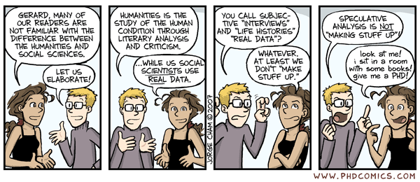
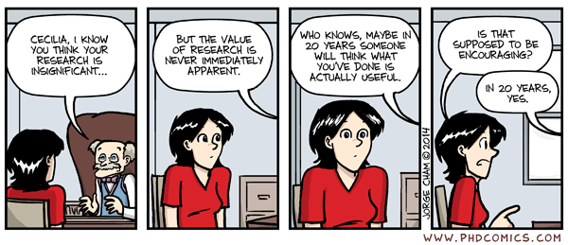

Slide 14
Who Does Research?
Graduate Students
Masters Degree (lower expected output)
Ph.D. Degree (higher expected output)
Researchers at universities
Post-Doctoral students
Faculty members
Researchers in industry
Research scientists
Many other technical workers
Undergraduate students

Slide 15
Who Does Research?
Individuals
Teams
Teams almost always make the process easier
Feedback from team members
Multiple-skill sets and division of labor
Each member can work to own strengths

Slide 16
Scope of Research
Varies by level of work
Ph.D. students – contribution expected at global/world level; e.g.
background investigation on all past work
make meaningful addition to world knowledge
MS/Undergraduate students – contribution can be at local to national to world level; e.g.
background investigation at university up to world level
make meaningful addition to university up to world level of knowledge
much ugrad research is to learn the process and get started down the path

Slide 17
What is Research?
Quantitative vs. Qualitative Research
Quantitative – use of mathematical models, software statistical, formulaic or numerical analysis to analyze results
Main approach: discovery, analysis; causal determination, prediction, generalization of findings
Results: “This solution is N% better”
Qualitative – not quantitative; use of non-numeric techniques to analyse results
Main approach: discovery; analogy; understanding, extrapolation to similar circumstances
Results: “This is a new problem and here is how to solve it

Slide 18
Pragmatic method & Mixed methods:
Generally problem driven
combines both quantitative and qualitative approaches, using right tool for a given task.
Advocacy/participatory research methods:
Predefined agenda, often focused on improving outcomes for a group of (marginalized) people.

Slide 19
Approaches to CS research
Attack a known problem, find/compare tools to solve it.
Formalize a new problem, then attack it and find/compare tools to solve it.
Build a new tool and test it on your own private data

Slide 20
Rest of Today’s Agenda
Some common tools for the course:
Latex
Zotero
Git

Slide 21
Experiment Design in Computer Science
Notes:
<number>

Slide 22
Computer Science
Origins
Mathematics,
Engineering, and
Commercial practice.
Evolved into
Theoretical,
Experimental and
Design (or user) orientated aspects.
Balance and synthesize these aspects
Mathematics (what is?), CS (how to?)

Slide 23

How does this Drive progress?
Theoretical advances due to new mathematical results
You prove a theorem
Fun, short, no argument!
Not our concern here. But rarely enough.
Experimental results
The real stuff?
The rest of this lecture …

Slide 24
Experimentation is Always important in Computer Research
Why: “It doesn’t matter how beautiful your theory is, it doesn’t matter how smart you are – if it doesn’t agree with the experiment, it’s wrong.”
-- R. Feynman
“It does matter if its ‘optimal’ unless is at least good in real experiments.
-- T. Boult

Slide 25
What is an Experiment in Computer Science (ECS)?
ECS is the creation of, or the experimentation with or on, nontrivial hardware and software systems
These systems, taken broadly, are called computational artefacts.
ECS process:
Form a hypothesis
Construct a model and make a prediction
Design an experiment and collect data
Analyze results

Slide 26
Outline
What is Experimental Computer Science?
Debunking reasons not to experiment
How do you do Experimental Computer Science?
What are Information Artefacts?
In Conclusion
Source: W Tichy, “Should Computer Scientists Experiment More?”, IEEE Computer, 31(5), May 1998, pp. 32-40

Slide 27
Is Computer Science really an Experimental Science?
Computer Science is “not a science, but a synthetic, an engineering discipline” [Brooks]:
Phenomena are manufactured
CS is a type of engineering
So experimentation is misplaced
But other Sciences:
Study manufactured entities, e.g., super-heavy elements, lasers
Make inferences about models, e.g. simulations

Slide 29
Why should we experiment?
Experiments cannot prove anything with absolute certainty
But they are good for:
Reducing uncertainty about theories, models, and tools
Leading to new insights and whole new areas of investigation
Quickly eliminating fruitless approaches
Testing theoretical assumptions about the world.

Slide 30
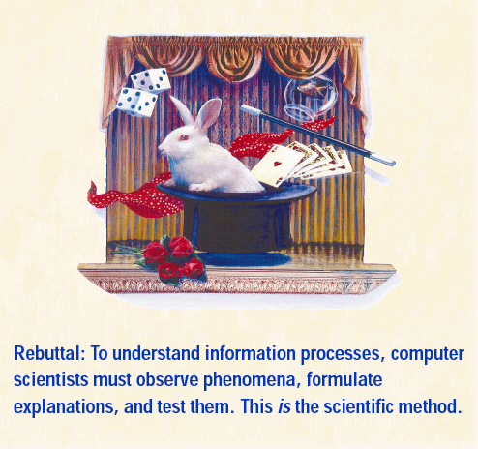
Fallacy #1: Traditional scientific method isn’t applicable
Subject of inquiry is information unlike traditional sciences which study matter or energy
Example:
Object-oriented programming, is it genuinely better?

Slide 31
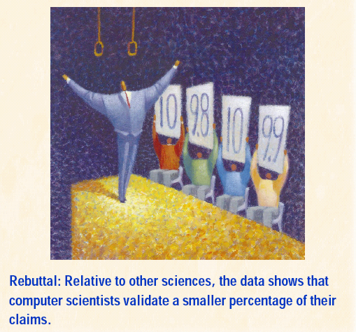
Fallacy #2: Current levels of experimentation are enough
In a late 1990s study of CS papers requiring empirical backup, 40-50% had none.
Compared to <15% in non-CS papers
The youth of CS as a discipline is not sufficient justification.
More recent studies show that is changing..

Slide 32

Fallacy #3: Experiments cost too much
Experiments can be expensive, but:
Often cheaper than the alternative
The cost may be worthwhile for important questions (general relativity)
Explore cheaper options (benchmarking)
Notes:
<number>
Proving general relativity required a special trip to West Africa and the very latest in photographic techniques

Slide 33

Fallacy #4: Demonstration will suffice
Demos allow proof of concept and illustrate potential
But they cannot provide solid evidence
Easier for bias to hide in a “demo”

Slide 34
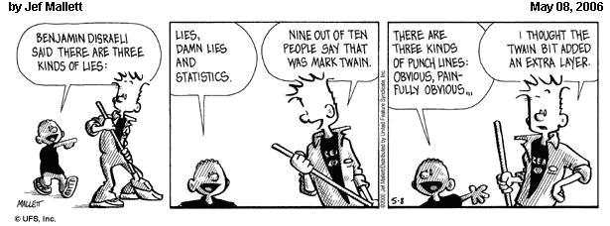
Fallacy #5: There’s too much noise in the way
Too many variables, effects swamped by noise
Answers:
Use benchmarks
Apply statistical controls from medicine and psychology

Slide 35
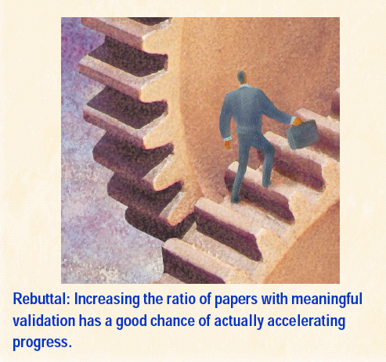
Fallacy #6: Experimentation will slow progress
Research takes longer → fewer ideas
Actually weeds out questionable ideas and their offshoots
Still a place for the hypothesis paper

Slide 36
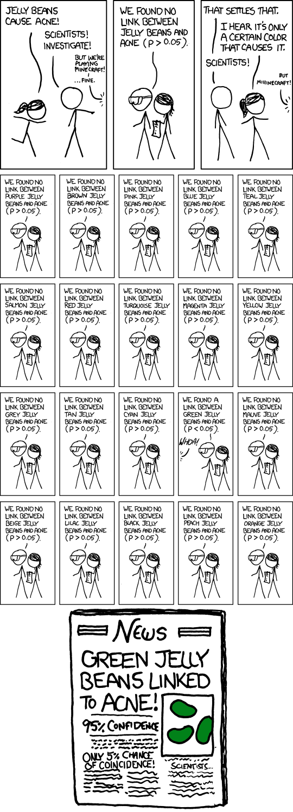
Fallacy #7: Technology changes too fast
“The rate of change in computing is so great that by the time results are confirmed they may no longer be of any relevance” [Mudge]
Look to fundamental long term problems rather

Slide 37
Fallacy #8: There are substitutes
Theory
Can be contradicted in practice by incorrect simplifying or modeling assumptions
Intuition
Fails in the face of counterintuitive results
E.g., productivity is NOT necessarily improved by typechecking
1Experts
Science must always be backed up by evidence
E.g., claims about cold fusion
Notes:
<number>
Trusting in experts would have led to believing Ponds and Fleischman’s claims of having achieved cold fusion

Slide 38
Stellman, Steven. "A Spherical Chicken". Science 28 Dec 1973: Vol. 182, Issue 4119, pp. 12961977 .https://science.Sciencemag.org/content/182/4119/1296.3

Slide 39
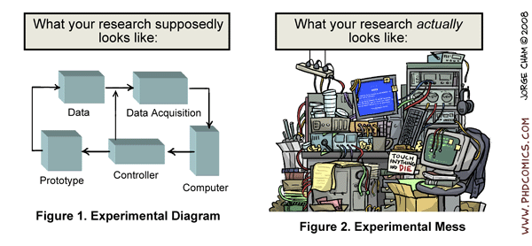
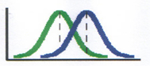
Outline
What is Experimental Computer Science?
Debunking reasons not to experiment
How do you do Experimental Computer Science?

Slide 40
Experimental Hypothesis
Any scientific research should state a hypothesis, then
Provide evidence for/against
Conclude whether it is supported or refuted
Should be:
Precise, explicit statement
Falsifiable
Run experiment to confirm or refute
Ensure that the experiment really tests the hypothesis in a meaningful way
Notes:
<number>
From greek “foundation” - a proposition made as a basis for reasoning without the assumption of its truth

Slide 41
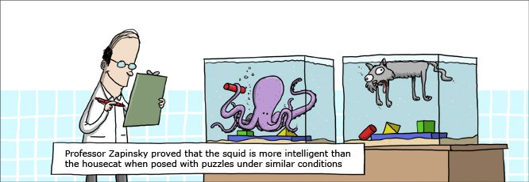
Experimental Design

Slide 42
Elaborating the Hypothesis
Hypothesis might be that system/theory/technique/ parameter P is:
Good for task X
Better than rivals Q and R for task X
According to:
Behavior - correctness or quality of solution
Coverage - range of problems to which it applies
Efficiency - resources consumed
Evidence can be theoretical, experimental or both
Theoretical evidence - theorem based
Experimental evidence - testing on a range of examples

Slide 43
Designing an Experiment
Specification needs to be complete and explicit
Make sure the experiment really tests the hypothesis
Plan for managing variance
Requirements:
Controlled - other factors must be kept constant
Quantitative - provide numbers
Coverage - are tests representative of the full range of the hypothesis

Slide 44
Analyzing and Reporting Results
Analyze the measured data:
Does statistical evidence really support (or refute) the hypothesis?
Make sure differences are not due to chance or natural variability
Be Careful:
Better to admit to flaws in your methodology
Don’t generalize without adequate support
Report everything:
Procedures, results and conclusions
So that others can replicate the experiment
And build on your conclusions

Slide 45
Message - Prove your Claims
which means that you have to have claims to prove
and evidence to back you up
and evidence is almost always convincing numbers, e.g. statistically significant
from well constructed, all influences considering, set of experiments
that are discussed
and from which a series of conclusions are drawn

Slide 46
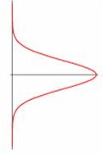
A Good read.. Cohen’s Book..
Textbook, MIT Press, 1995
Other material:
Empical Methods Tutorial at the Pacific Rim AI Conference, 2008
Assessing the Intelligence of Cognitive Decathletes. Paul Cohen. Presented at the NIST Workshop on Cognitive Decathlon. Washington DC. January 2006.
If Not the Turing Test, Then What? Paul Cohen. Invited Talk at the National Conference on Artificial Intelligence. July, 2004.
Various papers on empirical methods.

Slide 48
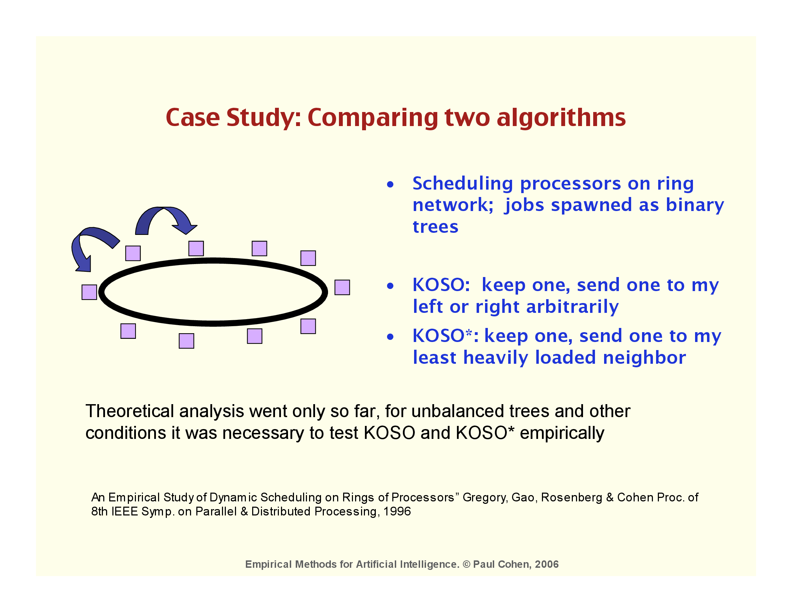

Slide 49
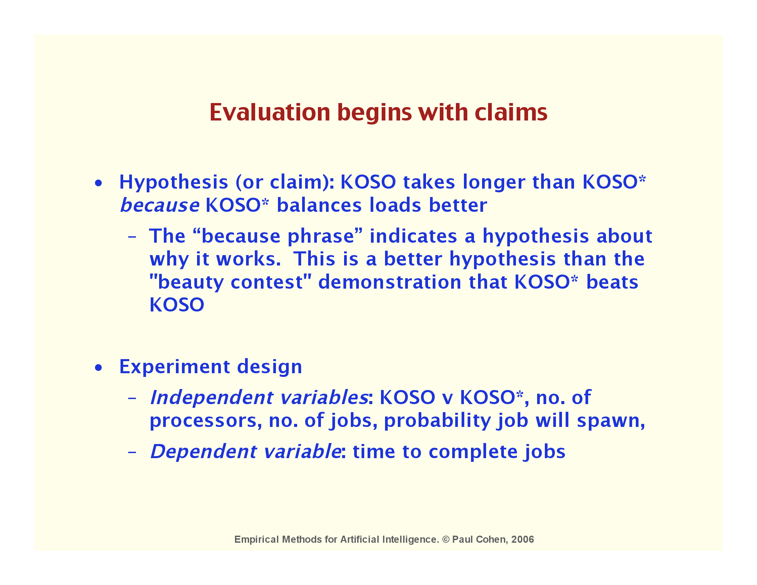

Slide 50
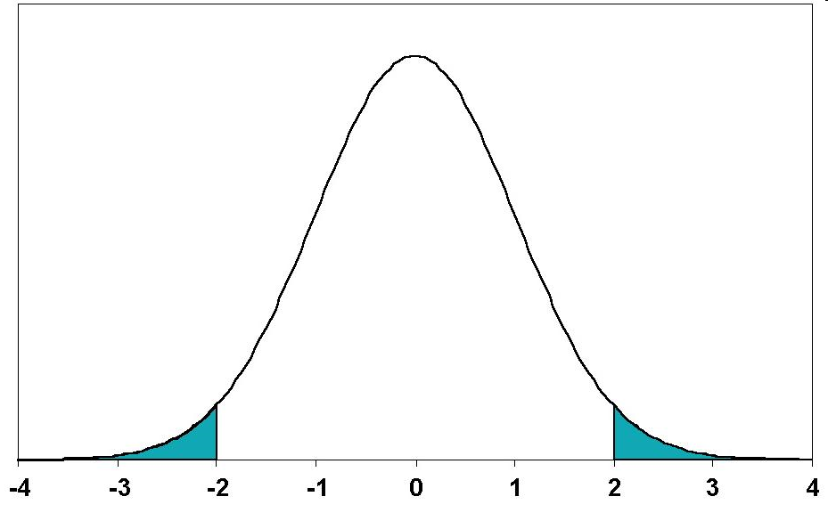

Slide 51
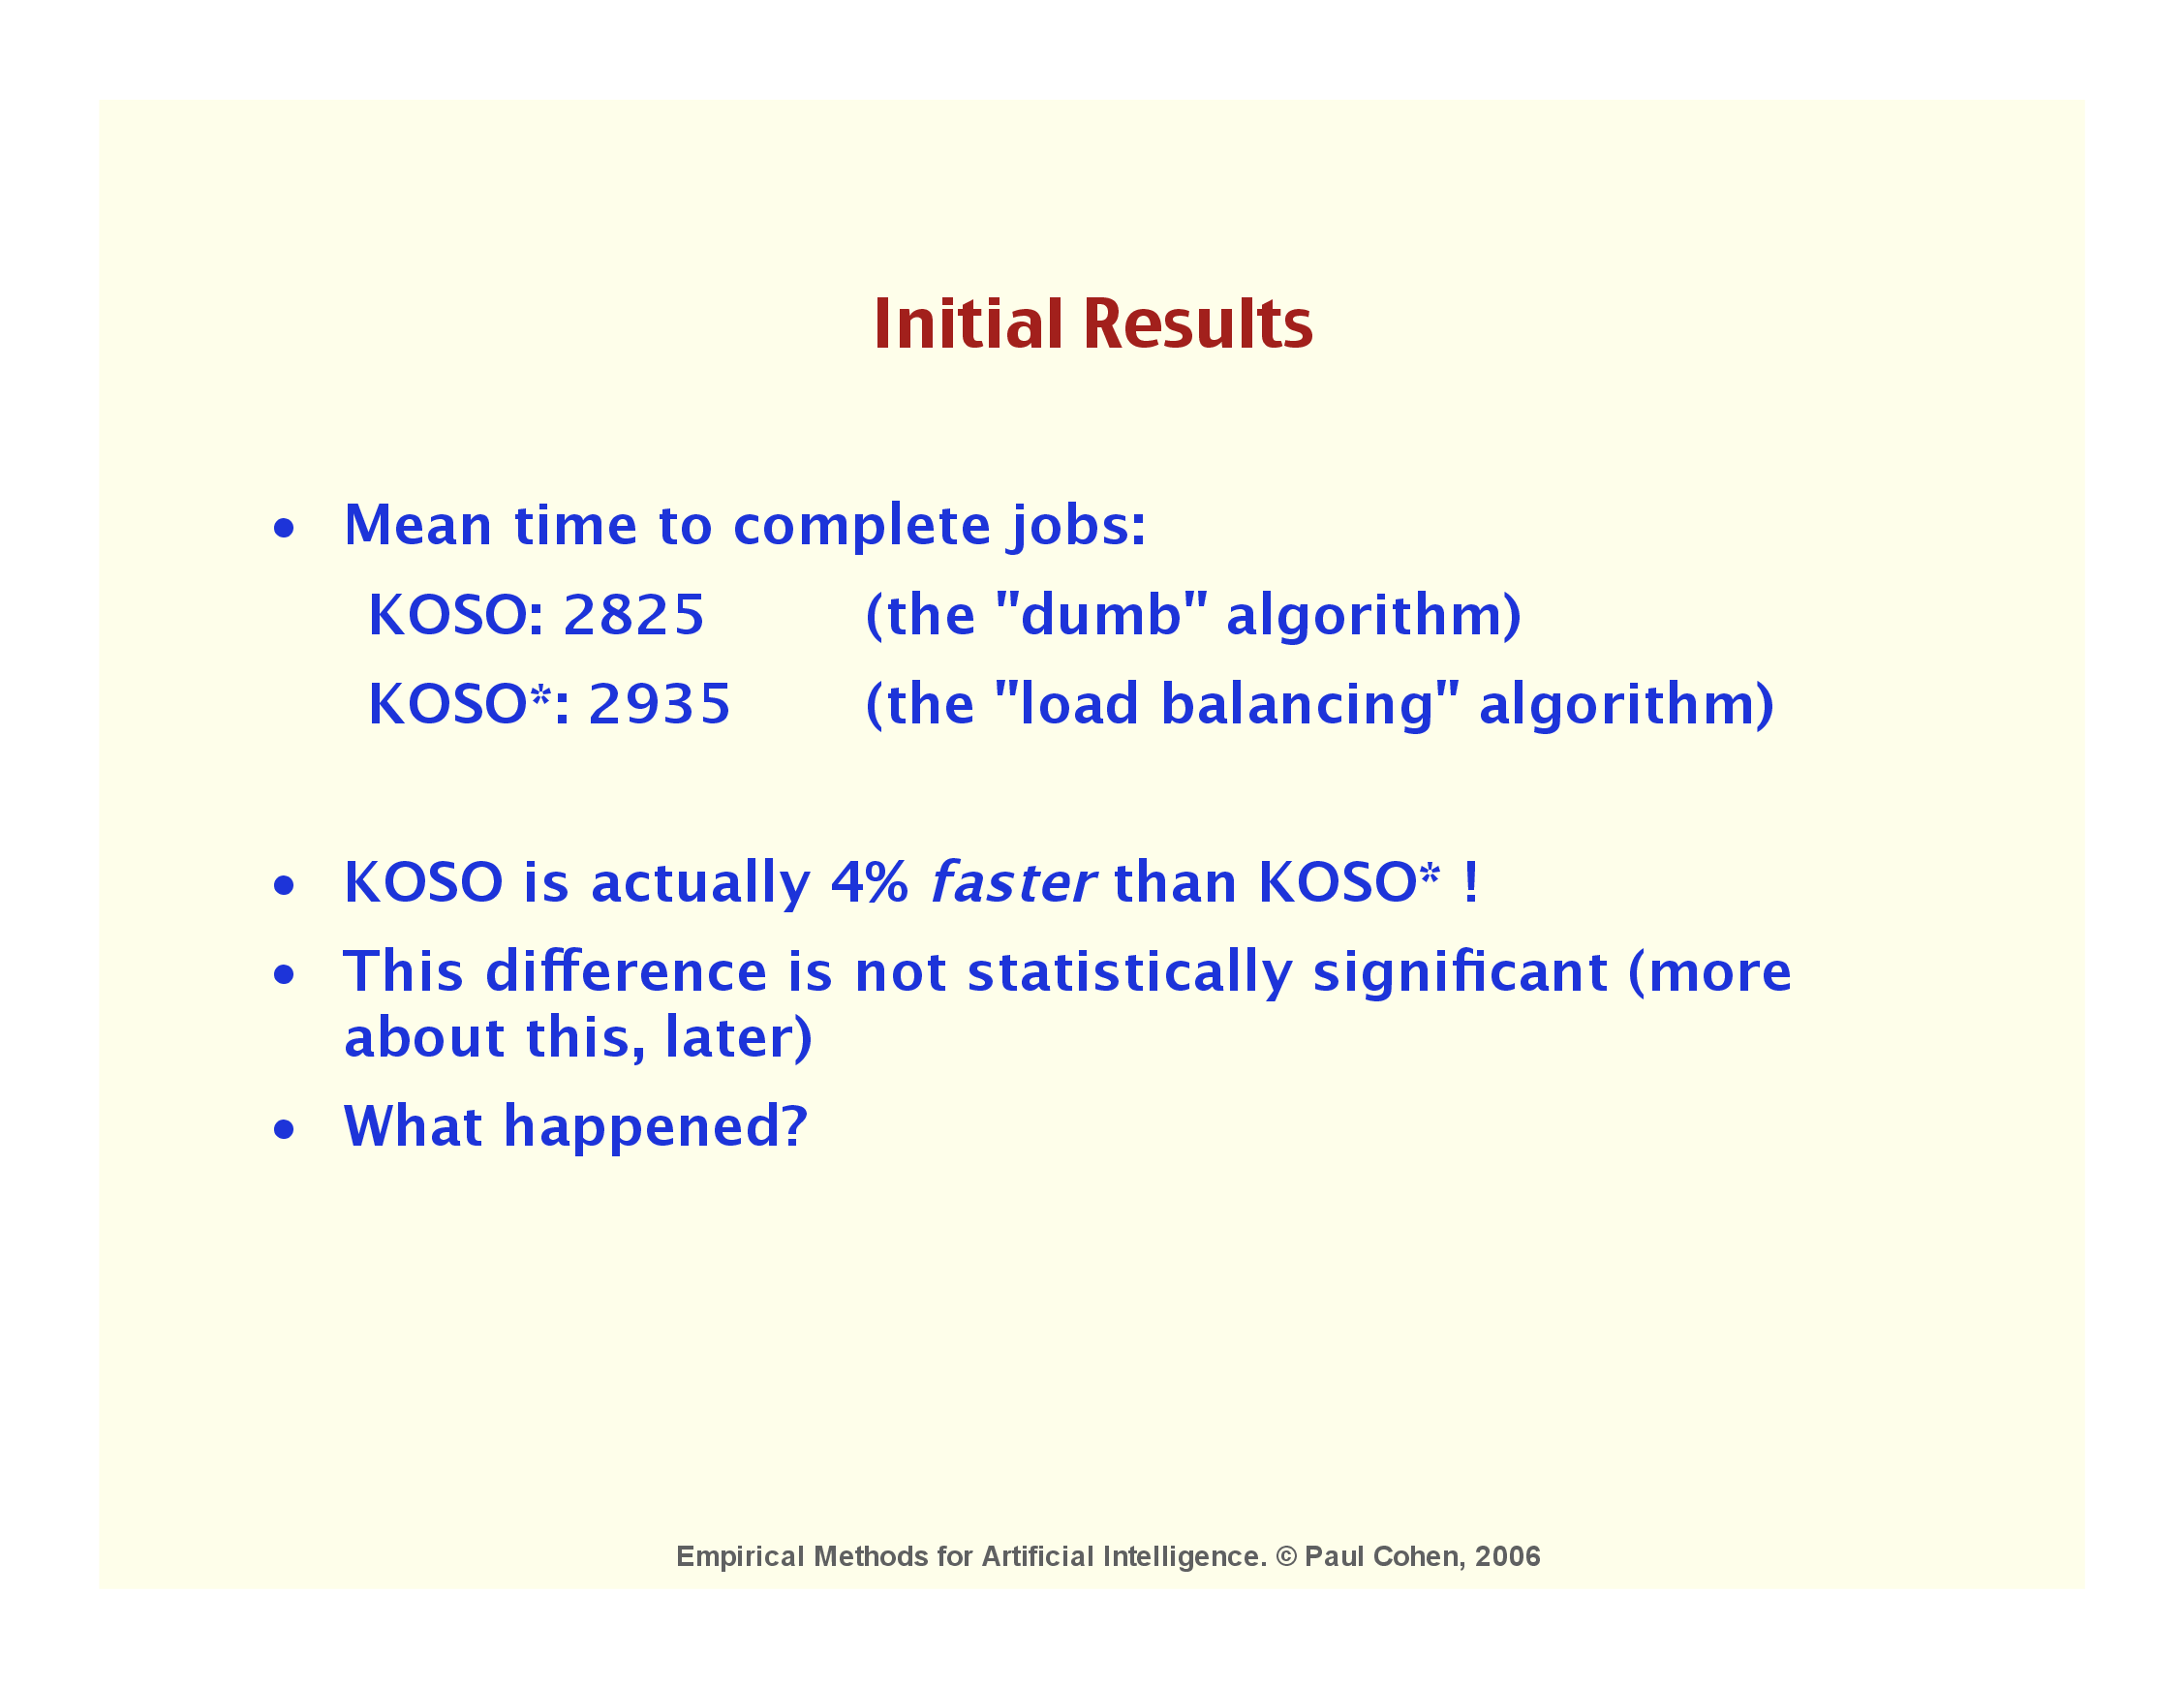

Slide 52
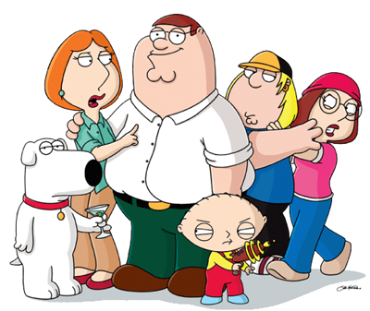

Slide 53
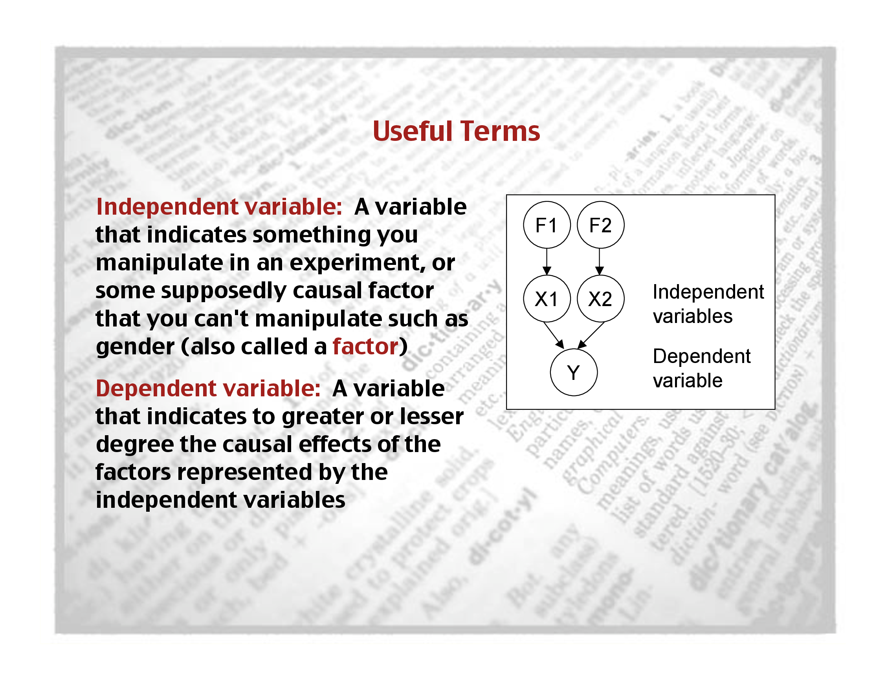

Slide 54
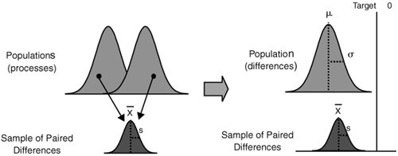

Slide 57
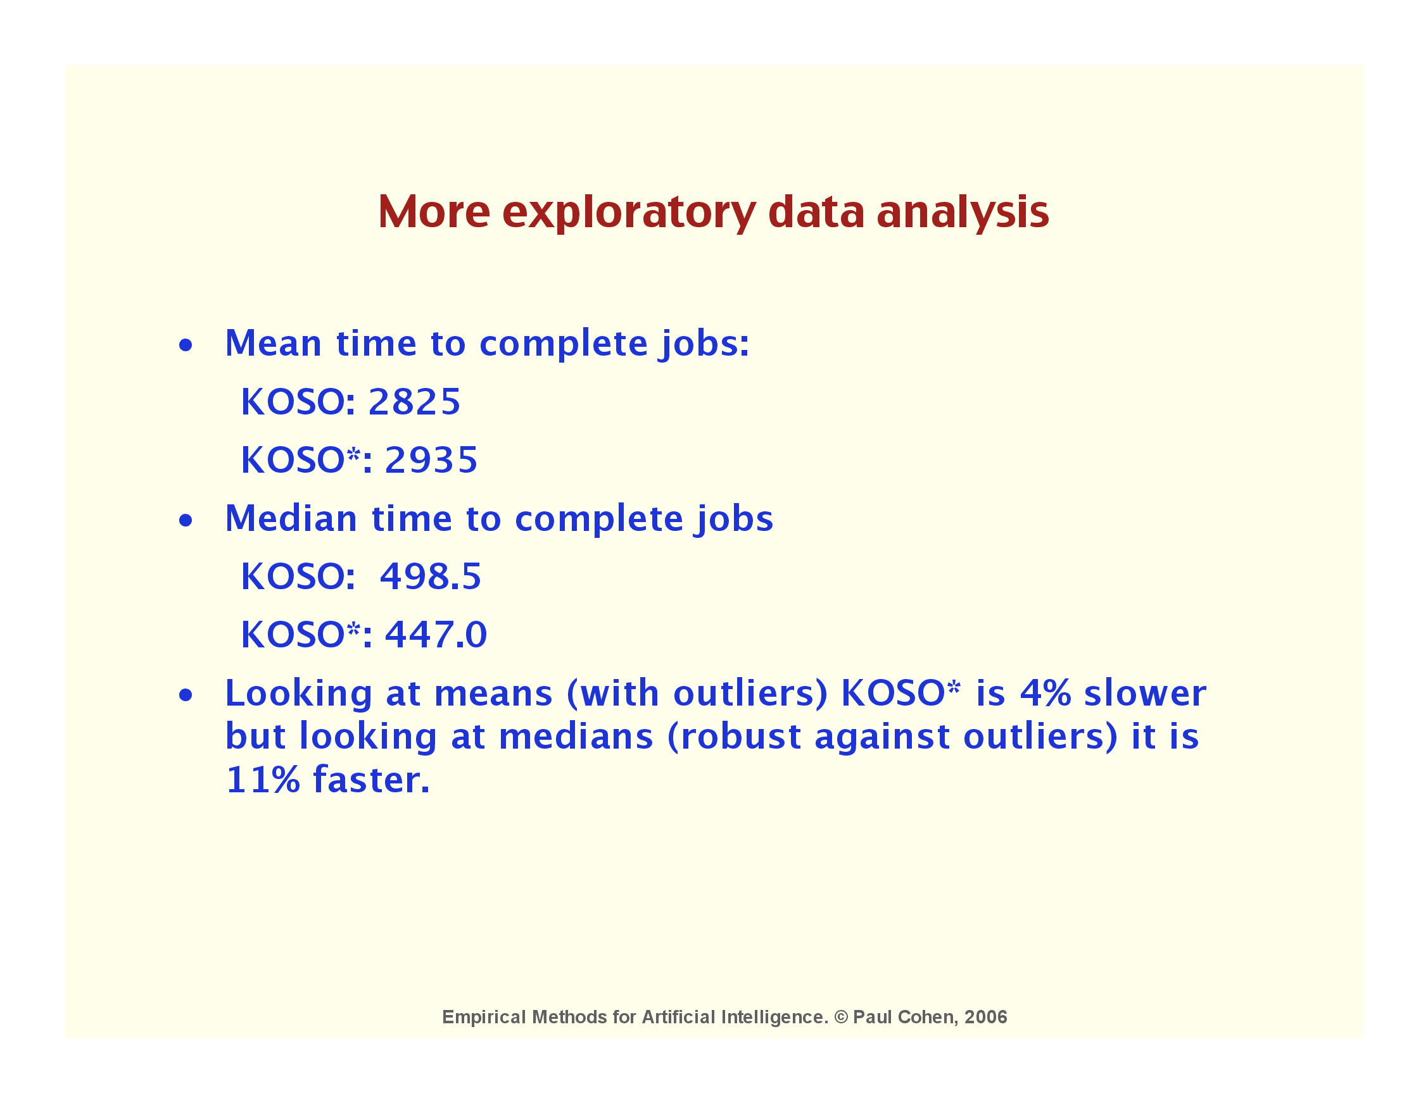

Slide 59
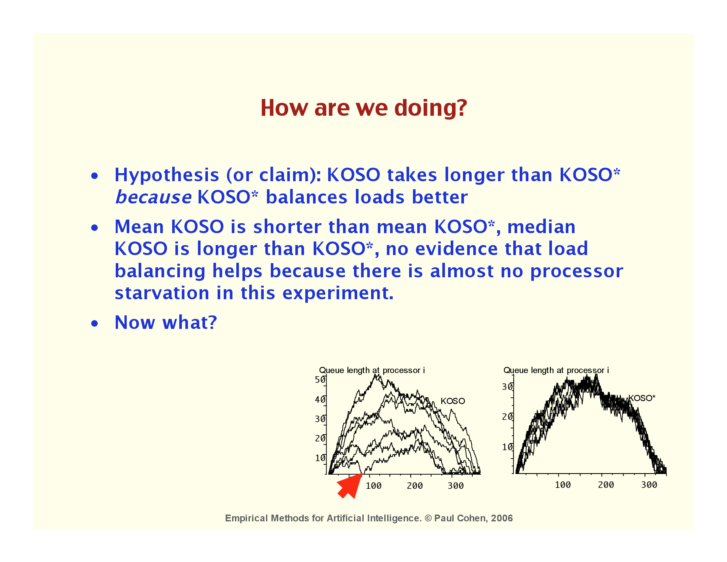

Slide 61
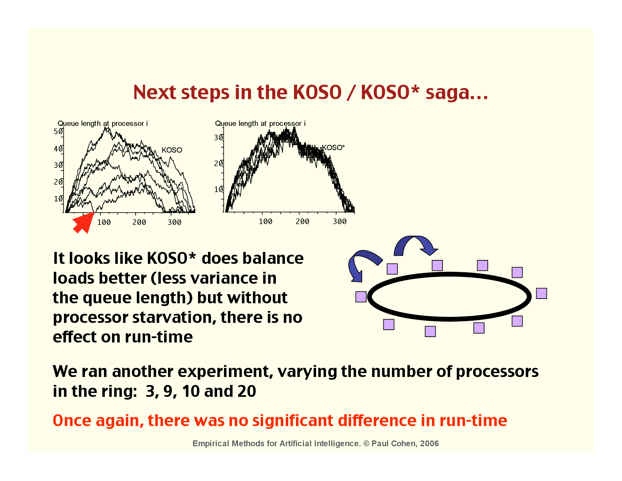

Slide 62
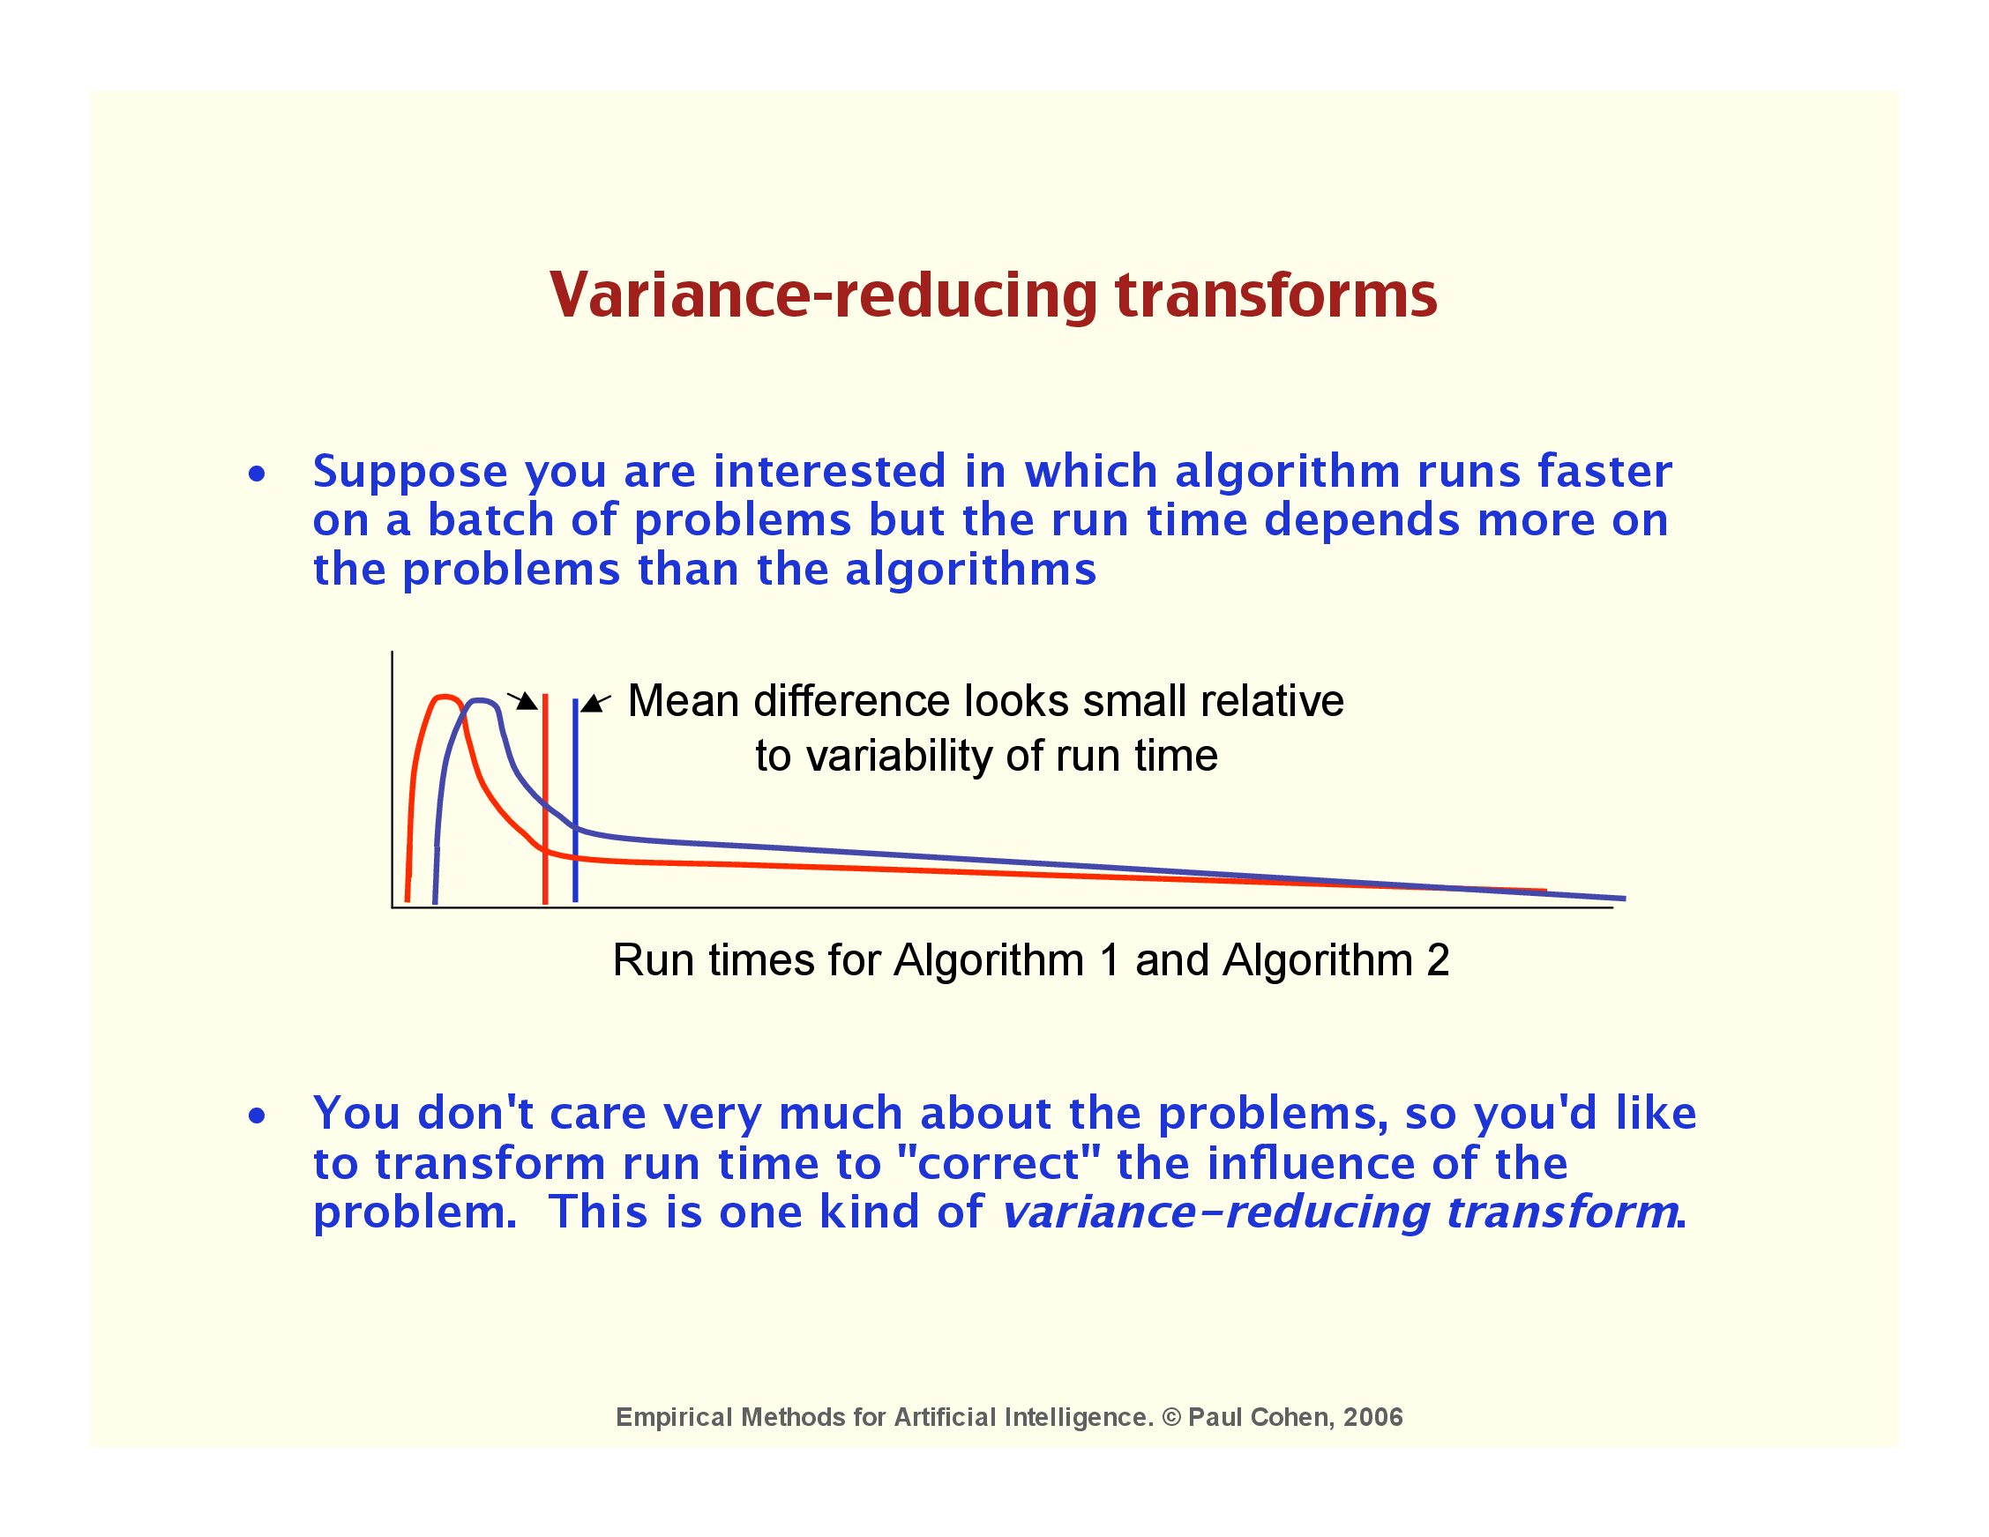

Slide 63
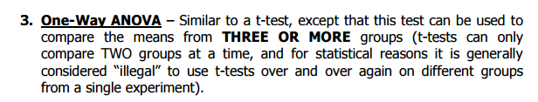

Slide 64
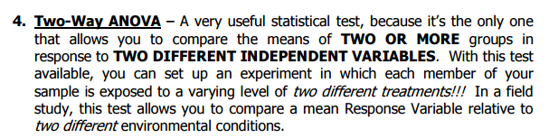

Slide 65
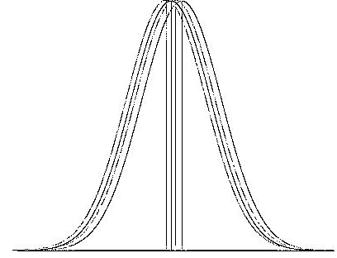

Slide 66
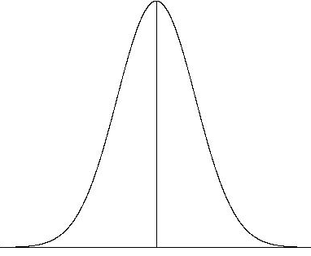

Slide 67
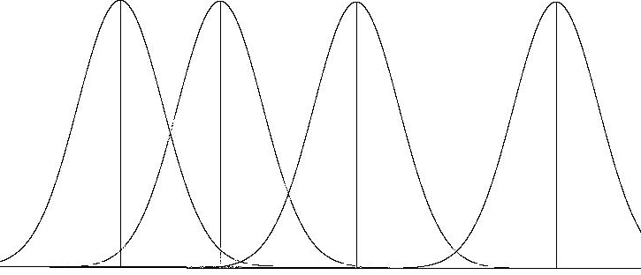

Slide 70
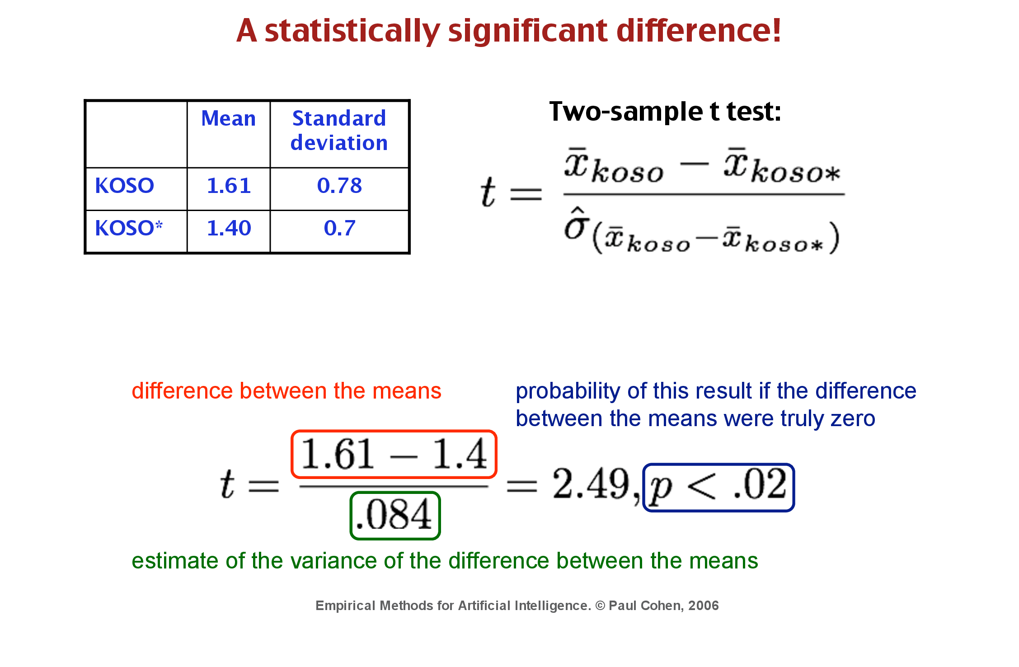
More on Statistical Tests later in term

Slide 72
Some Lessons for Evaluators of “DARPA Programs”
Based on slides and the book of Paul Cohen
Some Lessons for Evaluation of Programs
Notes:
Slides from Paul Cohen..
<number>

Slide 74
Outline
Some general lessons about how to conduct evaluations of DARPA programs
Some specific methodological lessons that every DARPA program manager should know – illustrated with a case study of a large IPTO program evaluation
A checklist for evaluation designs

Slide 75
General lessons from DARPA program evaluations
All DARPA program evaluations serve three masters: The director, the program manager, and the research(ers).
A well-designed evaluation gives these stakeholders what they need, but compromise is necessary and the evaluator should broker it
The evaluator is not there to trip up the performer, but to design a test that can be passed. Whether it is passed is up to the performer.
Start early. Ideally, the program claims, protocols and metrics are ready before the BAA/solicitation is even released.
Keep the claims simple, but make sure there are claims
Write (no Powerpoint!) the protocol, including claims, materials and subjects, method, planned analyses and expected results
Run pilot experiments. Really. It's too expensive not to. Really. I mean it.
Provide adequate infrastructure for the experiments. Don’t be cheap.

Slide 76
General lessons from DARPA program evaluations
You are spending tens of millions on the program, so require the evaluation to provide more than one bit (pass/fail) of information (Lesson 5, below: demos are good, explanations better; or as Tony Tether said, “passing the test is necessary but not sufficient for continued funding.”)
Stay flexible: Multi-year programs that test the same thing each year quickly become ossified. Review and refine claims (metrics, protocol...) annually.
Stay flexible II: Let some parameters of the evaluation (e.g., number of subjects or test items) be set pragmatically and don’t freak if they change.
Stay flexible III: Avoid methodological purists. Any fool can tell you why something is “not allowed” or your “sample size is wrong,” etc. A good evaluator finds workarounds and quantifies confidence.

Slide 77
Some methodological lessons that every DARPA program manager should know
Evaluation begins with claims; metrics without claims are meaningless
The task of empirical science is to explain variability
Humans are great sources of variability
Of sample variance, effect size, and sample size, control the first before touching the last
Demonstrations are good, explanations are better
Most explanations involve additional factors; most interesting science is about interaction effects, not main effects
Exploratory Data Analysis: use your eyes to look for explanations in data
Not all studies are experiments, not all analysis hypothesis testing;
Significant and meaningful are not synonyms

Slide 78
Lesson 1: Evaluation begins with claims
The most important, most immediate and most neglected part of evaluation plans.
What you measure depends on what you want to know, on what you claim.
Claims:
X is bigger/faster/stronger than Y
X varies linearly with Y in the range we care about
X and Y agree on most test items
It doesn't matter who uses the system (no effects of subjects)
My algorithm scales better than yours (e.g., a relationship between size and runtime depends on the algorithm)
Non-claim: I built it and it runs fine on some test data
Notes:
<number>

Slide 79
THE TEAM CLAIMS THAT ITS SYSTEM PERFORMANCE IS DUE TO LEARNED KNOWLEDGE
Hybrid learning
methods
Learning that chooses
its own features
Learning by
advice
Learning by
example
Learning over
diverse features
New
methods
Perceptual
learning
Learning relations
Common experimental
environment
System that supports
Integrated Learning
Knowledge Base
Notes:
<number>

Slide 80
Learning to put email in the right folders
Subjects' mail
Subjects' mail folders
Training
Testing
REL
KB
SVM
Three learning methods
Compare to get classification accuracy

Slide 81
Lesson 2: The task of empirical science is to explain variability Lesson 3: Humans are a large source of variability
Classification accuracy
Number of training instances

Slide 82
Lesson 2: The task of empirical science is to explain variability Lesson 3: Humans are a large source of variability
Why do you need statistics?
When something obviously works, you think don't need statistics
When something obviously fails, you think don't need statistics
Statistics is about the ambiguous cases, where things don't obviously work or fail.
Ambiguity is generally caused by variance, some variance is caused by lack of control
If you don't get control in your experiment design, you try to supply it post hoc with statistics
Classification accuracy
Number of training instances

Slide 83
Accuracy vs. Training Set Size Averaged over subject
Accuracy
REL
KB
No differences are statistically significant
SVM
100
150
200
250
300
350
400
450
500
≥550
Training set size
Notes:
<number>
For each X point (100, 150, … exs), we average the accuracy of all people who do have that many exs

Slide 84
Accuracy vs. Training Set Size (100% Coverage, Grouped)
REL
Accuracy
KB
SVM
No differences are statistically significant
100 - 200
250 - 400
450 - 750
Number of training instances
Notes:
<number>
For each X point (100, 150, … exs), we average the accuracy of all people who do have that many exs

Slide 85
Why are things not significantly different? Lesson 6: Most explanations involve additional factors
Means are close together and variance is high
Means are far apart but variance is higher
Why is variance high? Your experiment looks at X1, the algorithm, and Y, the score, but there is usually an X2 lurking which contributes to variance
Lesson 2: The task of empirical science is to explain/reduce variability. Find and control X2!
X1=REL
X2 =
X1=KB

Slide 86
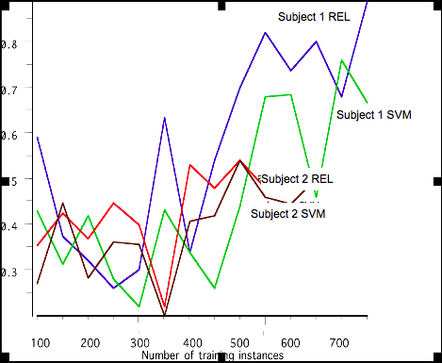
Lesson 7: Exploratory Data Analysis means your eyes to look for explanations in data
Accuracy
Which contributes more to variance in accuracy scores: Subject or Algorithm?

Slide 87
7) EDA: use your eyes to look for explanations in data
Classification accuracy
Three categories of “errors” identified
Mis-foldered (drag-and-drop error)
Non-stationary (wouldn’t have put it there now)
Ambiguous (could have been in other folders)
Users found that 40% – 55% of their messages fell into one of these categories
Number of training instances
EDA tells us the problem: We're trying to find differences between algorithms when the gold standards are themselves errorful – but in different ways, increasing variance!
Notes:
<number>

Slide 88
Lesson 4: Of sample variance, effect size, and sample size, control the first before touching the last. (You cannot control effect size!)
x₁
x₂
–
t =
s²
N

Slide 89
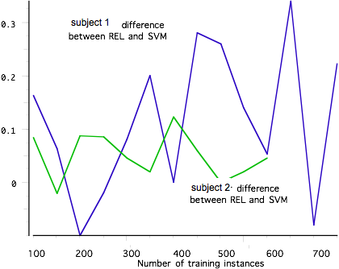
Lesson 4: Of sample variance, effect size, and sample size, control the first before touching the last
Subtract Alg1 from Alg2 for each subject, i.e., look at difference scores, correcting for variability of subjects
"matched pair" test

Slide 90
SIGNIFICANT DIFFERENCE HAVING CONTROLLED VARIANCE DUE TO SUBJECTS
REL
Accuracy
KB
n.s.
SVM
n.s.
100 - 200
250 - 400
450 - 750
Number of training instances
Notes:
<number>
For each X point (100, 150, … exs), we average the accuracy of all people who do have that many exs

Slide 91
Lesson 5: Demonstrations are nice; explanations better
Having demonstrated that one algorithm is better than another we still can't explain:
• Why is it better? Is it something to do with the task or a general result?
• Why is it not better at all levels of training? Is it an artefact of the analysis or a repeatable phenomenon?
• Why does the REL curve look straight, unlike conventional learning curves?
These and other questions tell us we have demonstrated but not explained an effect; we don't know much about it.
REL
Accuracy
KB
n.s.
SVM
n.s.
100 - 200
250 - 400
450 - 750
Number of training instances
Notes:
<number>
For each X point (100, 150, … exs), we average the accuracy of all people who do have that many exs

Slide 92
Lesson 6: Most interesting science is about interaction effects, not main effects
System’s performance improves at a greater rate when learned knowledge is included than when only engineered knowledge is included.
Learned knowledge begets learned knowledge
The lines aren’t parallel: The effect of development effort (horizontal axis) is different for the learning system than for the nonlearning system.
Interaction effect!
Performance
System with learned knowledge
Systemw/o learned knowledge
Y2
Y3
Y4
Y5
Notes:
<number>
Throughout the process, the system will be tested to measure how well it learns to be a competent cognitive assistant.
At the end of year 1, in May, there will be a “finger exercise” -- a test of some new learning algorithms, while the framework for the full system is being developed.
Then, starting in year 2, CALO will be given a grand challenge test that will be repeated each year.
The Grand Challenge will be preceded by CALO being used for several months by members of the CALO team -- as they manage their project, send emails, schedule meetings, purchase equipment, etc.
all the while, the CALO’s will be learning from their users
at the end of the use period, the CALO’s will be tested
The test will take the form of an SAT-like exam – about typical office scenarios
project setup
project execution
equipment purchase
Each scenario will consist of a situation description and set of questions.
The system will take this test in two ways
with all of its knowledge intact
with the knowledge it LEARNED ablated
This will give us an annual comparison of how well CALO learns.
We expect that each year the effect of learning will become larger and larger.
We are an the process of hiring an independent evaluator who will design these exam questions and detailed conditions for do test.

Slide 93
Lesson 8: Not all studies are experiments, not all analyses are hypothesis testing
The purpose of the study might have been to model the rate of learning
Modeling also involves statistics, but a different kind: Degree of fit, percentage of variance accounted for, linear and nonlinear models…
REL
Accuracy
KB
SVM
100 - 200
250 - 400
450 - 750
Number of training instances

Slide 94
Lesson 9: Significant and meaningful are not synonyms
σ
2
−
σ
2
2
1
1
|
Algorithm
Reduction in uncertainty due to knowing Algorithm
ω
=
2
σ
1
t
2
−
1
Estimate of reduction in variance
ˆ
2
ω
=
2
t
+
N
−
1
ˆ
2
ω
.192 KB vs SVM
.336 REL vs SVM
.347 REL vs KB
For "fully trained" algorithms (≥ 500 training instances)

Slide 95
Review of lessons every DARPA program manager needs to know
Evaluation begins with claims; metrics without claims are meaningless
The task of empirical science is to explain/reduce variability
Humans are large sources of variability
Of sample variance, effect size, and sample size, control the first before touching the last
Demonstrations are good, explanations are better
Most explanations involve additional factors; most interesting science is about interaction effects, not main effects
Exploratory Data Analysis: use your eyes to look for explanations in data
Not all studies are experiments, not all analysis hypothesis testing;
Significant and meaningful are not synonyms

Slide 96
Experimental Design

Slide 97
Experiments
Studies in which conditions are controlled so that one or more independent variable(s) can be manipulated to test a hypothesis about a dependent variable

Slide 98
Experimental Research
Claim: Manipulation of A treatment variable (x), followed by observation of response variable (y)
Experiment must be designed to control for other variables to establish causal relationship
Experiments often can only reject hypothesis.

Slide 99
Descriptive Research
Descriptive provides a snapshot of some aspect of system at a specific point in time
No true hint of a causal insight can be obtained from descriptive data. Well written may convince people of incorrect causal links. You may delude yourself

Slide 100
What Constitutes Causality?
A change in one variable will produce a change in another
Concept of a precondition influencing a variable of interest
Sequence in time
No other possible explanation
Attitude Behavior

Slide 101
Direction of Causation Issue
Determining the direction of causation
Draw on logic and previous theory
Whether one of the variables is relatively fixed and unalterable
If a time lag exists between cause and effect then the causal variable should have a positive association with the effect variable lagged in time
Temporal Correlation != Casual (but people often assume it is)

Slide 102
What is a causal diagram?
Components
Variables
Unidirectional arrows
D
A
C
E
B
1

Slide 103
Rules: displaying variables
Called “nodes” or “vertices”
Should be clearly understood by others
Displayed along the time axis (left to right or top to bottom)
but sometimes we ignore this rule if too complex
Variables, not values of variables
“complexity” or “parallelism” is okay; “O(N)” or 128 nodes is not
1

Slide 104
Rules: drawing arrows
An arrow
From a postulated cause to its postulated effect
No bidirectional arrows
An arrow with a question mark
The research question at hand
An arrow without a question mark
Background theory or axiomatic
A
B
A
B
C
A
?
B
1

Slide 105
Conditions for valid Causal Inference
Types of evidence relevant to evaluating causal relationships:
Condition of concomitant variation
Evidence that a strong association exists between an action and an observed outcome
Condition of time order of occurrence
Evidence that the action preceded the outcome
Absence of competing causal explanations
Evidence that there is no strong competing explanation for the relationship – that a high level of internal validity exists

Slide 106
Issues In Experimental Research
What type of experimental design should be used?
We start with designs involving humans somewhere, then pure computational experiments
Should the experiment be performed in a “laboratory” setting or in the “field”?
What are the internal and external threats to the validity of the experiment, and how can we control for the various threats to the experiment’s internal and external validity?

Slide 107
Basic Symbols and Notations
O denotes a formal observation or measurement
X denotes exposure of test units participating in the study to the experimental manipulation of treatment
EG denotes an experimental group of test units that are exposed to the experimental treatment.
CG denotes a control group of test units participating in the experiment but not exposed to the experimental treatment
R denotes random assignment of test units and experimental treatments to groups. Increases reliability
M denotes that both the experimental group and the control group are matched on the basis of some relevant characteristics

Slide 108
Types of Experimental Designs
Classical
Considers only one treatment level of an independent variable at a time
Statistical
Allows for examining the impact of different treatment levels of an independent variable and the impact of two or more independent variables

Slide 109
Preexperimental Designs
One-group, After-Only Design
One group, Before-After Design
Nonmatched Control Group Design
Matched Control Group Design
True Experimental Designs
Two-group, Before-After Design
Two group, After-Only Design
Solomon Four Group Design
Quasi-Experimental Designs
Time Series Design
Continuous Panel Design
Classical Designs
Completely Randomized Design
Statistical Designs
Randomized-Block Design
Experimental Designs
Latin Square Design
Factorial Design

Slide 110
Classical Designs - Pre-experimental Designs
One Group, After-only Design
Apply the experimental treatment to a subject or group and measure the results
EG X O
AVOID using this if at all possible. Why
Leaves open the possibility that the results could be explained by events external to the design

Slide 111
Classical Designs - Pre-experimental Designs (Contd.)
Nonmatched Control Group
Introduce a control group to control for history and maturation
EG X O₁
- - - - - - - - -
CG X O₂

Slide 112
Classical Designs - Pre-experimental Designs (Contd.)
Matched Control Group Design
Matches experimental and control groups to reduce selection bias
EG M X O₁
- - - - - - - - - - -
CG M X O₂

Slide 113
Classical Designs - Pre-experimental Designs (Contd.)
One-group, Before - After Design (also called pre-post)
Improve control by adding before measure
EG O₁ X O₂
Before measure adds sensitivity by adding another method to control for confounding variables
Do we need control Group?

Slide 114
Classical Designs - Pre-experimental Designs (Contd.)
Threats to Experiment Validity
Before Measure Effect
May change response because respondents know that they are being studied
Results in more “socially desirable” behavior
Mortality Effect
Some subjects may stop participating in the experiment
Instrumentation Effect
Results from a change in the measuring instrument

Slide 115
Classical Designs - True-experimental Designs
True experimental designs adopt random assignment procedure and use one or more control groups
Random Assignment
For any given assignment to a treatment, every member of the universe has an equal probability of being chosen for that assignment

Slide 116
Classical Designs - True-experimental Designs (Contd.)
Two-group, Before-after Design
Adds a control group to one-group, before - after design
Helps control for history and maturation
Controls for reactive effect of O₁ and O₂
EG R O₁ X O₂
- - - - - - - - - - - - - -
CG R O₃ O₄

Slide 117
Classical Designs - True-experimental Designs (Contd.)
Two Group, After-only Design
Randomization can match test and control groups on all dimensions simultaneously, given a sufficient sample size
EG R X O₁
- - - - - - - - - - - - - -
CG R O₂
There is no interaction effect of testing as there are no pretest requirements

Slide 118
Pretest-Posttest (one group)
Quasi-experimental
One set of measures taken before and after treatment or intervention
Compare pretest and posttest scores
Analysis
paired t test
Weakness
No comparison or control group

Slide 119
Pretest-Posttest (control group)
Experimental design - random assignment
Two groups
Control
Experimental
Measures on dependent variable made on both groups pre- and posttest
Significant differences in experimental group not found in control group attributable to treatment
Analysis
difference scores compared with independent t test
ANCOVA pretest score as covariate

Slide 120
Classical Designs - Quasi-experimental Designs
Offer some degree of control but there is no random assignment of variables
Provide more measurements and more information than pre-experimental design
Time Series Designs
Series of measurements are employed during which an experimental treatment occurs
EG O₁ O₂ O₃ O₄ X O₅ O₆ O₇ O₈

Slide 121
Classical Designs - Quasi-experimental Designs (Contd.)
Trend Studies
Measures over time come from succession of separate random samples from the same population
Continuous Panel Studies
Collect a series of measurements on the same sample of test units over an extended period of time

Slide 122
Statistical Designs
Completely Randomized Design
Any number of treatments can be assigned to test units on a random basis
EG₁ R X₁ O₁
- - - - - - - - - - - - - - - -
EG₂ R X₂ O₂
- - - - - - - - - - - - - - - -
EG₃ R X₃ O₃

Slide 123
Statistical Designs (Contd.)
Randomized Block Design
Employs the randomization process for all variables
Matching ensures that there are no differences between test samples on matched variables
Matching and randomization are combined in randomized block design
EG₁ R X O₁
- - - - - - - - - - - - - - - -
CG₁ R O₂
-------------------------------
EG₂ R X O₃
- - - - - - - - - - - - - - - -
CG₂ R O₄

Slide 124
Statistical Designs (Contd.)
Latin Square Design
Reduces number of groups involved when interaction between the treatment levels and control variables are unimportant
Requires same number of rows, columns, and treatment levels
Cannot be used to determine interaction effects

Slide 125
Latin Square Design
Minimizes order effects
Test session
1 2 3
Subject 1
Subject 2
Subject 3
A B C
B C A
C A B

Slide 126
Two-Way Factorial Design
Studies multiple independent variables
Main effects (ME)
Each with a number of levels (L)
Permits study of interactions
Analysis
ANOVA
Example: 2 x 3
ME2
L1 L2 L3
L1
ME1
L2

Slide 127
Three-Way Factorial Design
Example 2 x 2 x 3
Studies multiple independent variables
Main effects (ME)
Multiple levels (L)
Interactions effects
Analysis
ANOVA
Post hoc pairwise comparisons
ME 2
L2
L1
L1
ME1
L2
L1 L2 L3
ME3

Slide 128
Statistical Designs (Contd.)
Factorial Designs
Two or more experimental variables are considered simultaneously
Each combination of the experimental treatment levels applies to randomly selected groups
EG₁ X₁ O₁
EG₂ X₂ O₂
.
EG_{n} X_{n} O_{n}
Provides the ability to determine interactive effects of pairs of experimental variables and the main effect

Slide 129
PURE COMPUTATIONAL DESIGNS FOR STATIC DATA WITH NO PEOPLE.
If one can run the algorithms on “static” data without human interaction, then can do perfectly matched pairs. But often hard to show anything causal in such testing. For causality testing, or if dynamic data, must use (fully) factorial designs on control variables.
Must avoid tuning on test data and contamination of test data into training processes.
Datasets always have bias. Unfair to select just datasets where you do well without analysis/discussion of why.

Slide 130
EXAMPLES FOR DISCUSSION
Comparing two algorithms for UW Communication?
Evaluating a models for predicting battery charge?
Evaluating Adversarial examples?
Comparing two processes for improving Security?

Slide 131
Issues in Experimental Research
What type of experimental design should be used?
Should the experiment be performed in a "laboratory" setting or in the "field"?
What are the internal and external threats to the validity of the experiment?

Slide 132
Laboratory Experiments
Experiments in which the experimental treatment is introduced in an artificial or laboratory setting
Laboratory experiments with people tend to be artificial
Testing effect exists as respondents are aware of being in a test and may not respond naturally
Results may not have external validity
Least costly and allow experimenter greater control over the experiment
Alternative explanations of results are reduced, increasing internal validity

Slide 133
Field Experiments
Research study in which one or more independent variables are manipulated by the experimenter under carefully controlled conditions as the situation will permit
Experimental treatment or intervention introduced in a completely natural setting
Response tends to be natural
Tend to have much greater external validity
Difficult to control
Competing explanations for results exist

Slide 134
Threats to Experimental Validity
Threats to Internal Validity
History
Maturation
Testing
Instrumentation
Statistical Regression
Selection Bias
Mortality
Selection - Maturation Interaction

Slide 135
Threats to Experimental Validity (Contd.)
Threats to External Validity
Reactive or interaction effect of testing
Interaction effect of selection bias and experimental variable
Reactive effects of experimental arrangements
Multiple treatment interference

Slide 136
Limitations of Experiments
Time and Cost
Security
Implementation Problems
Difficult to gain cooperation within the organization
Contamination may occur in experiments involving human subject due to inability to confine the treatment to designated experimental area
Variability in behavior across test units can be so large that it is difficult to detect experimental effects

Slide 137
Conclusion
Experimental CS is a fundamental underpinning of the information age
Synthetic: studies phenomena that are entirely the product of human creation
But they may be models of and depend on real data thus its studying the world or people.
Information artefacts are extremely complex and can only be understood via empirical observation, especially if people use them
Complexity often precludes direct theoretical analysis
Even with proofs, need to validate assumptions
Your Project Needs Experimental Analysis

Slide 138
Checklist for evaluation design
What are the claims? What are you testing, and why?
What is the experiment protocol or procedure? What are the factors (independent variables), what are the metrics (dependent variables)? What are the conditions, which is the control condition?
Sketch a sample data table. Does the protocol provide the data you need to test your claim? Does it provide data you don't need? Are the data the right kind (e.g., real-valued quantities, frequencies, counts, ranks, etc.) for the analysis you have in mind?
Sketch the data analysis and representative results. What will the data look like if they support / don't support your conjecture?
Notes:
<number>

Slide 139
Checklist for evaluation design, cont.
Consider possible results and their interpretation. For each way the analysis might turn out, construct an interpretation. A good experiment design provides useful data in "all directions" – pro or con your claims
Ask yourself again, what was the question? It's easy to get carried away designing an experiment and lose the big picture
Is everyone satisfied? Are all the stakeholders in the evaluation going to get what they need?
Run a pilot experiment to calibrate parameters
Notes:
<number>

Slide 140
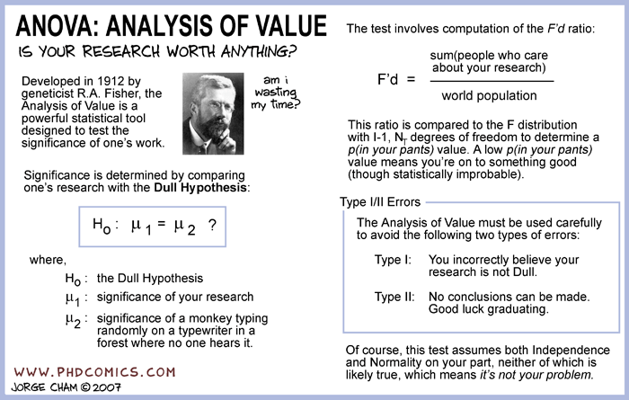

Slide 141
CS 6000 Research Methods
Terrance E. Boult
El Pomar Prof. of Innovation and Security

Slide 142
How To Read a Research Paper
CS 6000 Computer Science Research methods
Terrance E. Boult

Slide 143
The way I read a letter's this:
'Tis first I lock the door,
And push it with my fingers next,
To transport it be sure.
And then I go the farthest off
To counteract a knock
Then draw my little letter forth
And softly pick its lock.
….
Emily Dickinson

Slide 144
Why Read?
Learn to do research
Learn to think critically about quality of research and research papers
Someone will be thinking critically about your own work!
In any discipline, there are fads and there are lasting ideas… learn to tell the difference!
Gain perspective
Key issue: what are the questions to ask/answer?
Notes:
<number>

Slide 145
Research Papers
Primary form in which research results are disseminated in computer science
Conference papers (shorter)
Journal papers (longer)
Often the complete version of a conference paper
May come out several years after the conference paper, may combine multiple conf. papers
Peer review is the cornerstone of the scientific publishing process -- quality and Impact matters. We’ll talk about that again when we discuss writing. This is reading for YOU.
Notes:
<number>

Slide 146
How to Read a CS Research Paper
five-pass method:
Pass 1: Browse
Pass 2: Scan to get General ideas
Pass 3: Critical Read
Pass 4: Creative Read
Pass 5: In-depth understanding
Source: S. Keshav

Slide 147
Searching is NOT enough.
We’ve discussed searching for papers.
But it is very important to also keep aware, especially when starting out, so need to just look though stuff.
Need to be able to “consider” 100’s of papers per year. Big conferences 200~700 papers and journals have 100-600 papers per year. With 2-3 big conferences per area per year, plus 4-5 tier-1 journals 4 or 5- tier 2 journals there is a lot to consider in your field.
Keep a “reading list”.. add to it frequently

Slide 148
The browse
You need to go through 100's or 1000’s of papers a year The "Browse” is to help be efficient.
You "browse" through many many papers to see what is interesting/relevant. One approach is to first read abstract, scan figures/captions, This is a 1-2 min "gut check” based on content.
Venue check? Author Check? Citation check
papers in places by people or that cite stuff you already know are relevant are more likely relevant.
Err on being positive. Add to “to read” list if even slightly positive.

Slide 149
The Skim
if Browse is positive, time to skim positively. Believe the author and assume its all true, decide if the paper is actually interesting and worth more exploration. You'll be surprised how many papers fail at this stage.
If in 2-3 sentences you cannot say what is the problem addressed and what is new about the papers solution, and how significant was the experimentation/theory, you skimmed too lightly. If you have too many ideas to express it in only 2-3 sentences each you may have gone too deep. 5-10 min max.

Slide 150
After the scan you should be able to answer the “six Cs”:
Category
What type of paper?
Context
What other papers is it related to? How related to your work?
Contributions
Main contributions?
Credible
Does it appear to have any credibility?
Care (i.e. the Who care’s test)
Given its valid, will anyone care? will it change anything?
Cost:
How much time and effort will it cost you to read it carefully

Slide 151
Critical read: 3rd pass
~ 1 hour
Read carefully, but ignore details (proofs, for example).
Note assumptions and question them
Analyze experiments/conclusions
Analyze Figures, diagrams, illustrations, graphs.
Properly labeled? Error bars? Etc…
Mark relevant unread references
After you should be able to summarize main thrust & point out likely weakness in assumptions, methodology and/or experiments.

Slide 152
Reading a Paper Critically
Understand the problem
Understand the proposed solution
Understand competing approaches / designs
Understand the Evaluation Methodology
Understand the comparison to state of the art
Evaluate the paper’s claims. Do not assume the paper is correct, even if published in a prestigious peer-reviewed venu
Critical read may require back tracking, and fact checking you need to jump around to evaluate claims and relate items in the paper.
Notes:
<number>

Slide 153
Critically Evaluating Sources
When reading sources critically.
Ask questions about the credentials and reputation of the author and the place of publication.
What do you think is the writer’s purpose and the audience whom the author is addressing?
Ask questions about the ideas you read: an easy way to do highlight setions, write your annotations in the margins or a reading journal and/or if you get a sense of doubt, make a note of what troubles you.
Be on the lookout for assumptions that may be faulty. If you are reading an article on computer-aided home-schooling and the writer favors home-schooling because it avoids subjecting students to violence in schools, the unstated (but untrue) assumption is that all schools are violent places.

Slide 154
Make sure the writer’s evidence is adequate and accurate. For example, if the writer is making a generalization about all Chinese students based on a study of only 10, you have cause to challenge the generalization as resting on inadequate evidence.
Note how the writer uses language. Which terms does the writer use with positive—or negative---connotations, signaling the values the writer holds? Does the writer flamboyantly denigrate and dismiss the views of others with such phrases as “a ridiculous notion” or “laughably inept policies?”
Be alert for sweeping generalizations, bias, and prejudice: “Women want to stay home and have children.” “Men love to spend Sundays watching sports.”

Slide 155
Critical Questions
Is the problem carefully stated/formulated?
Is it a meaningful/real problem?
Is it the RIGHT problem (formulation vs description)?
Can you make a list of assumptions, explicit and more importantly implicit about the problem?
What, if anything, is novel about the problem formulation?
What well known problems are related or the same?
Are there simple solutions the authors do not seem to have considered?
Notes:
<number>

Slide 156
Critical Questions
Can you make a list of assumptions, explict and more importantly implicit about the technique? Consider every divide, matrix op, function inversion, minimization (maximization) ? Are the assumptions justified?
What are the limitations of the solution (including limitations the authors might not have noticed or clearly admitted)?
Is the logic of the paper clear and justiﬁable, given the assumptions, or is there a ﬂaw in the reasoning?

Slide 157
Critical Questions
Do all the pieces of their work ﬁt together logically?
Has the right theorem been proven?
Are Theorems Logically supported? Are proofs given? Cited? If cited, how credible a source?
If the authors present data, did they gather the right data to substantiate their argument, and did they appear to gather it in the correct manner?
Did they have enough data to make a statistically sound decision?

Slide 158
Critical Questions
Did they interpret the data in a reasonable manner?
Would other data be more compelling?
Did they compare with actual state of the art performance?
Was the same data used for training and testing?
Were Parms selected on Test Results?
What were the results? Did they do what they set out to do?
On what dimension(s) did they advance the art?

Slide 159
Critical Questions
Have the authors been cutting corners (intentionally or unintentionally)?
Would results be reproducable?
Problematic experimental setup?
Confounding factors?
Unrealistic or artificial benchmarks?
Comparing apples and oranges?
Methodological misunderstanding?
Do the numbers add up?
Are the generalizations valid?
Are the claims modest enough?

Slide 160
4th pass: Creative Read
Fourth read is to read creatively. Reading a paper critically is easy, in that it is generally easier to tear something down than to build it up. Reading creatively involves harder, more positive thinking and more "creative" thinking.
What is the Novelity of the paper? Does it open up new directions?
What are the good ideas in this paper? Do these ideas have other applications or extensions that the authors might not have thought of? Can they be generalized further?

Slide 161
4th pass: Creative Read
Could their ideas be combined with other approaches? Combined with your work?
If there were other assumptions made, could that improve the approach? Could you ensure those assumptions were true for some problem?
Are there better numerical methods than what they are doing?
Are there possible improvements that might make important practical differences?
If you were going to start doing research from this paper, what would be the next thing you would do?

Slide 162
Assignment #2 Due in 2 weeks
Choose a “top” journal or conference in your field with >= 45 papers one 2017/2018 issues. (DO NOT search for papers with keywords.. but can search for journals/conf title)
Browse at least 45 papers in that issue, in order. Time yourself on each, aim for no more than 2 min.
Scan 8+ papers, write 2-3 sentence summary
Critically & Creatively read best 2 or 3.
Upload your notes as a latex document
In you journal discuss your process and your learning about the process (not the papers).
slide 1

Slide 163
Where: Sources and Publication Venues
Why do we cite papers?
Relate our problem to prior work
To establish what is the current state-of-the-art
To add credibility to our arguments/story
To show readers/reviewers we know what is important in prior work, what is solved and what is open.
1

Slide 164
Why Publish?
To go to exotic location and fancy hotels
To impress your mother with your name in print
To become rich and famous
To graduate
To get a job
To satisfy research contract requirements
To help others learn from your experience
To grow the body of useful knowledge.

Slide 165
Recognize scholarly articles
Scholarly articles are not usually found in magazines in a dentist’s office.
Scholarly articles are peer reviewed—that is, other scholars read all the articles and approve them for publication.
These articles have section headings, abstracts, and “summary” and/or “conclusion” headings. They determine the author’s main idea.
They refer to works of other scholars (Reference Page, in-text citations, author credentials, notes, in depth analysis, uses academic or technical language for informed readers, appears in journals that don’t include colorful advertisements, etc.

Slide 166
Evaluating sources: Developing junk antennae
If you find an article in a subscription database (IEEExplore, InfoTrac, LexisNexis, etc.) you will know that the article has been published in print.
If the article has been published in a reputable periodical or in an online journal sponsored by a professional organization or university, you can assume that it is a valid source for a research paper citation But beware junk publications.
For works devised specifically for the Web, need strong checking o separate the information from the junk.

Slide 167
Scrutinize the domain name of the URL. Reliable information can be found on .gov and .edu addresses that are institutionally sponsored. With .com or .org sources, always assess whether the source provides factual information or advocates a specific point of view on an issue.
Assess the originator of an .edu source. Check that the institution or a branch of it is sponsoring the site. A tilde (~) followed by a name in the URL indicates an individual posting from an academic source. Try to ascertain whether the individual is a faculty member or a student. Increasingly, though, individuals are setting up websites under their own domain name.

Slide 168
Check the About page or the home page. Always take the link from a Web site to its “About” page or its home page, if you are not already there. These pages often provide more information about the author, the sponsor, the purpose, and the date of posting.
Determine the author, and discover what you can about him/her. Look for a list of credentials, a home page, a resume, or Web publications. In Google or Google Scholar, use the author’s name as a search term to see what the author has published on the Internet or who has cited the author. If no individual author or institutional author is to be found anywhere, check the purpose and sponsor of the site.

Slide 169
Investigate the purposes of a Web page author or sponsor. Objectivity and rationality are not necessarily features of all Web pages. The sponsor of a site may want to persuade, convert, or sell. Even if the message is not obviously biased and extreme, be aware that most authors write from some sense of conviction or purpose. (Note, though, that a Web site can be oriented toward a specific view without necessarily being irresponsible.)
Evaluate the quality of the writing. A Web page filled with spelling and grammatical errors should not inspire confidence. If the language has not been checked, the ideas probably haven’t been given much time and thought, either. Don’t use such a site as a source. Exceptions are discussion lists and Usenet postings. They are written and posted quickly, so even if they contain errors, they can also contain useful ideas to stimulate thinking on your topic.

Slide 170
Follow the links. See whether the links in a site take you to authoritative sources. If the links no longer work (you’ll get a 404 message: “Site Not Found”), the home page with the links has not been updated in a while—not a good sign.
Check for dates, updates, ways to respond, and ease of navigation. A recent date of posting or recent updating; information about the author; ways to reach the author by e-mail, regular mail, or phone; a clearly organized site; easy navigation; up-to-date links to responsible sites are all indications that the site is well managed and current.

Slide 171
Where to publishes and where to look for papers
IEEE Xplore
Google Scholar (Demo/features later)
Researchgate (Demo later)
Other DBs in library
Signup for mailing lists
Before we get into how to read let look at understanding venue quality and metrics
slide 1

Slide 172
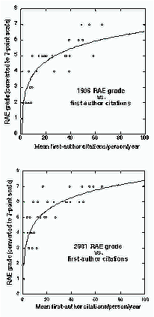
Research Assessment, Research Funding, and Citation Impact
“Correlation between RAE ratings and mean departmental citations +0.91 (1996) +0.86 (2001) (Psychology)”
“RAE and citation counting measure broadly the same thing”
“Citation counting is both more cost-effective and more transparent”
(Eysenck & Smith 2002)
http://psyserver.pc.rhbnc.ac.uk/citations.pdf
Notes:
<number>
Every four years, the UK conducts the “Research Assessment Exercise” in which every department of all 73 UK research universities is rank-ordered in terms of its research impact, and funded proportionately.
The exercise is based on submitting many performance indicators, and there is long, time-consuming assessment.
But the rank order can already predicted (with a correlation of 0.9) by simply counting the total citations.
This is true even though citation counts are not submitted.
Yet they could have replaced the whole RAE exercise, and much less cost in time and effort for all.
This illustrates the importance of citation impact for research funding.

Slide 173
Assessing Pub. Venue Quality
Amount of Influence
# readers
Journal Impact Factors
Leading Conferences (really only in CS, most other fields conferences don’t matter)
Acceptance Rates (Selectivity)
Total Citations
H-index
slide 1

Slide 174
The Classic Journal Impact Factor
2007
Tracks All scholarly articles in journals covered by SSCI
2005-2006
journal-X
publishes 158 articles
238 Cites
2007 Impact = 238 2007 citeatios = 1.506 Factor 158 2005-06 articles

Slide 175
So what?
JIF is a measure of relative currency – 2 year window.
JIF is a GROSS average. Average article in Nano Letters cited 10.371 times,
But the citation RANGE = 0 - 319 times (14 articles cited zero times!).
Never ever intended to measure quality of an individual article or author, even Thomson Scientific says that.

Slide 176
A Better Citation Metric
h-Index (Hirsch Index)
An h-Index of 45means a person (or dept. or a journal) has 45 articles cited at least 45 times.
Can be calculated from Web of Science http://library.buffalo.edu/libraries/e-resources/webofscience.html
Estimated in Google Scholar and MS Academic Index (but both include self-citations in it and can be somewhat gamed.. so check for self-citations in people..

Slide 177
Critique of h-index
Rewards longevity, but not least-publishable-unit or sheer quantity. (Though quantity does matter)
Recent and old work rewarded equally
± Does not reward highly cited papers more
Many variants (g-index, m-index, etc. proposed to weight age, recent work, & highly cited papers, # of coauthors)
Relatively insensitive to manipulation. (but some demonstrated cases of manipulation)

Slide 178
Variants of h-index
g-index = g number of papers that received (collectively) g² citations [Rewards highly cited papers]
m-index = h-index / no. of years a researcher has published [normalizes for longevity]
hX-index = h-index based on citations in the most recent X years (but includes citations to older papers). (e.g. h5-index in google scholar)
iY-index number of papers with at least Y citations (ie.g i10-index in scholar)

Slide 179
Pub Indexes – Many more players – 1
Google Scholar/Harzing’s POP
SciFinder
NASA Astrophysics Data System (ADS)
Amazon (Search inside this book)
Scitation/Spin Web/PROLA
Citation Bridge (US Patents)
USPTO
Optics InfoBase

Slide 180
Pub Indexes – Many more players - 2
CiteSeer (primarily computer & info sci)
ScienceDirect
PsycInfo
IEEE Xplore
Spires (High Energy Physics)
IOP Journals
CrossRef

Slide 181
My Take
Top quality venues looked at more favorably for hiring (since time for pubs to get citations is short.)
For an individual or department:
h-index plus
Total cites to all published articles plus
List of top citation papers
This gives a pretty good take on the impact of one’s articles within the limits of available citation data.
Demonstrably superior to Journal Impact Factor in terms of perceived quality (by experts)

Slide 182
CS 6000 Research Methods Publishing Venues, OA and Predatory Publishers
Terrance E. Boult
El Pomar Prof. of Innovation and Security

Slide 183
As a scientists/professor you are
a professional writer;
you get paid, in large part, to produce papers!

Slide 184
What is a scientific paper
A scientific paper is a written and published report describing original research results.
It must be the first publication of original research results,
In a form whereby peers of the author can repeat the experiments and test the conclusions, and
In a journal or other source document readily available within the scientific community

Slide 185
Definition of Scientific paper
An accepted original scientific publication containing scientific information to enable peers:
To assess observations
To repeat experiments
To evaluate intellectual processes
Must have an impact
Available to scientific community without restriction
Available for regular screening by one or more of the major recognized secondary services

Slide 186
THE FACETS OF AN ACADEMIC CAREER (US) in Research University

Slide 187
Remember what you put in the literature is your scientific legacy after all else is gone

Slide 188
ALWAYS LOOK FROM A DISTANCE
See your paper as the reviewer will see it – believe me the reviewer will not see it as the best thing since sliced bread even if you do!

Slide 189
Understand that the best scientists get rejected and/or have to make major revisions

Slide 190
Science (the journal)
The rejection rate is tough:
~3%
~4%
18%
75%
1
Notes:
<number>

Slide 191
Choosing a Venue
Fit to your topic
Quality
Various “Tiers” of publications & Formal rating in some countries.
Acceptance Rate
Generally in the publication (message from chairs, etc). Top venues are often summarized in websites.
H5-Index in google or Journal Impact Factor
Timelines
Other dimensions of impact (e.g. OA, publisher etc).

Slide 192
Finding Venues
Google “top conferences in xyz” top journals in XYZ” (e.g. http://www.guide2research.com/topconf/)
Wikicfp.com
Make a calendar
Search to make sure you are a good fit.
Ask someone else to make sure you are a good fit.
Read some papers in the venue
Read what you can about their review process (more later on that).

Slide 193
Finding Venues
Most good venues do not allow double submission. Check before you submit!
Plan maybe submit
tier1->tier2->tier3
As your plan.. Or maybe
tier1->tier1->tier[23].
With most fields in CS, can do 2-3 conference rounds within a year, with mixed tiers.
Understand your commitment (e.g. reviewing if you submit)
Understand your costs and how you might reduce them, e.g. volunteer.

Slide 194
Primer on Open Access (OA)
OA simply means free-to-read.
OA is fully compatible with rigorous peer review.
OA does not necessarily mean author-pay (there are many models being tested).
OA journals can be low or high quality, just like subscription journals.

Slide 195
Can OA have Prestige?
PLOS One (Maybe the largest science journal in the world) – est. 8,000 articles
JIF= 4.351 (10th out of 76 gen. biology journals)
PLOS Biology
JIF=12.916 (8th out of 283 biochem journals)
Started in October 2003
CVPR, most cited CS publication has been IEEE+“open access’ since 2011 and seen substantial increases in citations.

Slide 196
OA – a flash in the pan?
Directory of Open Access Journals (DOAJ)
www.doaj.org
More than 10500 fully OA, peer reviewed journals with over1.9Million articles.
new titles per day
OA journal not the whole story
Most non-OA journals allow authors to deposit their articles in an IR/DR (e.g. arxiv)

Slide 197
SO WHAT?
We publish for prestige, but we also publish to be read & cited.
Some research that shows OA articles in good OA venues are cited 25-250% more than toll access (TA) articles?
Lawrence S (2001) Free online availability substantially increases a paper’s impact. Nature, 31 May 2001. http://www.nature.com/nature/debates/e-access/Articles/lawrence.html
Open Access Citation Advantage: An Annotated Bibliography – A. Ben Wagner, Issues in Science & Technology Librarianship, Winter 2010.
http://www.istl.org/10-winter/article2.html

Slide 198
The OA Advantage
As scholar, enlarge your audience/impact.
As reader, enjoy free online access to the literature.
As teacher, your students have free, liability-free access (fair use, course pack).
For all of us, moving away from an unsustainable journal publishing system.

Slide 199
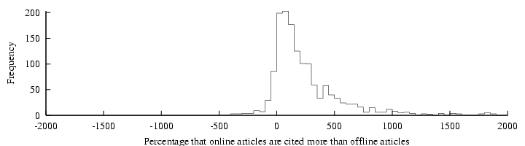
“Online or Invisible?” (Lawrence 2001)
“average of 336% more citations to online articles compared to offline articles published in the same venue”
Lawrence, S. (2001) Free online availability substantially increases a paper's impact Nature 411 (6837): 521.
http://www.neci.nec.com/~lawrence/papers/online-nature01/
Notes:
<number>
Lawrence’s study using articles in computer science, comparing articles ffrom the same venue (mostly refereed conference proceedings, which is the main form of publication in computer science) and showing that the ones that were self-archived had 300% more citations than the ones in the same venue that were not self-archived.

Slide 200
Research Impact
measures the size of a research contribution to further research (“publish or perish”)
generates further research funding
contributes to the research productivity and financial support of the researcher’s institution
advances the researcher’s career
promotes research progress
Notes:
<number>
Self explanatory: Describes the various aspects of research impact.

Slide 201
The author/institutional self-archived version is a supplement to -- not a substitute for -- the publisher’s official version
Link the self-archived author/institution supplement to the publisher’s official website
Pool and credit download counts for the self-archived supplement with downloads counts for the official published version
(All citation counts of course accrue to the official published version)

Slide 202
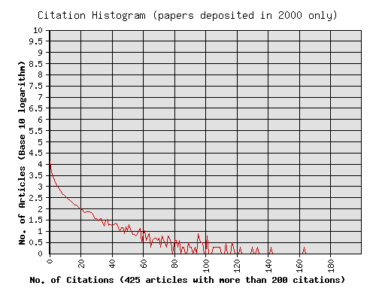
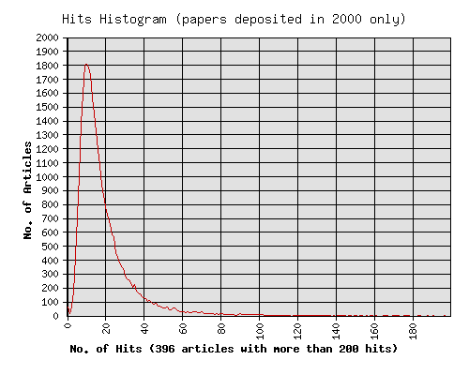
Usage Impact (downloads) is correlated with Citation Impact (Physics ArXiv: hep, astro, cond, quantum; math, comp) http://citebase.eprints.org/analysis/correlation.php downloads from first 6 months after publication predict citations 2 years after publicattion
(Quartiles Q1 (lo) - Q4 (hi))
All r=.27, n=219328
Q1 (lo) r=.26, n=54832
Q2 r=.18, n=54832
Q3 r=.28, n=54832
Q4 (hi) r=.34, n=54832
hep r=.33, n=74020
Q1 (lo) r=.23, n=18505
Q2 r=.23, n=18505
Q3 r=.30, n=18505
Q4 (hi) r=.50, n=18505
(correlation is highest for high-citation papers/authors)
Most papers are not cited at all
Average UK downloads per paper: 10
(UK site only: 18 mirror sites in all)
Notes:
<number>
The correlation in the access-impact cycle are also confirmed by the download/citation correlator: There is a strong positive correlation between the number of downloads a paper receives when it is self-archived and the number of citations it receives about 2 years later.
This correlation could be used in early-days evaluation and comparison of researchers and research.
The correlation between downloads and citations is greatest for the high-impact papers and authors.
Note how most papers are not cited at all (upper graph).
Other analyses show that when a paper is first self-archived (and there is an alerting service, as in the physics arxiv, there is a burst of downloads which subsides quickly -- except for papers that later turn out to be highly cited ones.
Those get donwloaded more often, and for a longer time after they first appear. Once the downloads generate citations, the citations generate more downloads.

Slide 203
Publishing models for scholarly journals
Traditional (subscription) model
Gold open access = free to reader, author pays a fee
Platinum open-access = free to author, free to reader
Delayed open access = subscription model but OA after some time
Green Open Access: Open-Access Self-Archiving (Traditional + Arxiv)
Slide adapted from Predatory Publishers are Poisoning Scholarly Communication by yJeffrey Beall UC Denver
Notes:
Slide adapted from
Predatory Publishers are Poisoning Scholarly Communication byJeffrey Beall
University of Colorado Denver
ORCID number 0000-0001-9012-5330
<number>

Slide 204
Some economic aspects of open access
The change from subscription-financed journals to author-financed journals has many negative, unanticipated effects
New business models focus on authors as revenue source
Conflict of interest: more papers accepted = more income
Not all subscription journals are good; not all OA journals are bad
Notes:
Alide adapted from
Predatory Publishers are Poisoning Scholarly Communication byJeffrey Beall
University of Colorado Denver
ORCID number 0000-0001-9012-5330
<number>

Slide 205

Predatory publishers
Predatory publishers (journals) are those that exploit the gold open-access model for their own profit
They take advantage of, exploit, and pander to scholarly authors
They pretend to be legitimate, copying established and respected journals' websites and practices
Many do a poor or fake peer review
While Beall address journals, There are also predatory conferences..
Notes:
Slide adapted from
Predatory Publishers are Poisoning Scholarly Communication byJeffrey Beall
University of Colorado Denver
ORCID number 0000-0001-9012-5330
<number>

Slide 206
Top Red Flags for Predatory Conferences
Email to you inviting you to apply, especially with your name
Not in google scholar under metrics
Unrealistic review timelines
Part of large multi-topic conference
No listing of program committee
Old topic with new conference.
Insufficient Contact Information
Unclear Author Fee structure
False Index Claims
No ISSN/ISBN

Slide 208
Breakdown of research cultures
Undoubtedly some have earned tenure and promotion through easy articles in predatory journals
The role of merit in academic advancement is disappearing
Never before has so much pseudo-science been published that looks like real science
Some academic databases are filled with junk science
Many researchers now expect cheap, easy, and fast publishing
Open access advocates are in denial about the problems OA has caused
It is possible for articles to be published open access yet still hidden
Notes:
Slide adapted from
Predatory Publishers are Poisoning Scholarly Communication byJeffrey Beall
University of Colorado Denver
ORCID number 0000-0001-9012-5330
<number>

Slide 209

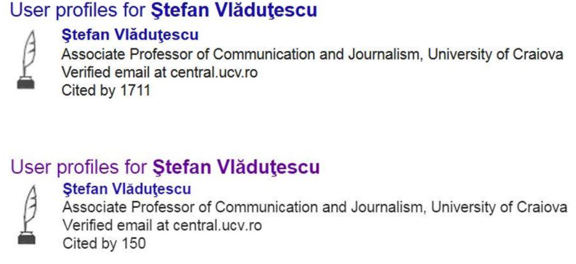
Impact on Scholarly metrics
Metrics can be somewhat gamed using predatory publishers
Alternative metrics (ISI) gamed too
Backlash against the impact factor
After a blog article by Beall brought up this case, google change scholar resulting in the drop.
Notes:
Slide adapted from
Predatory Publishers are Poisoning Scholarly Communication byJeffrey Beall
University of Colorado Denver
ORCID number 0000-0001-9012-5330
<number>

Slide 210
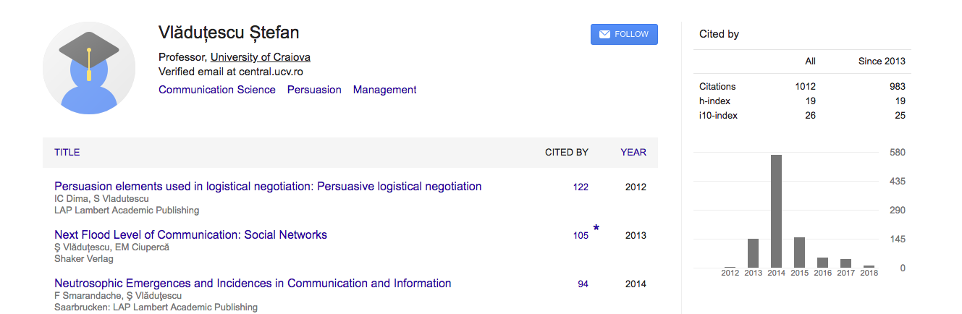
And people are are still playing their games But lawsuits & pressure on employers have reduced publicity
https://www.insidehighered.com/quicktakes/2015/01/21/scholar-accused-bogus-boost-google-rating
http://www.biochemia-medica.com/2017/27/273

Slide 211
How predatory publishers damage science
They've increased published research misconduct, such as plagiarism
The pseudo-science they publish gets indexed in Google Scholar and other academic indexes
They threaten demarcation, the division between science and pseudo-science, the cumulative nature of research
They feed bogus research to societal institutions that depend on authentic science
Entrepreneurs are using predatory publishers to make products appear efficacious
Notes:
Slide adapted from
Predatory Publishers are Poisoning Scholarly Communication byJeffrey Beall
University of Colorado Denver
ORCID number 0000-0001-9012-5330
<number>

Slide 212




Fake Impact Factors
Companies make up and sell impact factors to open-access journal publishers
Many publish articles mistakenly believing that their work is in an reasonable impact factor journal
Predatory journals advertise their bogus impact factors in spam email and on their websites
Notes:
Slide adapted from
Predatory Publishers are Poisoning Scholarly Communication byJeffrey Beall
University of Colorado Denver
ORCID number 0000-0001-9012-5330
<number>

Slide 213
Resources on Predatory Pub.
https://libguides.gwumc.edu/PredatoryPublishin
https://www.councilscienceeditors.org/resource-library/editorial-policies/cse-policies/approved-by-the-cse-board-of-directors/predatory-deceptive-publishers-recommendations-caution/
https://libguides.usask.ca/predatorypublishers

Slide 214



Author services companies
Provide services such as copyediting, pre-publication peer-review, statistical, methodological review, research promotion
Most are not predatory but quality varies.
Advantages those with money, who submit polished manuscripts
The costs of scholarly publishing on the authors, favoring those with money (I say it has for a long time)
Notes:
Slide adapted from
Predatory Publishers are Poisoning Scholarly Communication byJeffrey Beall
University of Colorado Denver
ORCID number 0000-0001-9012-5330
<number>

Slide 216
How to give a great research talk
Based in part on on material from Simon.Jones, J.Huges, J. Launchbury,
Stephanie Pfirman, Tom Carsey
Notes:
<number>

Slide 217
Giving a good talk
This presentation is about how to give a good research talk
What your talk is for
What to put in it (and what not to)
How to present it
Notes:
<number>

Slide 218
Why you should listen to this talk
Because many research talks are poor...
...and quite simple things can make your talks much better
Because everyone benefits from good talks
Your audience is happier
You get promoted
Because a research talk gives you access to the world’s most priceless commodity: the time and attention of other people. Don’t waste it!
Notes:
<number>

Slide 219
What your talk is for
Your paper = The beef
Your talk = The sizzle, advertising the beef
Do not confuse the two
Notes:
<number>

Slide 220
Which ”scale” talk are you giving?
1-3Min
5Min
10Min
20Min
30min
Job talk
Advertising to get them to look at paper.
Why+Overview of what is most important
Why,What (what more) & How
Why,What (what more) & How &How it fails
Why,What (what more) & How + Details
Who,Why,What & Why can do other things

Slide 221
The purpose of your talk…
The purpose of your talk is not:
To impress your audience with your brainpower
To tell them all you know about your topic
To present all the technical details
Notes:
<number>

Slide 222
The purpose of your talk…
The purpose of your talk is:
To give your audience an intuitive feel for your idea
To make them foam at the mouth with eagerness to read your paper
To engage, excite, provoke them
To make them glad they came
Notes:
<number>

Slide 223
Your audience…
The audience you might think you would like
Have read all your earlier papers
Thoroughly understand all the relevant theory of cartesian closed endomorphic bifunctors
Are all agog to hear about the latest developments in your work
Are fresh, alert, and ready for action
Notes:
<number>

Slide 224
But that is probably a very small audience
And they will read they paper anyhow

Slide 225
Your actual audience…
The audience you get
Have never heard of you
Have heard of your subarea, but probably wish they hadn’t
Have just had lunch and are ready for a doze
Your mission is to
WAKE THEM UP
And make them glad you did
Notes:
<number>

Slide 226

Tell a Story
Prepare your material so that it tells a story logically
Use examples, anecdotes, and significant details
Create continuity so that your slides flow smoothly
Guide the audience through your story
Your last point on one slide can anticipate the next slide
http://www.cgd.ucar.edu/cms/agu/scientific_talk.html

Slide 227
What to put in
Notes:
<number>

Slide 228
What to put in
Motivation (20%)
Part of your key idea (70%)
Impact 10%
Notes:
<number>

Slide 229
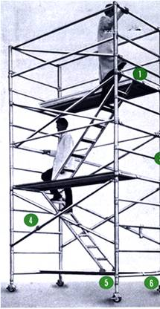
Structure
Basic rule
Say what you are going to say
1-3 main points in the Motivation
Say it
Give the talk’s key ideas
Then say what is the impact of what you said
Don’t try to build suspense and then unveil a surprise ending
http://www.safetyoffice.uwaterloo.ca/hspm/tools/images/scaffold_stair.png

Slide 230
Motivation
You have 15 seconds for they judge and 2 minutes
to engage your audience before they start to doze
They are thinking...
Why should I tune into this talk?
What is the problem?
Why is it an interesting problem?
Does this talk describe a worthwhile advance?
Notes:
<number>

Slide 231
The Motivation should end with a 1-sentence story. THE BARE BONES VERSION OF THE EIGHT ESSENTIAL ELEMENTS _______________ (CHARACTER) NEEDED _________________ BECAUSE _________________ BUT _____________________ SO, _____________________ FINALLY ___________________
Notes:
<number>

Slide 232
Your key idea
If the audience remembers only one thing from your talk, what should it be?
You must identify a key idea. “What I did this summer” is Not Good.
Be specific. Don’t leave your audience to figure it out what is important for themselves.
Be absolutely specific. Say “If you remember nothing else, remember this.” Or “The key idea is..”
Organize your talk around this specific goal. Ruthlessly prune material that is irrelevant to this goal.
Notes:
<number>

Slide 233

Narrow, deep beats wide, shallow
No
Best
Better
Avoid shallow overviews at all costs
Cut quickly to the chase: the technical “meat”
Best is quick context, the meat, and broad impact at end
Notes:
<number>

Slide 234
Your main weapon
Examples & stories are your main weapons
To motivate the work
To convey the basic intuition
To illustrate The Idea in action
To show extreme cases
To highlight shortcomings
When time is short, omit the details, not the example
Notes:
<number>

Slide 235
Paper Ruberic
90 total
15 Story
30 Comparative Analsysis
20 Number and appropriate Refernces
25 Writing, style grammar.

Slide 236
What to leave out
Notes:
<number>

Slide 237
Skip the “Outline of my talk” (unless >30min)
Background
The FLUGOL system
Shortcomings of FLUGOL
Overview of synthetic epimorphisms
π-reducible decidability of the pseudo-curried fragment under the Snezkovwski invariant in FLUGOL
Benchmark results
Related work
Conclusions and further work
Notes:
<number>

Slide 238
No outline!
“Outline of my talk”: conveys near zero information at the start of your talk
Worse, since your audience only gives you 2 minutes before dozing, you’ve just lost them
But in long talks can put up an outline for orientation after your motivation
…and if >30min can have signposts at pause points during the talk
Notes:
<number>

Slide 239
Related work
[PMW83] The seminal paper
[SPZ88] First use of epimorphisms
[PN93] Application of epimorphisms to wibblification
[BXX98] Lacks full abstraction
[XXB99] Only runs on Sparc, no integration with GUI
Notes:
<number>

Slide 240
Do not present related work
But
You absolutely must know the related work; respond readily to questions
Acknowledge co-authors (title slide), and pre-cursors (as you go along)
Don’t forget acknowledgements (cite on slide), always give proper credit
Tip: Everyone in the audience has come to listen to your lecture with the secret hope of hearing their work mentioned
Praise the opposition
“X’s very interesting work does Y; I have extended it to do Z”
Notes:
<number>

Slide 241
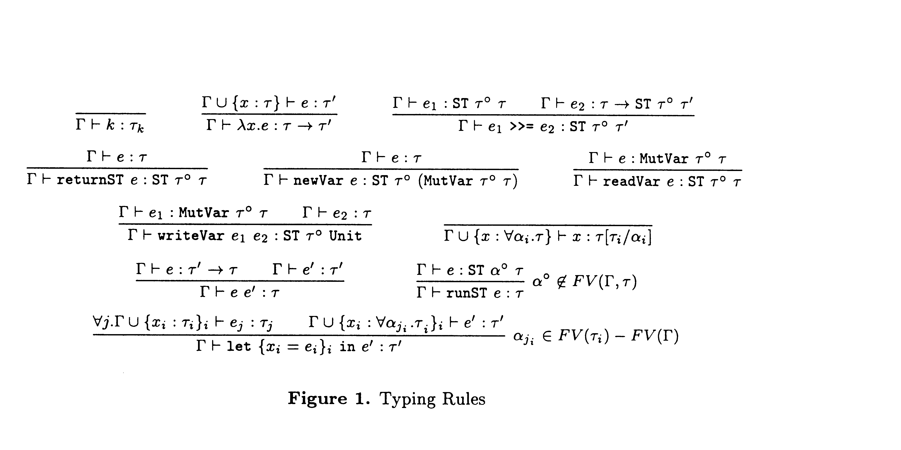
Technical detail
Notes:
<number>

Slide 242
Omit technical details
Even though every line is drenched in your blood and sweat, dense clouds of notation will send your audience to sleep
Present specific aspects only; refer to the paper for the details (and poster if you have one)
By all means have backup slides to use in response to questions
Notes:
<number>

Slide 243
Presenting your talk
Notes:
<number>

Slide 244
How to present your talk
Your most potent weapon, by far, is your
enthusiasm
Notes:
<number>

Slide 245
Enthusiasm
If you do not seem excited by your idea, why should the audience be?
It wakes ‘em up
Enthusiasm makes people dramatically more receptive
It gets you loosened up, breathing, moving around
Notes:
<number>

Slide 246
Write your slides the night before
Ideas will occur to you during the conference, as you obsess on your talk during other people’s presentations. Make it fresh and update it just before you give it
But your talk absolutely must be fresh in your mind. So do review it the day before
Notes:
<number>

Slide 247
Technology
Borrow a laser pointer, but avoid using it. Better to use mouse on the laptop.
Even better don’t need to point!
Consider borrowing a wireless slide changer
Test that your laptop works with the projector, in advance and just before presentation session.
Laptops break: leave a backup copy on the web; bring a backup copy on a disk or USB key
Notes:
<number>

Slide 248
Do not apologize
“I didn’t have time to prepare this talk properly”
“My computer broke down, so I don’t have the results I expected”
“I don’t have time to tell you about this”
“I don’t feel qualified to address this audience”
Notes:
<number>

Slide 249
The jelly effect
If you are anything like I was when I starting, you may experience apparently-severe pre-talk symptoms
Inability to breathe
Inability to stand up (legs give way)
Inability to operate brain
Notes:
<number>

Slide 250
What to do about it
Deep breathing during previous talk
Script your first few sentences precisely (=> no brain required)
Use time talks/videos.
Practice, Practice (maybe with flying objects;-)
Move around a lot, use large gestures, wave your arms, stand on chairs
Go to the bathroom before the session.
You are not a wimp. Most People feels this way.
Notes:
<number>

Slide 252
Being seen, being heard
DO NOT turn to the screen. Point using mouse and keep facing the audience.
Speak to someone at the back of the room, even if you have a microphone on
Make eye contact; identify a nodder, and speak to him or her (better still, more than one).
Don’t focus on a friend.
Watch audience for body-language and questions…
Notes:
<number>

Slide 253
Questions
Questions are not a problem
Specifically encourage questions during your talk: pause briefly now and then, ask for questions if appropriate. If there is after session send questions there.
Be prepared to truncate your talk if you run out of time. Better to connect, and not to present all your material
Questions are a golden golden golden opportunity to connect with your audience
Notes:
<number>

Slide 254
Presenting your slides
A very annoying technique
is to reveal
your points
one
by one
by one, unless…
there is a punch line
Notes:
<number>

Slide 255
Presenting your slides
Use animation effects
very
very
very
very
very
very
very
sparingly
Notes:
<number>

Slide 256
Finishing
Absolutely without fail, finish on time
Audiences get restive and essentially stop listening when your time is up. Continuing is very counter productive
Simply truncate and conclude
Do not say “would you like me to go on?” (it’s hard to say “no thanks”)
Notes:
<number>

Slide 257
Conclusion: there is hope
The general standard is often low. You don’t have to be outstanding to stand out
You will attend 50x as many talks as you give. Watch other people’s talks intelligently, and pick up ideas for what to do and what to avoid.
Notes:
<number>

Slide 258
Do it! Do it! Do it!
Good papers and talks are a fundamental part of research excellence
Invest time
Learn skills
Practice
Write a paper, and give a talk, about any idea, no matter how weedy and insignificant it may seem to you
Notes:
<number>

Slide 259
Research is communication
The greatest ideas are worthless if you keep them to yourself
Your papers and talks
Crystalise your ideas
Communicate them to others
Get feedback
Build relationships
(And garner research brownie points)
Notes:
<number>

Slide 260
Talk Prep Tips
1) Know your presentation tool
2) Choose aspect ratio
3) Choose right font
4) Choose colors
5) Timing

Slide 261
What aspect? Platform? Connector
Ask about ratio
Changing aspect in PPT scales things, often oddly.
Bring connectors/converters for VGA/HDMI
Test well before your talk.

Slide 262
What Font to Use
Type size should be 18 points or larger:
18 point
20 point
24 point
28 point
36 point
Max (~ ½ the age of oldest audience member, ½ the distance to a screen)
AVOID USING ALL CAPITAL LETTERS BECAUSE IT’S MUCH HARDER TO READ
* References can be in 12-14 point font

Slide 263
Color
Dark letters against a light background work
Dark letters against a light background are best for smaller rooms, especially when the lights are on for teaching. Best for any “dim” projector
http://www.fw.msu.edu/orgs/gso/documents/GSOWorkshopDocsSp2006/PresentationTipsinPowerPoint.ppt#302,5,Powerpoint basics: 1. What font to use

Slide 264
Color
Light letters against a dark background also work
Many graphics experts feel that a dark blue or black background works best for talks in a large room, best “perceived” color & image differences. Greater chance of “sleeping”
Colors on your screen are NOT how they project Test color pallets on a projector. Check again on the actual projector
http://www.fw.msu.edu/orgs/gso/documents/GSOWorkshopDocsSp2006/PresentationTipsinPowerPoint.ppt#302,5,Powerpoint basics: 1. What font to use

Slide 265
Talk Timing
The shorter the talk the more important it is you have the timing down very tight.
I recommend auto-timed slides or a video for talks < 10min, or any length if you are nervous but will NOT be interrupted with questions.
Feels awkward at first, as they will “go on without you”. You may feel everyone is starring at you, but its less noticeable than if you have very long pauses and look lost.
Good to practice with distractions. Having things tossed at you while practicing is good.
If you record a video with narration you can “practice” via listening to help know the material cold. But beware of losing energy in final talk!

Slide 266
Copyright & Talks
If for an academic venue, “Fair use” applies. Good to have reference on source (at least in notes). Ideal choose images with “reuse rights” in google search
Images & relevant Clip art can greatly improve talk. Weakly related images/art can distract but can still work.
A talk where you can connect your story and visualize it as all the pictures on every slide is way easier to remember, for you and your audience.
Finding/creating good images takes times. But its worth it.

Slide 267
Get inspired
Lots of conferences have their talks on line. Watch some with some friends and discuss what works and what does not.
Watch some (technically oriented) TED talks. (Some TedX are good, but you don’t get to TED unless you are a good speaker).

Slide 268
7 Talk Tips (From inspiring Ted Speakers)
Immerse your audience in a story.
Tell an emotional or personal story.
Create suspense
Bring characters to life.
Show. Don’t tell.
Build up to a S.T.A.R. moment.
End with a positive takeaway.

Slide 269
Duarte, Nancy. “Resonate.” Duarte. 2014.
A successful presentation creates a connection with the audience. In other words, it has to have “Something They’ll Always Remember.” The STAR moment doesn’t have to be particularly big or flashy, but it needs to be awe-inspiring. According to Duarte, it’s all about creating a “significant, sincere, and enlightening moment…that helps magnify your big idea.
1.) Memorable Dramatization
2.) Repeatable Sound Bites
3.) Evocative Visuals
4.) Emotive Storytelling
5.) Shocking Statistics

Slide 270
#5 STICKY STORIES
Think about everything you say in terms of its impact on your “story” and its stickness
Notes:
Facts and figures are forgotten.
Stories are retold.
Design a sticky story.
<number>

Slide 271
SUCCESS: STICKY STORIES
Simple
Unexpected
Concrete
Credible
Emotional
Stories
Stick!
Plan for
SUCCESS

Slide 272
Stats for Computer Science Experiments
Notes:
<number>

Slide 273
Median
Mean
Performance
Alg 1
Alg 2
Parameter estimates or algorithm comparisons without realistic error bars are nearly useless. As a reviewer call people on it.. as an author expect reviewers to call you on it.

Slide 274
Always take the standard error into account when quoting summary statistics. Quoting a silly number of decimal places/significant figures is a sure indicator of statistical and/or scientific illiteracy.
mean of 10 runs of a program on single input with times 3.01, 3.10 … 3.19, 3.23
don’t report run time of 3.14159
Report 3.1 ± .05 (where .05 is standard deviation),

Slide 275
Why Statistics
Almost all experimental CS of interest involves noisy data.
Need to separate our hypothesized meaningful variations from random variations caused by noise.
Ideally, we want to show the difference in performance is statistically significant

Slide 276
Experimental Hypothesis
Any scientific research should state a hypothesis, then
Provide evidence for/against
Conclude whether it is supported or refuted
Should be:
Precise, explicit statement
Falsifiable
Run experiment to confirm or refute
Ensure that the experiment really tests the hypothesis
Notes:
<number>
From greek “foundation” - a proposition made as a basis for reasoning without the assumption of its truth

Slide 277
Elaborating the Hypothesis
Hypothesis might be that system/theory/technique/ parameter P is:
Good for task X
Better than rivals Q and R for task X
According to:
Behavior - correctness or quality of solution
Coverage - range of problems to which it applies
Efficiency - resources consumed
Evidence can be theoretical, experimental or both
Theoretical evidence - theorem based
Experimental evidence – statistical testing on data

Slide 278
Nonstatistical Hypothesis Testing…
A criminal trial is an example of hypothesis testing without the statistics.
In a trial a jury must decide between two hypotheses. The null hypothesis is
H₀: The defendant is innocent
The alternative hypothesis or research hypothesis is
H₁: The defendant is guilty
The jury does not know which hypothesis is true. They must make a decision on the basis of evidence presented.

Slide 279
Nonstatistical Hypothesis Testing…
In the language of statistics convicting the defendant is called rejecting the null hypothesis in favor of the alternative hypothesis. That is, the jury is saying that there is enough evidence to conclude that the defendant is guilty (i.e., there is enough evidence to support the alternative hypothesis).
If the jury acquits it is stating that there is not enough evidence to support the alternative hypothesis. Notice that the jury is not saying that the defendant is innocent, only that there is not enough evidence to support the alternative hypothesis.

Slide 280
Nonstatistical Hypothesis Testing…
There are two possible errors.
A Type I error occurs when we reject a true null hypothesis. That is, a Type I error occurs when the jury convicts an innocent person. We would want the probability of this type of error [maybe 0.001 – beyond a reasonable doubt] to be very small for a criminal trial where a conviction results in the death penalty, whereas for a civil trial, where conviction might result in someone having to “pay for damages to a wrecked auto”,we would be willing for the probability to be larger [0.49 – preponderance of the evidence ]
P(Type I error) = α [usually 0.05 or 0.01]

Slide 281
Nonstatistical Hypothesis Testing…
A Type II error occurs when we don’t reject a false null hypothesis. That occurs when a guilty defendant is acquitted.
While less critical in law, in experiments this type of error is by far the most serious mistake we normally make. For example, if we test the hypothesis that the amount of medication in a heart pill is equal to a value which will safely cure your heart problem and “accept” the null hypothesis that the amount is ok. Later on we find out that the average amount is WAY too large and people die from “too much medication” [I wish we had rejected the hypothesis and threw the pills in the trash can], it’s too late because we shipped the pills to the public.

Slide 282
Nonstatistical Hypothesis Testing…
The probability of a Type I error is denoted as α (Greek letter alpha). The probability of a type II error is β (Greek letter beta).
The two probabilities are inversely related -- for a fixed sample size, decreasing one increases the other.
In other words, you can’t force α and β to both be real small for any given sample size. You may have to take a much larger sample size, or in the court example, you need much more evidence.

Slide 283
Hypothesis Testing…
The critical concepts are theses:
1. There are two hypotheses, the null and the alternative hypotheses.
2. The procedure begins with the assumption that the null hypothesis is true.
3. The goal is to determine whether there is enough evidence to infer that the alternative hypothesis is true, or the null is not likely to be true.
4. There are two possible decisions:
Conclude that there is enough evidence to support the alternative hypothesis. Reject the null.
Conclude that there is not enough evidence to support the alternative hypothesis. Fail to reject the null.

Slide 284
Concepts of Hypothesis Testing (1)…
The two hypotheses are called the null hypothesis and the other the alternative or research hypothesis. The usual notation is:
H₀: — the ‘null’ hypothesis
H₁: — the ‘alternative’ or ‘research’ hypothesis
The null hypothesis (H₀) will always state that the parameter equals the value specified in the alternative hypothesis (H₁)
pronounced
H “nought”

Slide 285
Concepts of Hypothesis Testing (4)…
The two possible decisions that can be made:
Conclude that there is enough evidence to support the alternative hypothesis
(also stated as: reject the null hypothesis in favor of the alternative)
Conclude that there is not enough evidence to support the alternative hypothesis
(also stated as: failing to reject the null hypothesis in favor of the alternative)
NOTE: we do not say that we accept the null hypothesis especially if a statistician is around…
11.1

Slide 286
Statistical Hypothesis testing
Tests of statistical significance assuming some model of and random noise
Data not consistent with H₀ :
H₀ can be rejected in favour of some alternative hypothesis H₁ (the objective of our study).
Data are consistent with the H₀ :
H₀ cannot be rejected
You cannot say that the H₀ is true.
You can only decide to reject it or not reject it.
1
Notes:
<number>

Slide 287
p value
p value = probability that our result (e.g. a difference between proportions or a RR) or more extreme values could be observed under the null hypothesis
H₀ rejected using reported p value
1
Notes:
<number>

Slide 288
p values – practicalities
Low p values = low degree of compatibility between H₀ and the observed data:
→association unlikely to be by chance
→you reject H₀, the test is significant
High p values = high degree of compatibility between H₀ and the observed data:
→association likely to be by chance
→you don’t reject H₀, the test is not significant
1
Notes:
<number>

Slide 289
Levels of significance – practicalities
We need of a cut-off !
1% 5% 10%
p value > 0.05 = H₀ not rejected (non significant)
p value ≤ 0.05 = H₀ rejected (significant)
BUT:
Better to give the p-value rather than “significant“
vs. “non-significant“.
1
Notes:
<number>

Slide 290
Examples from the literature
”The limit for statistical significance was set at p=0.05.”
”There was a strong relationship (p<0.001).”
”…, but it did not reach statistical significance (ns).”
„ The relationship was statistically significant (p=0.0361)”
p=0.05 → Agreed convention
Not an absolute truth
”Surely, God loves the 0.06 nearly as much
as the 0.05” (Rosnow and Rosenthal, 1991)
1
Notes:
<number>

Slide 291
p = 0.05 and its errors
Level of significance, usually p = 0.05
p value used for decision making
But still 2 possible errors:
H₀ should not be rejected, but it was rejected :
→Type I or alpha error
H₀ should be rejected, but it was not rejected :
→Type II or beta error
1
Notes:
<number>

Slide 292
Types of errors
Truth
No diff
Diff
Decision based on the p value
No diff
Diff
H₀ is “true” but rejected: Type I or α error
H₀ is “false” but not rejected: Type II or β error
1
Notes:
<number>

Slide 293
NEED Bonferroni correction for multiple tests

Slide 294
Hypothesis Testing Procedures
Many More Tests Exist!
Notes:
12

Slide 295
Parametric Test Procedures
1. Involve Population Parameters (Mean)
2. Have Stringent Assumptions
(Normality)
3. Examples: Z Test, t Test, χ² Test,
F test

Slide 296
Nonparametric Test Procedures
1. Do Not Involve Population Parameters
Example: Probability Distributions, Independence
2. Data Measured on Any Scale (Ratio or Interval, Ordinal or Nominal)
3. Example: Wilcoxon Rank Sum Test

Slide 297
Advantages of Nonparametric Tests
1. Used With All Scales
2. Easier to Compute
3. Make Fewer Assumptions
4. Need Not Involve Population Parameters
5. Results May Be as Exact
as Parametric Procedures
© 1984-1994 T/Maker Co.

Slide 298
Disadvantages of Nonparametric Tests
1.May Waste Information
Parametric model more efficient
if data Permit
2.Difficult to Compute by
hand for Large Samples
(But easy to compute ;-)
3.Less widely known
© 1984-1994 T/Maker Co.

Slide 299
Parametric tests-nonparametric equivalent
Paired t-test – Wilcoxon signed rank
Two sample t-test – Wilcoxon rank sum
ANOVA – Kruskal-Wallis test
When you have two or more independent samples and the assumptions of ANOVA are not met, you can use the Kruskal-Wallis test. This is a rank based test.
Notes:
<number>

Slide 300
t-tests
comp
infer
12
10
95% CI
8
6
Left hemisphere
right hemisphere
Exp. 1 Exp. 2
lesion site
Compare the mean between 2 samples/ conditions
if 2 samples are taken from the same population, then they should have fairly similar means
⇨ if 2 means are statistically different, then the samples are likely to be drawn from 2 different populations, i.e., they really are different
Notes:
<number>
assesses whether the means of two samples are statistically different from each other. This analysis is appropriate whenever you want to compare the means of two samples/ conditions
mean
arithmetic average
a hypothetical value that can be calculated for a data set; it doesn’t have to be a value that is actually observed in the data set
calculated by adding up all scores and dividing them by number of scores
assumptions of a t-test:
from a parametric population
not (seriously) skewed
no outliers
independent samples

Slide 301
Formula
Difference between the means divided by the pooled standard error of the mean
Reporting convention: t= 11.456, df= 9, p< 0.001
Notes:
<number>
t-value+ an end product of a calculation
df = degrees of freedom (the number of individual scores that can vary without changing the sample mean)
Standard error
Is the standard deviation of sample means
It is a measure of how representative a sample is likely to be of the population
Large SE (relative to the sample mean): lots of variability between means of different samples ⇨ used sample may not be representative of a population
Small SE: most sample means are similar to the population mean ⇨ sample is likely to be an accurate reflection of the population

Slide 302
Formula cont.
Cond. 1
Cond. 2
Notes:
<number>
I admit I stole this from last year’s presentation: you may read this at your own leisure ☺
To calculate the t score,
Take mean from condition 1 (x bar)
Then the mean from condition 2
Find the difference between these two
And divide this by their shared standard error
Calculate this by…
Taking the variance for group 1 and dividing it by the sample size for this group
Do the same for group 2 and add together.
Then finally take the square root of this and put the resulting value back into the original calculation to get your t value.

Slide 303

Types of t-tests cont.
2-tailed tests vs one-tailed tests
2 sample t-tests vs 1 sample t-tests
2.5%
2.5%
Mean
Mean
A known value
5%
Mean
Notes:
<number>
2-tailed tests vs one-tailed tests
If you set alpha-level at 0.05, there is 5% “area” in which a score would fall (outside where it is expected)
2-tailed tests leave room for this area to occur on both extreme ends, ie improvement may be either positive or negative (ie, 2,5% at either end)
One-tailed tests deny this and assume that the 5% can only occur at one extreme end (5%)
Both tails are meaningful in behavioural studies and should be favoured
2 sample t-tests vs 1 sample t-tests
2 sample t-tests compare the mean of 2 samples (both means are measured within the experiment)
1 sample t-tests compare the mean of one sample to a known value, often a (previously known) population mean
In fMRI: compare either 2 activation means of 2 different groups to each other or see if your one sample reaches a level of activation that you are expecting given some prior knowledge

Slide 304
Why Paired Test

Slide 305
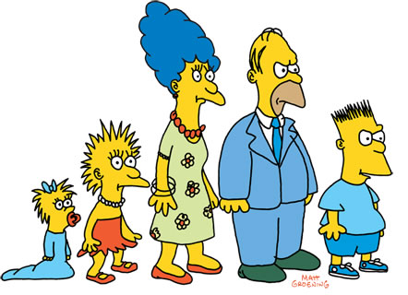
Types of t-tests
 | Independent Samples | Related Samples also called dependent means test
Interval measures/ parametric | Independent samples t-test* | Paired samples t-test**
Ordinal/ non-parametric | Mann-Whitney U-Test | Wilcoxon test
* 2 experimental conditions and different participants were assigned to each condition
** 2 experimental conditions and the same participants took part in both conditions of the experiments
Notes:
<number>
There are lots of different types of t-tests, which need to be used depending on the type of data you have
(equal) interval measures
Scales in which the difference between consecutive measuring points on the scale is of equal value throughout
No arbitrary zero, ie positive and negative measures, eg temperature
Ordinal measures
Scales on which the items can be ranked in order
There is an order of magnitude but intervals may vary, ie one item on the scale is more or less than another but it is not clear by how much as this cannot be measured
Often statements/ feelings are attached to numbers which can then be used for rating; in fact, this data can only be ranked (from highest to lowest) , ie what score had the highest turn-out
1= very good, 2= good, 3= neutral, 4= bad, 5= very bad
Different measurements have a direct influence on the way analysis is conducted because some of them are more amenable to mathematical operations than others

Slide 306
Excel: TTEST function
TTEST (array1, array2, tails, type)
array1 = the cell address for the first set of data
array2 = the cell address for the second set of data
tails: 1 = one-tailed, 2 = two-tailed
type: 1 = a paired t test; 2 = a two-sample test (independent with equal variances); 3 = a two-sample test with unequal variances
Notes:
<number>

Slide 307
Excel: TTEST function
It does not compute the t value
It returns the likelihood that the resulting t value is due to chance (the possibility of the difference of two groups is due to chance)
Notes:
<number>

Slide 308
Wilcoxon signed rank test
To test difference between paired data when data is not “normal” (guassian) e.g. it is ordinal (e.g. survey data)

Slide 309
STEP 1
Exclude any differences which are zero
Put the rest of differences in ascending order
Ignore their signs
Assign them ranks
If any differences are equal, average their ranks

Slide 310
STEP 2
Count up the ranks of +ives as T₊
Count up the ranks of –ives as T₋

Slide 311
STEP 3
If there is no difference between Treatment(T₊) and baseline (T₋), then T₊ & T₋ would be similar
If there were a difference
one sum would be much smaller and
the other much larger than expected
The smaller sum is denoted as T
T = smaller of T₊ and T₋

Slide 312
STEP 4
Compare the value obtained with the critical values (5%, 2% and 1% ) in appropriate table
N is the number of differences that were ranked (not the total number of differences)
So the zero differences are excluded

Slide 313
Subject | Hours of sleep |  | Difference | Rank Ignoring sign
 | Treatment | Baseline
1 | 6.1 | 5.2 | 0.9 | 3.5*
2 | 7.0 | 7.9 | -0.9 | 3.5*
3 | 8.2 | 3.9 | 4.3 | 10
4 | 7.6 | 4.7 | 2.9 | 7
5 | 6.5 | 5.3 | 1.2 | 5
6 | 8.4 | 5.4 | 3.0 | 8
7 | 6.9 | 4.2 | 2.7 | 6
8 | 6.7 | 6.1 | 0.6 | 2
9 | 7.4 | 3.8 | 3.6 | 9
10 | 5.8 | 6.3 | -0.5 | 1
3rd & 4th ranks are tied hence averaged
T= smaller of T₊ (50.5) and T₋ (4.5)
Here T=4.5 significant at 2% level indicating the Treatment is effective

Slide 314
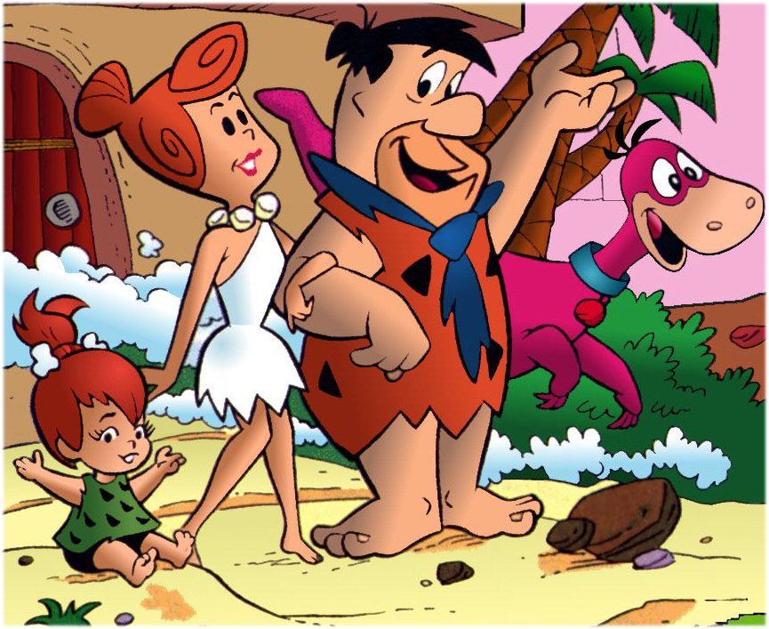
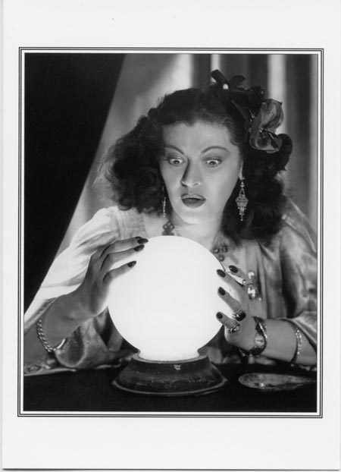
Comparison of more than 2 Gruops
Tell me the difference between these groups…
Thank God I have ANOVA
Notes:
<number>
In an experiment with more than 2 samples or more than 2 tasks (or 2 samples and 2 tasks), one could do lots of t-tests and compare all the different groups with each other this way but actually you increase the possibility of falsely rejecting the null-hypothesis tremendously (this is referred to as familywise/ experimentwise error rate). It is much better to use ANOVA.

Slide 315
Multiple paired comparisons
Let a_{c} be the probability of an error in a single comparison
alpha = the probability of incorrectly rejecting null hypothesis
1-a_{c}: probability of making no error in a single comparison
(1-a_{c})^{m}: probability of no error in m comparisons (experiment)
a_{e} = 1-(1-a_{c})^{m}: probability of an error in the experiment
Under assumption of independent comparisons
a_{e} quickly becomes large as m increases

Slide 317
Types of analysis-independent samples
Outcome | Explanatory | Analysis
Continuous | Dichotomous | t-test, Wilcoxon test
Continuous | Categorical | ANOVA, linear regression
Continuous | Continuous | Correlation, linear regression
Dichotomous | Dichotomous | Chi-square test, logistic regression
Dichotomous | Continuous | Logistic regression
Time to event | Dichotomous | Log-rank test
Notes:
<number>

Slide 318
Example
A recent study compared the hypointensity of gray matter structures on MRI in normal controls, benign MS patients and secondary progressive MS patients
Increased hypointensity is a marker of disease
Question: Is there any difference among these groups?
Notes:
<number>

Slide 319
The null hypothesis is that all of the groups have the same hypointensity on average
Categorical predictor
Continuous outcome
You could compare each of the groups to each of the other groups which would be 3 pair wise comparisons at the 0.05 level, but what happens to the overall alpha level?
What is α?
α = P(reject H₀ | H₀ is true) so in this case α = P(one difference | all are equal )
Also, P(fail to reject H₀ | H₀ is true) = 1 - α
Notes:
<number>

Slide 320
Overall α level
Now, if we completed each of the 3 pair wise tests at the 0.05 level and all of the tests were independent, P(fail to reject all 3 hypotheses | H₀ is true) = (1-0.05)³ = 0.857
Therefore, P(reject at least 1 | H₀ is true) = 1-0.857 = 0.143 = α = type I error
Type I error is greater than 0.05. This gets worse as number of comparisons increases
What can we do?
ANOVA
Notes:
<number>

Slide 321
Analysis of variance (ANOVA)
Null hypothesis is μ₁=μ₂=...=μ_{n}
We are testing if the mean is equal across groups
The alternative hypothesis is that at least one of the means is different (but we will not be able to determine which one using this test)
The name tells us that we are going to be using the variance, but the goal is to use the variance to compare the means (this is a common source of confusion)
Notes:
<number>

Slide 322
How does this work?
As with the t-test, we have a continuous outcome, but now we have multiple groups, which is a categorical variable
Before we begin, we must consider the assumptions required to use ANOVA
The underlying distributions of the populations are normal
The variance of each group is equal (This is critical for ANOVA), homoscedastic
These are similar to the two sample t-test
Notes:
<number>

Slide 323
Picture
If all of the groups had the same means, the distributions for all of the populations would look exactly the same (overlaid graphs)
Notes:
<number>

Slide 324
Picture II
Now, if the means of the populations were different, the picture would look like this. Notice that the variability between the groups is much greater than within a group
Notes:
<number>

Slide 325
Sources of variance
When we take samples from each group, there will be two sources of variability
Within group variability - when we sample from a group there will be variability from person to person in the same group
Between group variability – the difference from group to group
If the between group variability is large, the means of the two groups are likely not the same
Notes:
<number>

Slide 326
We can use the two types of variability to determine if the means are likely different
How can we do this?
Look again at the picture
Blue arrow: within group, red arrow: between group
Notes:
<number>

Slide 327
Blue arrow: within group, red arrow: between group
Notice that when the distribution are separate, the between group variability is much greater than the within group
Notes:
<number>

Slide 328
Notation
First we will define
How could we express the different forms of variability?
observation from student i from group j
mean of group j
grand mean over all of the groups
Notes:
<number>

Slide 329
Sources of variability
The distance of each observation from the grand mean can be broken into two pieces
Like the calculation of the variance, we are interested in the square of the deviation
What does the squared deviation look like?
Within group variability
Between group variability
Notes:
<number>

Slide 330
The final squared deviation simplifies to
As we discussed earlier, we are going to compare the two errors to determine if the group means are equal
Total sum of squares (SS_{T})
Within group sum of squares (SS_{W})
Between group sum of squares (SS_{B})
Notes:
<number>

Slide 331
The within group variability can be written in terms of the individual group standard deviations, s_{i.}
The result is called the within group mean square error, which is the combined estimate of the within group variance
Note the denominator is the total sample size minus the number of groups
Notes:
<number>

Slide 332
The between group variability can be broken into pieces from the summary statistics as well
The between group mean square error can be written as
The denominator of the MS_{B} is the number of groups minus 1 because we are considering the group means as the observations and the grand mean as the mean
Notes:
<number>

Slide 333
F-statistic
Now that we have estimates of the between group and within group variation, we can use an F-statistic
where k is the number of groups and n is the total sample size
This test statistic is compared to an F-statistic with k-1 and n-k degrees of freedom
Notes:
<number>

Slide 334
ANOVA table
To complete the analysis, we need to calculate the SS’s, MS’s and the F-statistic
A specific display of this data is often used called the ANOVA table
Standard software may provide results in this form
Source of variation | SS | df | MS | F | p-value
Between | SS_{B} | k-1 | MS_{B} | MS_{B}/MS_{W}
Within | SS_{W} | n-k | MS_{W}
Total | SS_{T}
Notes:
<number>

Slide 335
Example
Let’s perform an ANOVA test for the hypointensity
Here are the summary statistics
 | Healthy | BMS | SPMS
Mean | 0.404 | 0.389 | 0.391
Standard deviation | 0.022 | 0.017 | 0.014
Sample size | 24 | 35 | 26
Notes:
<number>

Slide 336
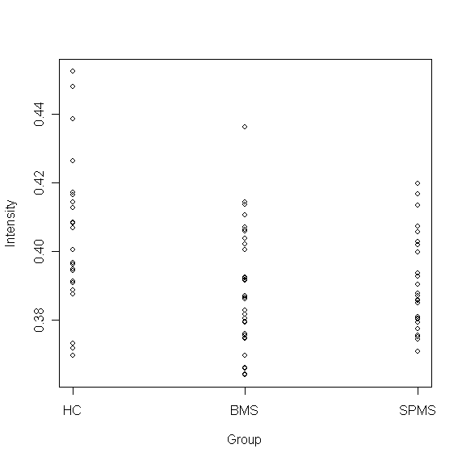

Slide 337
Hypothesis test
H₀: μ₁= μ₂= μ₃
Continuous outcome/categorical predictor
ANOVA
Test statistic: F=5.42
p-value=0.0062
Since the p-value is less than 0.05, we can reject the null hypothesis
We conclude that the mean is different in at least one group
Notes:
<number>

Slide 338
ANOVA table
Here is the ANOVA table for this data
Source of variation | SS | df | MS | F | p-value
Between | 0.0035 | 2 | 0.0017 | 5.42 | 0.0062
Within | 0.026 | 82 | 0.00032
Total
Notes:
<number>

Slide 339
An even smaller example
Suppose we have three groups
Group 1: 5.3, 6.0, 6.7
Group 2: 5.5, 6.2, 6.4, 5.7
Group 3: 7.5, 7.2, 7.9
We get the following statistics:

Slide 340
Computing ANOVA F statistic
overall mean: 6.44 F = 2.5528/0.25025 = 10.21575

Slide 341
Excel ANOVA Output
1 less than number of groups
number of data values - number of groups
(equals df for each group added together)
1 less than number of individuals
(just like other situations)

Slide 342
Notes
Remember the assumption of normality of data and equal variance across groups is required
We were able to conclude that one of the means is different, but we do not know which of the means is different. ANOVA is often considered a first step
We can do pair wise comparisons to determine which specific means are different, but we must still take into account the problem with multiple comparisons
Notes:
<number>

Slide 343
Bonferroni correction
The simplest way to handle the multiple comparisons is to correct the alpha level to allow the overall alpha level to be closer to the desired 0.05 level
The Bonferroni correction takes the observed p-values and multiplies it by the number of comparisons
If we have 3 groups and we would like to complete all pair wise comparison, we multiply the p-values by 3
In addition, we assume that the variance is equal in the pairwise t-tests
Notes:
<number>

Slide 344
Multiple testing
Say that you perform a statistical test with a 0.05 threshold, but you repeat the test on twenty different observations. Assuming that all of the observations are explainable by the null hypothesis, what is the chance that at least one of the observations will receive a p-value less than 0.05?
Pr(making a mistake) = 0.05
Pr(not making a mistake) = 0.95
Pr(not making any mistake) = 0.95²⁰ = 0.358
Pr(making at least one mistake) = 1 - 0.358 = 0.642
There is a 64.2% chance of making at least one mistake.
Notes:
<number>

Slide 345
Pairwise t-test
Here are the pairwise t-test results
Group 1 | Group 2 | p-value | Adjusted p-value
HC | BMS | 0.0022 | 0.0065
HC | SPMS | 0.014 | 0.042
BMS | SPMS | 0.62 | 1.0
We conclude that there is a significant difference between the healthy controls and both groups of MS patients, but no difference between the two groups of MS patients

Slide 346
More on Bonferroni correction
For three groups, we have three pairwise comparisons
What if we were only interested in comparing each MS group to the healthy controls? How many comparisons would we need to correct for?
Two comparisons
Multiply each p-value by 2

Slide 347
What is the
Bonferroni correction?

Slide 348
Bonferroni correction
Assume that individual tests are independent. (Is this a reasonable assumption?)
Divide the desired p-value threshold by the number of tests performed.
For the previous example, 0.05 / 20 = 0.0025.
Pr(making a mistake) = 0.0025
Pr(not making a mistake) = 0.9975
Pr(not making any mistake) = 0.9975²⁰ = 0.9512
Pr(making at least one mistake) = 1 - 0.9512 = 0.0488
Notes:
<number>

Slide 349
Type I and Type II Errors
Definition: A Type I error (α) corresponds to the error of rejecting H0, the null hypothesis, when it is, in fact, true. A Type II error (β) corresponds to the error of failing to reject H0 when it is false.
Definition: The power of a test is the probability of rejecting H0 given that it is false. Power = 1- β

Slide 350
Why does Power Matter? I
All the hypothesis tests described in the previous three sections are only concerned about reducing the Type I error.
i.e., they try to ascertain the conditions under which we are rejecting a hypothesis rightly.
They are not at all concerned about the case where the null hypothesis is really false, but we do not reject it.

Slide 351
Why does Power Matter? II
In the case of Machine Learning, reducing the type I error means reducing the probability of us saying that there is a difference in the performance of the 2 classifiers, when in fact, there isn’t.
Reducing the type II error means reducing the probability of us saying that there is no difference in the performance of the two classifiers, when, in fact, there is.
Power matters because we do not want to discard a classifier that shouldn’t have been discarded. If a test does not have enough power, then this kind of situation can arise

Slide 352
What is the Effect Size?
The effect size measures how strong the relationship between two entities is.
In particular, if we consider a particular procedure, in addition to knowing how statistically significant the effect of that procedure is, we may want to know what the size of this effect is.
There are different measures of effect sizes, including:
Pearsons’ correlation coefficient
Odd’s ratio
Cohen’s d statistics
Cohen's d statistic is appropriate in the context of a t-test on means. It is thus the effect size measure we concentrate on here.
[Wikipedia: http://en.wikipedia.org/wiki/Effect_size]

Slide 353
Cohen’s d-statistics
Cohen’s d-statistic is expressed as:
d = (X1 – X2)/ sp
Where sp², the pooled variance estimate is:
sp²= ((n1-1)*s₁² + (n2-1)*s₂²)
(n1+n2-2)
and sp, its square root.
[Note this is not exactly Cohen’s d measure which os expressed in terms of parameters. This is a very usable estimate of d].

Slide 354
Usefulness of the d statistic
d is useful in that it standardizes the difference between the two means. We can talk about deviations in terms of proportions of standard deviation points that are more useful than actual differences that are domain dependent.
Cohen came up with a set of guidelines concerning d:
d=.2 has a small effect, but is probably meaningful;
d= .5 is a medium effect that is noticeable.
d= .8 shows a large effect size.
1

Slide 355
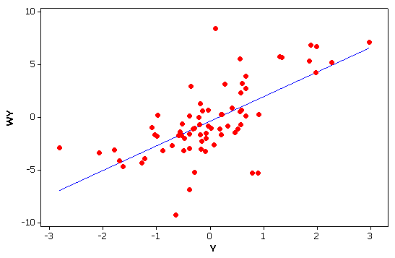
Bivariate and Multivariate
All measures so far have focused on one variable at a time
univariate
Often, we are interested in the association or relationship between two variables
bivariate.
Or more than two variables
multivariate
income
education
Y
income
gender*
education
X₁
X₂
*Gender = male or female
Notes:
<number>

Slide 356
Correlation and Regression The most commonly used techniques in science.
Review standard (non-spatial) approaches
Correlation
Regression
Notes:
<number>

Slide 357
Correlation and Regression What is the difference?
Mathematically, they are identical.
Conceptually, very different.
Correlation
Co-variation
Relationship or association
No direction or causation is implied
Y X X₁ X₂
Regression
Prediction of Y from X
Implies, but does not prove, causation
X (independent variable) Y (dependent variable)
Regression line
predicts
Notes:
<number>

Slide 358
Correlation Coefficient (r)
The most common statistic in all of science
measures the strength of the relationship (or “association”) between two variables e.g. income and education
Varies on a scale from –1 thru 0 to +1
+1 implies a perfect positive association
As values go up (⬆) on one, they also go up (⬆) on the other
income and education
0 implies no association
-1 implies perfect negative association
As values go up on one (⬆) , they go down (⬇) on the other
price and quantity purchased
Formal Full name is the Pearson Product Moment correlation coefficient,
(⬆) (⬇)
(⬆) (⬆)
-1
0
+1
Notes:
<number>

Slide 359
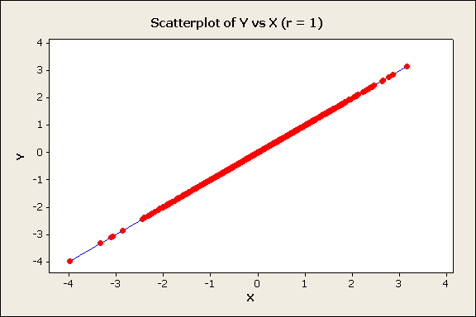
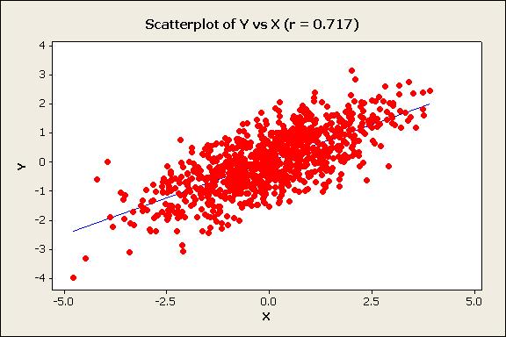
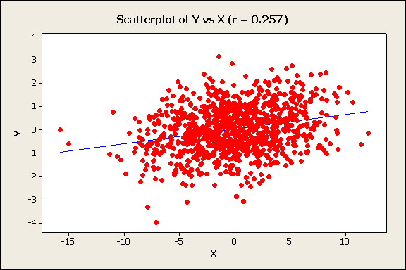
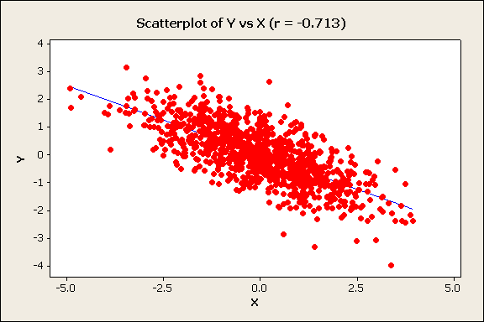
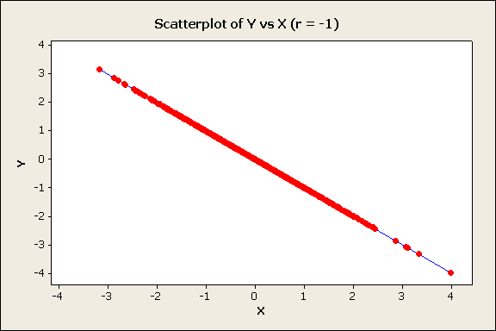
Examples of Scatter Diagrams and the Correlation Coefficient
Positive
r = 1
r = 0.72
r = 0.26
perfect
positive
Income
strong
positive
weak
positive
Education
Negative
r = -0.71
r = -1
Quantity
strong
negative
perfect
negative
Price
Notes:
<number>

Slide 360
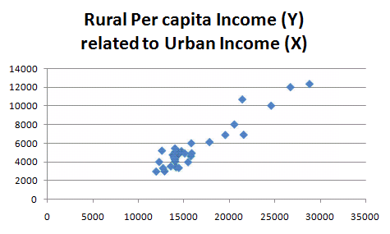
Correlation Coefficient: example
Correlation coefficient
= 0.9458
China Provinces 29
excludes Xizang/Tibet, Macao, Hong Kong, Hainan, Taiwan, P'eng-hu
Notes:
<number>

Slide 361
Calculation Formulae for Correlation Coefficient (r)
Before the days of computers, these formulae where easier to do “by hand.”
See next slide for example
Notes:
<number>

Slide 362
Regression
Simple regression
Between two variables
One dependent variable (Y)
One independent variable (X)
Multiple Regression
Between three or more variables
One dependent variable (Y)
Two or independent variable (X₁ ,X_{2…})
Y
X
Y
income
gender*
education
X₁
X₂
Notes:
<number>

Slide 363
Simple Linear Regression
Concerned with “predicting” one variable (Y - the dependent variable) from another variable (X - the independent variable)
Y = a +bX +ε
ε = residual= error = Y_{i}-Ŷ_{i} =Actual (Y_{i} ) – Predicted (Ŷ_{i} )
a is the intercept —the value of Y when X =0
b is the regression coefficient or slope of the line
—the change in Y for a one unit change in X
Y_{i}
Y
Regression line
Ŷ_{i}
b
1
a
X
0
Notes:
<number>

Slide 364
Ordinary Least Squares (OLS) --the standard criteria for obtaining the regression line
The regression line minimizes the sum of the squared deviations between actual Y_{i} and predicted Ŷ_{i}
Y_{i}
Ŷ_{i}
Min ∑(Y_{i}-Ŷ_{i})²
Y_{i}
Ŷ_{i}
Notes:
<number>

Slide 365
Coefficient of Determination (r²)
The coefficient of determination (r²) measures the proportion of the variance in Y (the dependent variable) which can be predicted or “explained by” X (the independent variable). Varies from 1 to 0.
It equals the correlation coefficient (r) squared.
SS Regression or Explained Sum of Squares
SS Total or Total Sum of Squares
Note:
SS Total or Total Sum of Squares
SS Regression or Explained Sum of Squares
SS Residual or Error Sum of Squares
=
+
Notes:
<number>

Slide 366
Partitioning the Variance on Y
Y
Y
Y
SS Total
or Total Sum of Squares
SS Regression
or Explained Sum of Squares
SS Residual
or Error Sum of Squares
Briggs Henan University 2010
1
Notes:
<number>

Slide 367
Standard Error of the Estimate (s_{e})
Measures predictive accuracy: the bigger the standard error, the greater the spread of the observations about the regression line, thus the predictions are less accurate
S_{e}² = error mean square, or average squared residual
= variance of the estimate, variance about regression
Sum of squared residuals
Number of observations minus degrees of freedom
(for simple regression, degrees of freedom = 2)
Notes:
<number>

Slide 368



Coefficient of determination (r² ), correlation coefficinet (r), regression coefficient (b), and standard error (S_{e})
(Values are hypothetical and for illustration of relative change only)
r² = 0.94 r = .97
S_{e}= 0.3
r² = r = 1
S_{e}= 0.0
S_{y} = 2
b = 2
r² = 0.51 r = .71
S_{e}= 1.1
b = 1.1
perfect
positive
Very strong
strong
r² = 0.26 r = .51
S_{e}= 1.3
b = 0.8
r² = 0.07
S_{e}= 1.8
b = 0.1
r² = r= 0.00
S_{e}= S_{y} = 2
moderate
weak
b = 0
none
Regression
line in
blue
As the coefficient of determination gets smaller, the slope of the regression line (b) gets closer to zero.
As the coefficient of determination gets smaller, the standard error gets larger, and closer to the standard deviation of the dependent variable (Y) (S_{y} = 2)
Notes:
<number>

Slide 369
Sample Statistics, Population Parameters and Statistical Significance tests
Y_{i} = a +bX_{i} +ε_{i} a and b are sample statistics
which are estimates of
population parameters α and β
β (and b) measure the change in Y for a one unit change in X. If β = 0 then X has no effect on Y, therefore
Null Hypothesis (H₀): in the population β = 0
Alternative Hypothesis (H₁): in the population β ≠ 0
Thus, we test if our sample regression coefficient, b, is sufficiently different from zero to reject the Null Hypothesis and conclude that X has a statistically significant affect on Y
Notes:
<number>

Slide 370
Test Statistics in Simple Regression
Test statistic for b is distributed according to the Student’s t Distribution (similar to normal):
where is the variance of the estimate,
with degrees of freedom = n – 2
A test can also be conducted on the coefficient of determination (r² ) to test if it is significantly greater than zero, using the F frequency distribution.
It is mathematically identical to the t test.
Notes:
<number>

Slide 371
Multiple regression
Y
We can rewrite simple regression as:
income
gender*
education
X₁
X₂
Multiple regression: Y is predicted from 2 or more independent variables
β₀ is the intercept —the value of Y when values of all X_{j} = 0
β₁… β _{m} are partial regression coefficients which give the change in Y for a one unit change in X_{j}, all other X variables held constant
m is the number of independent variables
Notes:
<number>

Slide 372
Multiple regression: least squares criteria
or
As in simple regression, the “least squares” criteria is used. Regression coefficients b_{j} are chosen to minimize the sum of the squared residuals (the deviations between actual Y_{i} and predicted Ŷ_{i})
The difference is that Ŷ_{i} is predicted from 2 or more independent variables, not one.
Regression
hyperplane
Notes:
<number>

Slide 373
Coefficient of Multiple Determination (R²)
Similar to simple regression, the coefficient of multiple determination (R²) measures the proportion of the variance in Y (the dependent variable) which can be predicted or “explained by” all of X variables in combination.
Varies from 0 to 1.
Formulae identical to simple regression
SS Regression or Explained Sum of Squares
SS Total or Total Sum of Squares
As with simple regression
SS Total or Total Sum of Squares
SS Regression or Explained Sum of Squares
SS Residual or Error Sum of Squares
=
+
Notes:
<number>

Slide 374
Reduced or Adjusted
R² will always increase each time another independent variable is included
an additional dimension is available
for fitting the regression hyperplane
(the multiple regression equivalent
of the regression line)
Adjusted is normally used instead of R² in multiple regression
Not perfect
Y
perfect
X₁
X₂
k is the number of coefficients in the regression equation, normally equal to the number of independent variables plus 1 for the intercept.
Notes:
<number>

Slide 375
Interpreting partial regression coefficients
The regression coefficients (b_{j}) tell us the change in Y for a 1 unit change in X_{j}, all other X variables “held constant”
Can we compare these b_{j} values to tell us the relative importance of the independent variables in affecting the dependent variable?
If b₁ = 2 and b₂ = 4, is the affect of X₂ twice as big as the affect of X₁ ?
No, no, no in general!!!!
The size of b_{j} depends on the measurement scale used for each independent variable
if X₁ is income, then a 1 unit change is $1
but if X₂ is rmb or Euro(€) or even cents (₵)
1 unit is not the same!
And if X₂ is % population urban, 1 unit is very different
Regression coefficients are only directly comparable if the units are all the same: all $ for example
Y
b
a
1
X
Notes:
<number>

Slide 376
Standardized partial regression coefficients Comparing the Importance of Independent Variables
How do we compare the relative importance of independent variables?
We know we cannot use partial regression coefficients to directly compare independent variables unless they are all measured on the same scale
However, we can use standardized partial regression coefficients (also called beta weights, beta coefficients, or path coefficients).
They tell us the number of standard deviation (SD) unit changes in Y for a one SD change in X)
They are the partial regression coefficients if we had measured every variable in standardized form
Note the confusing use of β for both standardized partial regression coefficients and for the population parameter they estimate.
Notes:
<number>

Slide 377
Test Statistics in Multiple Regression: testing each independent variable
A test can be conducted for each partial regression coefficient b_{j} to test if the associated independent variable influences the dependent variable. It is distributed according to the Student’s t Distribution (similar to the normal frequency distribution):
Null Hypothesis H_{o} : b_{j} = 0
.
with degrees of freedom = n – k, where k is the number of coefficients in the regression equation, normally equal to the number of independent variables plus 1 for the intercept (m+1).
The formula for calculating the standard error (SE) of b_{j} is more complex than for simple regression , so it is not shown here.
Notes:
<number>

Slide 378
Test Statistics in Multiple Regression testing the overall model
We test the coefficient of multiple determination (R² ) to see if it is significantly greater than zero, using the F frequency distribution.
It is an overall test to see if at least one independent variable, or two or more in combination, affect the dependent variable.
Does not test if each and every independent variable has an effect
Similar to the F test in simple regression.
But unlike simple regression, it is not identical to the t tests.
It is possible (but unusual) for the F test to be significant but all t tests not significant.
Again, k is the number of coefficients in the regression equation, normally equal to the number of variables (m) plus 1.
Notes:
<number>

Slide 379

Always look at your data
Don’t just rely on the statistics!
Anscombe's quartet Summary statistics are the same for all four data sets:
mean (7.5),
standard deviation (4.12), correlation (0.816) regression line
(y = 3 + 0.5x).
Anscombe, Francis J. (1973). "Graphs in statistical analysis". The American Statistician 27: 17–21.
Notes:
<number>

Slide 380

Real data is almost always more complex than the simple, straight line relationship assumed in regression.
Waiting time between eruptions and the duration of the eruption for the Old Faithful Geyser in Yellowstone National Park, Wyoming, USA. This chart suggests there are generally two "types" of eruptions: short-wait-short-duration, and long-wait-long-duration.
Source: Wikipedia
Notes:
<number>

Slide 381


Beware Spurious relationships
Eating ice cream inhibits swimming ability.
--eat too much, you cannot swim
Omitted variable problem
--both are related to a third variable not included in the analysis
Help!
Summer temperatures:
--more people swim
(and some drown)
--more ice cream is sold
Notes:
<number>

Slide 382


Regression does not prove direction or cause! Income and Illiteracy
Provinces with higher incomes can afford to spend more on education, so illiteracy is lower
Higher Income>>>>Less Illiteracy
The higher the level of literacy (and thus the lower the level of illiteracy) the more high income jobs.
Less Illiteracy>>>>Higher Income
Regression will not decide!
Illiteracy
Income
Income
Illiteracy
Notes:
<number>

Slide 383
What if there is not enough data?
Bootstrap
Jackknife
Cross-validation

Slide 384
What is Bootstrap
Bootstrapping is a method for estimating the sampling distribution of an estimator by resampling with replacement from the original sample.
The bootstrap procedure is a means of estimating the statistical accuracy . . . from the data in a single sample.
Bootstrapping is used to mimic the process of selecting many samples when the population is too small to do otherwise
The samples are generated from the data in the original sample by copying it many number of times (Monte Carlo Simulation)
Samples can then selected at random and descriptive statistics calculated or regressions run for each sample
The results generated from the bootstrap samples can be treated as if it they were the result of actual sampling from the original population

Slide 385
Characteristics of Bootstrapping
Full Sample
Sampling with Replacement

Slide 386
Bootstrapping Example
Random sampling with replacement can be employed to create multiple independent samples for analysis
Limited number of observations
Original Data Set
1st Random Sample
Pittsburgh
Navy
Michigan
Ohio State
Michigan State
USC
Washington
Washington
Purdue
10⁹ Copies of each observation
Ohio State
USC
USC
BYU
BYU
Tennessee
Stanford
Navy
Pittsburgh
Syracuse
Creating a much larger sample with which to work
Ohio State
Stanford
Stanford
Ohio State
Michigan

Slide 387
When it should be used
Bootstrapping is especially useful in situations when no analytic formula for the sampling distribution is available.
Traditional forecasting methods, like exponential smoothing, work well when demand is constant – patterns easily recognized by software
In contrast, when demand is irregular, patterns may be difficult to recognize.
Therefore, when faced with irregular demand, bootstrapping may be used to provide more accurate forecasts, making some important assumptions…

Slide 388
Assumptions and Methodology
Bootstrapping makes minimal assumption regarding the population (does need full independence)
No normality of error terms
No equal variance
Allows for accurate forecasts of intermittent demand
If the sample is a good approximation of the population, the sampling distribution may be estimated by generating a large number of new samples
For small data sets, taking a small representative sample of the data and replicating it will yield good results. If not representative it will exaggerate bais

Slide 389
Application and Uses
Setting Parameters
Agilent Technologies determined it was time to transfer manufacturing of its 3070 in-circuit test systems from Colorado to Singapore
Major concern was the change in environmental test conditions (dry vs humid)
Because Agilent tests to tighter factory limits (“guard banding”), they needed to adjust the guard band for Singapore
Bootstrap was used to determine the appropriate guard band for Singapore facility
Notes:
<number>

Slide 390
Variations
Bayesian Bootstrap
Block Bootstrap
Stratified Block Resampling bootstrap
Case resampling
Bias-Corrected Bootstrap
Gaussian process regression bootstrap
Resampling residuals

Slide 391
An Alternative to the bootstrap
Jackknife
A statistical method for estimating and removing bias* and for deriving robust estimates of standard errors and confidence intervals
Created by systematically dropping out subsets of data one at a time and assessing the resulting variation
Bias: A statistical sampling or testing error caused by systematically favoring some outcomes over others

Slide 392
A comparison of the Bootstrap & Jackknife
Bootstrap
Yields slightly different results when repeated on the same data (when estimating the standard error)
Not bound to theoretical distributions
Jackknife
Less general technique
Explores sample variation differently
Yields the same result each time
Similar data requirements

Slide 393
Another alternative method
Cross-Validation
The practice of partitioning data into a sample of data into sub-samples such that the initial analysis is conducted on a single sub-sample (training data), while further sub-samples (test or validation data) are retained “blind” in order for subsequent use in confirming and validating the initial analysis

Slide 396
Bootstrap vs. Cross-Validation
Bootstrap
Requires a small of data
More complex technique – time consuming
Cross-Validation
Not a resampling technique
Requires large amounts of data
Extremely useful in data mining and artificial intelligence

Slide 399
“HOW TO DEVELOP A SURVEY PAPER”
Based in part on examples/slides from
Dr. Manish Kumar Bajpai

Slide 400
Your Primary paper assignment this term
Solo: Survey paper at 8-10 pages in length at least 50 references.
Will turn in draft (4 weeks) + final paper (6 weeks)
Everyone will be giving feedback on at least 3 other paper at some point. You will get feedback from others on each draft.
Step 1) Get the lay of the land. For next week you are “search” for survey papers in your area and critically read least 3 survey papers, and build a topic map of where there are gaps.

Slide 401
WHAT MAKES A GOOD SURVEY?
Disucssion in class. Online Stop and think of 3 characteristics of a good survey and put that in your journal

Slide 402
WRITING SURVEY PAPERS
Selection of the topic for a good/impactful survey must satisfy the following requirements:
The (sub) field is newly emerging.
Popularity of the field will grow over time.
A critical number of papers with new algorithms/approaches does exist (at least twenty to forty).
The author(s) are enthusiastic about the particular topic.
A survey paper does not exist.
Presents a new/useful organization of the space

Slide 403

Figure : Impact of the existence of another survey paper. Explanation: This figure gives a result which was absolutely unexpected. The expectation was that existence of a survey would decrease citations of our survey, but it happened absolutely the opposite. This means that the quality is more important than the pre-existence of another survey paper on the same subject. The paper with 2 preceded survey papers was the paper by Protic at al [Protic 1996]. The paper with one preceded survey was the paper by Tomasevic at al [Tomasevic1993]. The paper with no preceded survey was the paper by Jovanovic at al [Jovanovic1999].

Slide 404

Figure : Survey papers versus research papers, what generates more citations? Explanation: Surveys generate more, unless an extraordinary research paper is generated in a popular field.

Slide 405


SURVEY PAPERS
With the binary (or n-ary) criteria, one can create either a tree-like classification or a cube-like classification,
With a tree-like classification, one can classify only the approaches that entirely belong to a specific class. With a cube-like classification, one defines a space in which inner points include, to some extent, characteristics of all existing classes
What is useful, is to prepare a figure which includes the following:
The classification criteria.
The classification.
Technical mnemonics.
Symbolic mnemonics.
The number of selected examples per class.
The full list of references of selected examples.
A vector of relevant characteristics.
FIGURE . A tree-like classification: Classes are only at the leaves of the tree.

Slide 406

Figure . Classification of Internet Search Algorithms
Legend: C1 (criterion #1) = Retrieval-oriented vs Analysis-oriented C2A (criterion #2, in the MDB path) = Random Search vs Targeted Search C2B (criterion #2, in the CMA path) = Semantics-oriented vs Datamining-oriented

Slide 407
TRY MIND MAPPING SOFWARE
Coggle (Web) for beginners
Mindly (macOS, iOS, Android) for mobile mind mapping
Draw.io (Web, macOS, Linux, Windows, Chrome OS) for free mind mapping
iMindMap (macOS, Windows, iOS) for performing in-depth analysis on your mind map
MindMup (Web) for creating public mind maps
MindMeister (Web, iOS, Android, macOS, Windows) for collaborating on a mind map with a team
Scapple (macOS, Windows) for fluid, non-traditional mind mapping
SmartDraw (Web) for linear mind mapping
Stormboard (Web) for in-person mind mapping sessions
LucidChart (Web, iOS, Android) for turning your mind map into an organized flowchart

Slide 408


Slide 409
SURVEY PAPERS
When presenting each particular example, one can start with these 7 items:
Seven Ws about the survey example (Who, What, When, Where, Why, for Whom, hoW).
Essence (it can extremely difficult to give entire essence in only one sentence).
Structure
Some relevant details.
Example (here one can call a figure that explains an example using a pseudo-code; ideally, the same application case should be used for all surveyed examples).
Pros and cons.
Author’s opinion of this example and its potentials.
For short surveys, each template element is a sentence. For long surveys, each template element is a paragraph. For books, each template element can be a page, or more.

Slide 410
GOOD SURVEY PAPERS
The need to weave that into a story.
Good surveys are not just a summary.
Must to compare and contrast the papers.
Must tell a story, with a theme and goal.
Should help organize ideas for others
Need not be complete but should be through within its theme/story.

Slide 411
SURVEY PAPER
1) Read about the general subject, to warm up. Pick target journal and locate related surveys 2) Determine your proposed classification approach and select 40-80 papers, on various approaches from the open literature based on your classification ideas. Explain why the proposed classification represents a contribution to science. 3. For each example (covered by one or more papers), write the main 7 ideas mentioned earlier in this paper. Use these place with within the the chosen template/classification which sould enables easy comparison, and therefore represents a contribution to science.
Pick the “key” points of comparison among the papers, may try many more than the final paper.. 5. For each key point of comparison, generate two figures (for example, one block scheme of the structure and one pseudo code presentation of the algorithm). Choose the presentation form which indicates the essence of the class that the example belongs to. 6. If the generated classification includes a class without examples (which is highly desirable, since that points to possible new research avenues), define the research strategy of interest for those who decide to take that avenue. Form a section with appropriate discussions.

Slide 412
7. Define the research strategy for those who decide to analyze the hybrid approaches (those consisting of elements of two different classes). Hybrid approaches can be either a symbiosis (the two solutions used interchangeably, as the conditions dictate), or a synergy (the two solutions combined into one). Discuss possible new solutions or both types (symbiosis and synergy). Discuss other possible avenues leading to new inventions
8. Add the preamble and the conclusion and form the final text of the paper. Generate ONE pearl of wisdom that sheds light on the essence of the paper, and increases the probability that the paper be referenced a lot. 9. Ask peers to review your paper, and edit edit edit .
10. Submit the paper to a journal.

Slide 414
WRITING
CS6000
Prof. Boult

Slide 415
Suggested reading/books on writing
Watch his video: https://vimeo.com/17432903

Slide 416
The writing process
How to get started
A good process
why process != writing

Slide 417
GITOMERS 5.5 THINGS TO IMPROVE YOUR WRITING:
Just sit down and write something
Capture your though and ideas the second they occur.
Write it like you would say it (at least at first).
Edit to make sure your thoughts are simple and easy to understand ad complete.
Edit early, then often 5.5 Your writing for the reader AND yourself

Slide 418

Effective Writing: Process
All that you need to do is three things:
Prewrite (about 25 percent of your time)
Write (about 25 percent of your time)
Rewrite (about 50 percent of your time)
Have a good process, a timelines and tools
GIT and Latex prefered
Word (track changes, dropbox.. )
Notes:
<number>

Slide 419
The biggest mistake you can make as a writer is waiting until its “ready”, let alone waiting for perfect. The rewriting process begins when you show your first draft to people and start getting feedback. Beethoven went through 70 drafts of his symphonies. As William Zinsser put it:
“Rewriting is where the game is won or lost; rewriting is the essence of writing.”

Slide 420
“Rewriting is the essence of writing well: it’s where the game is won or lost. The idea is hard to accept. We all have an emotional equity in our first draft; we can’t believe that it wasn’t born perfect. But the odds are close to 100% that it wasn’t. Most writers don’t initially say what they want to say, or say it as well as they could. The newly hatched sentence almost always has something wrong with it. It’s not clear. It’s not logical. It’s verbose. It’s klunky. It’s pretentious. It’s boring. It’s full of clutter. It’s full of clichés. It lacks rhythm. It can be read in several different ways. it doesn’t lead out of the previous sentence. It doesn’t…The point is that clear writing is the result of a lot of tinkering.

Slide 421
SHI..Y FIRST DRAFTS
or why I don’t recommend starting with an outline..
All first drafts are “bad”.. so might as well get one done so you can start making things better.
You should do your first draft, getting lots of stuff down on paper. Then you can review it to make an outline.
(Read http://richardcolby.net/writ2000/wp-content/uploads/2017/09/Bird-by-Bird-Anne-Lamott.pdf chapter on shitty drafts (I’ll

Slide 422
In Class EXERCISE
Don’t let words get in the way..
Seeing words slows down thinking and often makes one want to edit. You are to close your eyes and write/type, in your native language, about your own research idea. You are free to jump between ideas but must spend at least 30seconds on each idea.
I’ll tell you when to stop.
(If at home, do it while the video plays)
Notes:
<number>

Slide 423
A BETTER WAY for many
Don’t write.. talk.. use a voice recorder or use your laptop to record your first draft.
Get an app that does “dictation” and talk to it.. It gets you even farther as much of the text is there. But DO NOT look at it as it types for you.
Ideal dictation software saves voices + text, but raw text is often good enough to prompt your memory.

Slide 424
Now look back and look for the storyline in it. You want a simple sticky story (we’ll define that latter)..
What is both novel and useful/interesting
Look for possible flows
What surprises can you find?
If they cannot remember your work, they won’t accept/cite your work!

Slide 425
LISTEN TO YOUR INNER CHILD
At least for the first draft.. they are more playful, creative and full of ideas. Exactly what you want in the first draft.
See if you can think in pictures, shapes, characters.

Slide 426
FIRST EXERCISE, REDUX
Try it again but go with the inner child’s voice and tell a story..
I’ll tell you when to stop.

Slide 427
SECOND EXERCISE
Lose the words.
The ideas from what you wrote, and sketch them in very crude figures.. see the figures, connect the concepts as a cartoon or comic book might. You can change the order to make it a more meaningful story.

Slide 428
WRITING
CS6000
Prof. Boult

Slide 429
Suggested reading/books on writing
Watch his video: https://vimeo.com/17432903

Slide 430
The writing process
How to get started
A good process
why process != writing

Slide 431
GITOMERS 5.5 THINGS TO IMPROVE YOUR WRITING:
Just sit down and write something
Capture your though and ideas the second they occur.
Write it like you would say it (at least at first).
Edit to make sure your thoughts are simple and easy to understand ad complete.
Edit early, then often 5.5 Your writing for the reader AND yourself

Slide 432
Effective Writing: Process
All that you need to do is three things:
Prewrite (about 25 percent of your time)
Write (about 25 percent of your time)
Rewrite (about 50 percent of your time)
Have a good process, a timelines and tools
GIT and Latex prefered
Word (track changes, dropbox.. )
Notes:
<number>

Slide 433
The biggest mistake you can make as a writer is waiting until its “ready”, let alone waiting for perfect. The rewriting process begins when you show your first draft to people and start getting feedback. Beethoven went through 70 drafts of his symphonies. As William Zinsser put it:
“Rewriting is where the game is won or lost; rewriting is the essence of writing.”

Slide 434
“Rewriting is the essence of writing well: it’s where the game is won or lost. The idea is hard to accept. We all have an emotional equity in our first draft; we can’t believe that it wasn’t born perfect. But the odds are close to 100% that it wasn’t. Most writers don’t initially say what they want to say, or say it as well as they could. The newly hatched sentence almost always has something wrong with it. It’s not clear. It’s not logical. It’s verbose. It’s klunky. It’s pretentious. It’s boring. It’s full of clutter. It’s full of clichés. It lacks rhythm. It can be read in several different ways. it doesn’t lead out of the previous sentence. It doesn’t…The point is that clear writing is the result of a lot of tinkering.

Slide 435
SHI..Y FIRST DRAFTS
or why I don’t recommend starting with an outline..
All first drafts are “bad”.. so might as well get one done so you can start making things better.
You should do your first draft, getting lots of stuff down on paper. Then you can review it to make an outline.
(Read http://richardcolby.net/writ2000/wp-content/uploads/2017/09/Bird-by-Bird-Anne-Lamott.pdf chapter on shitty drafts (I’ll

Slide 436
In Class EXERCISE
Don’t let words get in the way..
Seeing words slows down thinking and often makes one want to edit. You are to close your eyes and write/type, in your native language, about your own research idea. You are free to jump between ideas but must spend at least 30seconds on each idea.
I’ll tell you when to stop.
(If at home, do it while the video plays)
Notes:
<number>

Slide 437
A BETTER WAY for many
Don’t write.. talk.. use a voice recorder or use your laptop to record your first draft.
Get an app that does “dictation” and talk to it.. It gets you even farther as much of the text is there. But DO NOT look at it as it types for you.
Ideal dictation software saves voices + text, but raw text is often good enough to prompt your memory.

Slide 438
Now look back and look for the storyline in it. You want a simple sticky story (we’ll define that latter)..
What is both novel and useful/interesting
Look for possible flows
What surprises can you find?
If they cannot remember your work, they won’t accept/cite your work!

Slide 439
LISTEN TO YOUR INNER CHILD
At least for the first draft.. they are more playful, creative and full of ideas. Exactly what you want in the first draft.
See if you can think in pictures, shapes, characters.

Slide 440
FIRST EXERCISE, REDUX
Try it again but go with the inner child’s voice and tell a story..
I’ll tell you when to stop.

Slide 441
SECOND EXERCISE
Lose the words.
The ideas from what you wrote, and sketch them in very crude figures.. see the figures, connect the concepts as a cartoon or comic book might. You can change the order to make it a more meaningful story.

Slide 442
WHY ARE YOU WRITING?
The art of persuasion and getting your way.
If you are not calling the reader to action, you are not persuading them. What are your actions in a paper? Proposal?
What does it mean to persuade?

Slide 443
Organization is more important than grammar!
Grammatical errors are not good, but for the reader they’re not as bad as these problems:
illogical sequence of ideas – why am I reading about all these details when I don’t yet know the big picture?
no pattern of organization – is this section moving from most important to least important ideas, or not?
no flow of ideas – I feel as though I’m starting over again with each new sentence.
Jumpiness – topic seem to jump around
Notes:
<number>

Slide 444


OSCAR
Integral elements/order in all good (science) stories
Opening (broad hook)
Setting the (Science) Stage
Challenge (the problem)
Action (Alg & Experiments)
Resolution (Must tie back to opening)
_x0016_
_x0016_

Slide 445
more classical science format is IMRAD Format
I = Introduction, what question (problem) was studied
M = Methods, how was the problem studied
R = Results, what are the findings
A = and (or Analysis)
D = Discussion, what do these findings mean

Slide 446
Organization of a scientific paper
The most common structure in the rest of science is the IMRAD
If a number of methods were used to achieve directly related results or for comparison:
M + R = Experimental section
The results are so complex that they need to be immediately discussed:
R + D = Results and Discussion section

Slide 447
OSCAR vs IMRAD
Opening
Setting
Challenge
Action/Analysis/Approach
Resolution
I = Introduction, what question (problem) was studied
M = Methods, how was the problem studied
R = Results, what are the findings
A = and (Or analysis)
D = Discussion, what do these findings mean

Slide 448
Writing as PERSUASIVE story telling
Why do you think its PERSUASIVE?
What makes things PERSUASIVE
What makes a good story

Slide 449




FIVE KEY ELEMENTS OF PERSUASIVE PRESENTATION
1) Action oriented style with energy!
Think about everything your say in terms of its impact, not its information.
Notes:
You have to get out of classic “Writing Mode” or CVPR talk mode. This is not describing what you did.. its not research. It must be a call to action, not leaving them decide.
<number>

Slide 450
ANATOMY OF A STICKY STORY
Energy Level
Word Count
Stickiness

Slide 451




#2 WHAT’S IN IT FOR THEM
Notes:
If, as a listener, I don’t see a benefit, why would I care about the details. Show the listener you are thinking about them, not you.
<number>

Slide 452
#2, WIFT(WHATS IN IT FOR THEM)
#2 Benefits, then features
If, as a reader, I don’t see a benefit, why would I care about the details. Show the reader you are thinking about them, not you.
Think about everything your write in terms of its impact, not its information
Features need to be explained to make the benefits creditable.
Then work in the benefits again, but as a call to action!

Slide 453
#3 Structure & Scannable Elements
79% of people don’t read—they scan.
Must hook them with Heading, Bullets, Bold/italics.
Expect things to be in place, section order, &key first sentences of paragraphs.
Images that convey value more forcibly than text could, such as charts, graphs, or high-quality product photos
Captions—these get read by 50% more ”readers” than body text, and often have a nearly 100% recall rate

Slide 454


Slide 455




#4 BUILDING EMOTION AND MEMORY
Energy/Emotion
Notes:
Use meaningful Images or graphics that convey value/emotion more memorably than words
<number>

Slide 456

#5 STICKY STORIES
Think about everything you say in terms of its impact on your “story” and its stickness
Notes:
Facts and figures are forgotten.
Stories are retold.
Design a sticky story.
<number>

Slide 457

SUCCESS: STICKY STORIES
Simple
Unexpected
Concrete
Credible
Emotional
Stories
Stick!

Slide 458

Writing as Story Telling
Audience
Scientific
Truth
You
Story

Slide 459
THERE ARE TWO HALVES TO THE WORD “STORYTELLING:” STORY —AND— TELLING
Notes:
<number>

Slide 460

Notes:
<number>

Slide 461
GETTING WHAT YOU NEED
You can't always get what you want -
But if you try sometime, yeah, You just might find you get what you need!
-Rolling Stones
1

Slide 462
EIGHT ESSENTIAL ELEMENTS 1. CHARACTER 2. CHARACTER TRAITS (THAT MAKE CHARACTERS INTERESTING) 3. GOAL 4. MOTIVE 5. CONFLICTS & PROBLEMS 6. RISK & DANGER 7. STRUGGLES 8. DETAILS
Notes:
<number>

Slide 463
THE EIGHT ESSENTIAL ELEMENTS OF EVERY STORY/NARRATIVE 1. WHO IS THE MAIN CHARACTER? 2. WHAT CHARACTER TRAITS MAKE THEM INTERESTING? 3. WHAT DO THE CHARACTER NEED TO DO OR GET (GOAL)? 4. WHY IS THAT GOAL IMPORTANT (MOTIVE)? 5. WHAT CONFLICTS/PROBLEMS BLOCK THE CHARACTER? 6. HOW DO THEY CREATE RISK & DANGER? 7. WHAT DOES THE CHARACTER DO (STRUGGLES) TO REACH GOAL? 8. WHAT SENSORY DETAILS WILL MAKE THE STORY SEEM REAL?
Notes:
<number>

Slide 464
Science/Tech story
1. WHO IS THE MAIN CHARACTER? Algorithm/system/theory of the paper 2. WHAT CHARACTER TRAITS MAKE THEM INTERESTING? What helps reader remember WHY it works/is better 3. WHAT DO THE CHARACTER NEED TO DO OR GET (GOAL)? What is measure by which you beat state of the art 4. WHY IS THAT GOAL IMPORTANT (MOTIVE)? Why is that property important.. 5. WHAT CONFLICTS/PROBLEMS BLOCK THE CHARACTER? What make it hard to do.. 6. HOW DO THEY CREATE RISK & DANGER? What are the risks/danger if not successful. 7. WHAT DOES THE CHARACTER DO (STRUGGLES) TO REACH GOAL? Ablation study or experiments on parts of what make it work (related back to traits) 8. WHAT SENSORY DETAILS WILL MAKE THE STORY SEEM REAL? Show examples; show some failure cases
Notes:
<number>

Slide 465
Why might ”character” fail,
what happens if I does
Your
Science &
Its properties
The problem and limits of state of the art
Notes:
<number>

Slide 466
THE SCIENCE OF STORY for Science (IN 3 PARTS) 1. THE SCIENCE OF STORY STRUCTURE 2. ANTICIPATING THE MIND OF THE AUDIENCE 3. THE STORY PROCESS
Notes:
<number>

Slide 467
1. THE SCIENCE OF STORY STRUCTURE
Notes:
<number>

Slide 468
PEOPLE LEARNED: • TO READ (most people)… …200 YAG (YEARS AGO)
Notes:
<number>

Slide 469
MOST PEOPLE LEARNED: • TO READ 200 YAG • LOGIC & ARGUMENTATIVE FORMS… …3,200 YAG
Notes:
<number>

Slide 470
PEOPLE LEARNED: • TO READ 200 YAG • LOGIC & ARGUMENTATIVE FORMS 3,200 YAG • TO WRITE (advanced individuals)… …7,000 YAG
Notes:
<number>

Slide 471
PEOPLE LEARNED: • TO READ 200 YAG • LOGIC & ARGUMENTATIVE 3,200 YAG • TO WRITE 7,000 YAG • TO USE STORYTELLING... …>100,000 YAG!
Notes:
<number>

Slide 472
100,000 years of storytelling dominance in human interaction to communicate and to archive learning, wisdom, fact, knowledge, values, beliefs, history, etc. Has evolutionarily rewired the human brain to think in specific story terms.
(Or more likely storytelling evolved to use specific models that are match how humans think/remeber).
Notes:
<number>

Slide 473
THE HUMAN BRAIN IS PREDISPOSED TO THINK IN STORY TERMS. • TO UNDERSTAND • TO MAKE SENSE • TO REMEMBER
Notes:
<number>

Slide 474
PERSON #1: “WHERE’S JOHN?” PERSON #2: “WELL….I DIDN’T WANT TO SAY ANYTHING. BUT…I SAW A GREEN VW PARKED IN FRONT OF CAROL’S.”
Notes:
<number>

Slide 475
• DID ANYONE SAY THAT THERE IS NO CONNECTION? • DID ANYONE SAY THAT IT MAKES NO SENSE? NO! HUMAN MINDS AUTOMATICALLY ASSUME A CONNECTION AND ASSUME IT MAKES SENSE AND USE STORY STRUCTURES TO FILL IN MISSING INFORMATION.
Notes:
<number>

Slide 476
OUR STORIED MINDS IN ACTION:
Person 1: “Hi John.”
Person 2: “Shhhh! I’m not here! You never saw me. I’m not here!”
Person 1: “It’s okay. Carol’s gone home.”
Notes:
<number>
Module 1-2, #7

Slide 477
2. ANTICIPATING THE MIND OF THE AUDIENCE
Notes:
<number>

Slide 478
PRIOR KNOWLEDGE “BANKS OF EXISTING KNOWLEDGE AND EXPERIENCE ABOUT A RELEVANT TOPIC OR NARRATIVE STRUCTURE.”
Notes:
<number>

Slide 479
Prior knowledge creates context for new information.
Story structure makes new information relevant.

Slide 480
THE MAGIC INGREDIENTS
Context: “The surrounding parts that determine meaning; background.”
Relevance: “Implying close relationship or importance.”

Slide 481
APPLYING PRIOR KNOWLEDGE IS HOW WE REMEMBER. HERE ARE 10 GROUPS WITH 25 LETTERS. IN 10 SECONDS, TRY TO MEMORIZE THE GROUPS IN ORDER:
Notes:
<number>

Slide 482
AT TIB MAP PLEM ICR OS OF TT WIT TER

Slide 483
HOW MANY CAN YOU RECALL IN ORDER? (THE AVERAGE IS JUST UNDER 10 LETTERS.) DIFFERENT SPACING WILL EVOKE PRIOR KNOWLEDGE PRIOR KNOWLEDGE CREATES CONTEXT AND RELEVANCE.
Notes:
<number>

Slide 484
ATT IBM APPLE MICROSOFT TWITTER IT’S THE SAME LETTERS. AT TIB MAP PLEM ICR OS OF TT WIT TER NOW MEMORY LAUGHABLY EASY. THAT IS THE POWER OF PRIOR KNOWLEDGE AND PROPER GROUPING.
Notes:
<number>

Slide 485
PRIOR KNOWLEDGE CONSIDER THE FOLLOWING SEVEN SENTENCES: JOHN WALKED ON THE ROOF. BILL PICKED UP THE EGGS. PETE HID THE AX. JIM FLEW THE KITE. FRANK BUILT THE BOAT. HARVEY FLIPPED THE ELECTRIC SWITCH. TED WROTE THE PLAY.
Notes:
<number>

Slide 486
HOW MANY CAN YOU REMEMBER? WHO BUILD THE BOAT? WHO FLEW THE KITE? ETC.? YOU UNDERSTOOD THE SENTENCES, BUT HAVE NO CONTEXT OR RELEVANCE FOR THEM, SO WEREN’T ABLE TO REMEMBER.
Notes:
<number>

Slide 487
CHANGE THE NAMES TO INVOKE PRIOR KNOWLEDGE. SANTA CLAUSE WALKED ON THE ROOF. THE EASTER BUNNY PICKED UP THE EGGS. GEORGE WASHINGTON HID THE AX. BENJAMIN FRANKLIN FLEW THE KITE. NOAH BUILT THE BOAT. THOMAS EDISON FLIPPED THE ELECTRIC SWITCH. WILLIAM SHAKESPEARE WROTE THE PLAY.
Notes:
<number>

Slide 488
ANOTHER EXAMPLE OF PRIOR KNOWLEDGE AND STORY STRUCTURE: PARAGRAPH #1 A THIRSTY ANT WENT TO THE RIVER. HE WAS CARRIED AWAY BY THE RUSH OF THE STREAM AND WAS ABOUT TO DROWN. A DOVE, SITTING IN A TREE OVERHANGING THE WATER, PLUCKED A LEAF. THE LEAF FELL INTO THE STREAM CLOSE TO THE ANT AND THE ANT CLIMBED ONTO IT. THE ANT FLOATED SAFELY TO THE BANK. SHORTLY AFTER, A BIRDCATCHER CAME AND LAID A TRAP IN THE TREE. THE ANT BIT AND STUNG HIM ON THE FOOT. IN PAIN, THE BIRDCATCHER THREW DOWN HIS TRAP. THE NOISE MADE THE DOVE FLY AWAY.
Notes:
<number>

Slide 489
PRIOR KNOWLEDGE AND FAMILY STORIES WHEN YOU TELL STORIES TO THE FAMILY THERE IS MUCH YOU OMIT BECAUSE THEY ALREADY KNOW (THEY HAVE BANKS OF PRIOR KNOWLEDGE).
Notes:
<number>

Slide 490
THE CURSE OF KNOWLEDGE: “ONCE YOU KNOW, IT IS IMPOSSIBLE TO REMEMBER WHAT IT WAS LIKE TO NOT KNOW.” ONCE YOU KNOW, YOU TEND TO WRITE (AND TELL OTHERS) AS IF EVERY READER/LISTENER ALSO KNEW.
Notes:
<number>

Slide 491
WRITE FROM THE AUDIENCES KNOWN BANKS OF PRIOR KNOWLEDGE NOT FROM YOURS; NOT FROM THE BEST SCIENTISTS; AT MOST WRITE FROM THE AVERAGE AUDIENCE MEMBER. BETTER WRITE TO BELOW AVERAGE BUT MAKE THEM FEEL ABOVE AVERAGE CAN HAVE 2-3 PARAGRAPHS FOR THE BEST SCIENTISTS
Notes:
<number>

Slide 492
FACT IS MADE RELEVANT BY TURNING IT INTO STORY. TURNER (1996). “SCIENCE WRITINGS IMPLY (BURY) MOST OF THE KEY STORY ELEMENTS. MAKE THOSE EXPLICIT AND INFORMATION TURNS INTO STORY! “ EXAMPLE: MOTHER POURS MILK INTO A GLASS. (AN EVENT) UNSTATED: GOAL/MOTIVE/RESOLUTION/OBSTACLES
MAKE THOSE EXPLICIT: MOTHER’S LEFT SIDE HAS BEEN PARALIZYED BY A CRIPPPLING STROKE. SHE FIGHTS TO REGAIN USE OF LEFT HAND AND ARM. FOR THE FIRST TIME SHE TRIES A COMPLEX ACTION WITH HER LEFT HAND. SHE IS DETERMINED TO POUR THE MILK TO PROVE THAT SHE CAN.... NOW ITS A STICKY STORY!
Notes:
<number>

Slide 493
THE STORY PROCESS
Notes:
<number>

Slide 494
THE PROCESS: MERGING YOU INFORMATION CONTENT WITH EFFECTIVE STORY STRUCTURE
Notes:
<number>

Slide 495
The Story Process:
1. Create theme and “take away” message.
2. Search for a core metaphor.
3. Define/develop story characters.
Build story elements around character and metaphor.
5. Adjust for audience and media.

Slide 496
Theme Versus Goal
GOAL:
Is for characters
Should be physical, tangible, identifiable
Defines the story’s ending
Creates purpose and meaning for the story
THEME:
Is for readers
Relates to the human condition
What writer wants readers to ponder
Let’s readers interpret characters & events
Characters need not be aware of theme

Slide 497
Theme is the core of your message.
Story is the vehicle that effectively communicates your message and
can help the message stick!

Slide 498
THE BARE BONES VERSION OF THE EIGHT ESSENTIAL ELEMENTS _______________ (CHARACTER) NEEDED _________________ BECAUSE _________________ BUT _____________________ SO, _____________________ FINALLY ___________________
Notes:
<number>

Slide 499
OSCAR And Story Elements
Opening
Setting
Challenge
Action
Resolution
_______________ (CHARACTER) NEEDED _________________ BECAUSE _________________ BUT _____________________
SO, _____________________
FINALLY ___________________

Slide 500
Remeber OSCAR is applied recursively
Paper level
Section Level
Paragraph level (S and C become smaller)
Sentence Level often but not always the order often some parts missing. More variety here. e.g. can also be OAR or RA depending on context.

Slide 501


Once you have your story ideas, focus on organizing for your reader.
Learn to frame what’s important
Notes:
<number>
What is most important in this picture? The photograph has already made a selection and has “framed” the objects in the center with window-frames at the sides. Within that frame, what seems most important?
How could the photo better indicate that most important object?
Writing needs to do a similar job of framing your expressed ideas and facts. How do you foreground and frame and show connection?

Slide 502
Openings
Are critical to framing the paper. The first sentence is very audience specific.
Generally needs be a hook, intellectually or emotionally for Audience
Worth spend lots of time on this.. for abstract and for intro and for conclusion.

Slide 503
Setting the Science Scene
Intro should have a bit of setting the science context and the “problem”, maybe even danger. What is the most relevant existing science. Why should we care
Setup non-standard important terms.
This is NOT a lit review (Many papers will also have a “related work” section..
Its just framing the problem and showing reader that others are working in related areas too.
Be Positive, not critical.

Slide 504
The Challenge is defines your stories PROBLEMS & CONFLICTS AND RISK & DANGER • ARE ALWAYS THERE • DRIVE ALL STORIES • DOES NOT MEAN STORIES ARE ABOUT FAILURE • THEY ARE CHALLENGES ALONG THE ROAD TO SUCCESS.

Slide 505
DOES “DANGER” AUTOMATICALLY MEAN “PHYSICAL DANGER?” ABSOLUTELY NOT! ANY EMOTIONAL, MENTAL, SOCIAL, PROFESSIONAL, OR PHYSICAL DANGER WILL DO. (EMBARRASSMENT, REJECTION, LACK OF KNOWLEDGE & UNDERSTANDING, LACK OF INFORMATION, FAILURE, RIDICULE, BELITTLEMENT, BEING LAUGHED AT, BEING ABANDONED, BEING SCORNED, BEING UNWANTED, FEARS, ETC., ETC.) IN SCIENCE/ENG ACCURACY, SPEED, COST ARE ALSO DANGERS.

Slide 506
Resolution
Conclusion vs Discussion.
Good model is OSCAR in reverse.. state the resolution, review the action, science setting (now science clearly stating contribution) and resolve the opening.
What about future work?
Best is to put it in the body of the method or experiments (no need to summarize at end)
“Bad new sandwich”
Do it as But YES.. not YES But.. because But yes Ends strong

Slide 507
General comments on writing
Start early.
Work on the story before writing too much and before doing any/all experiments
Edit often
Review how the story works with experimental results
Edit some more
Get feedback
Edit even more

Slide 508
Common Avoidable Sins in papers
Grandmotherhood opening/ending
A table of contents in a paragraph form
Undercutting yourself with textbook level material
Conclusions that don’t conclude (summary != Conclusion)
Opening/Conclusion mismatch

Slide 509
Highlight information by repeating it.
Repeat major ideas in several places in the document. BUT ALWAYS DIFFERENT views of the same idea
Repeat same keywords:
“deep network” vs “CNN”
Don’t go for “variety” to keep it from being repetitive. You may read it 100 times, but the reader does it 1-2 times. So its not nearly as repetitive as you might think. If you used it < 20 times, go ahead reuse it as its not really “repetitive” yet.
DO avoid instant repetition/tautologies (e.g. basic fundamental, final ending, true facts mutual cooperation
Notes:
<number>

Slide 510
Writing Startup
Manage/Plan your time. This is a key element of being effective.
Don’t think about writing. This is about communication.
Generation of ideas
Using outlines
Questioning, Question/listing, Answering..
Brainstorm outlining ..
(for a twist.. try brainstorming with only action verbs, words that rhyme, words that start with a particular letter, etc. )
Post-it Notes or cards..
Free writing
Free talk / Dictations..

Slide 511
Writing a Research Paper
Based in part my own experiences plus slides from E. Kraemer and S. Peyton Jones. Note in parallel to “story telling” this is more about structure/process
Notes:
<number>

Slide 512
Related work !=Literature Survey
“Related work” section is different than a survey paper. Don’t need a “categorization”
Want 1-2 papers that set the stage of the problem 3-5 papers that use related tools, 2-3 papers that are state of the art and to which you will compare.
If your approach is a combination of 2-3 ideas may need more.
Be positive and talk about the good ideas/results in the papers, but if they missed some dimension you will explore, say so.

Slide 513
Writing papers is a skill
Many papers are badly written
Good writing is a skill you can learn
It’s a skill that is worth learning:
You will get more papers accepted, and brownie points (e.g. best paper awards)
Your ideas will have more impact
You will have better ideas
Increasing importance
Notes:
<number>

Slide 514
Writing papers: model 1
Idea
Do research
Write paper
Notes:
<number>

Slide 515
Writing papers: model 2
Idea
Do research
Write paper
Idea
Write paper
Do research
Forces us to be clear, focused
Crystallizes what we don’t understand
Opens the way to dialogue with others: reality check, critique, and collaboration
Notes:
<number>

Slide 516
Writing papers: The right model
Idea
Do research
Write paper
Idea
Write paper
Do research
Idea
Draft paper
Do research
Revise paper
Adjust to what is learned in research experiments.
Allows you to find the best “story” in what you have
Separated shitty-first draft from final paper
Notes:
<number>

Slide 517
Do not be intimidated
Fallacy You need to have a fantastic idea before you can write a paper. (Everyone else seems to.)
Write a paper, and give a talk, about any novel idea, no matter how weedy and insignificant it may seem to you
Notes:
<number>

Slide 518
Do not be intimidated
Write a paper, and give a talk, about any novel idea, no matter how insignificant it may seem to you
Writing the paper is how you develop the idea in the first place
It usually turns out to be more interesting and challenging that it seemed at first
Notes:
<number>

Slide 519
The purpose of your paper
Notes:
<number>

Slide 520

Why bother?
Good papers and talks are a fundamental part of research excellence
Fallacy
we write papers and give talks mainly to impress others, gain recognition, and get promoted
Notes:
<number>

Slide 521
Papers communicate ideas
Your goal: to infect the mind of your reader with your idea, like a virus
Papers ideas are far more durable than programs
Ideas may be a dime a dozen, but
Good papers are worth a lot.
The greatest ideas are (literally) worthless if you keep them to yourself
Notes:
<number>

Slide 522
The Idea
Idea
A re-usable insight, useful to the reader
Figure out what your idea(s) is/are. These are the MAIN CHARACTERS in your story. Have at least 1 main and at most 2 other supporting ideas in the paper
Make certain that the reader is in no doubt what the idea is. Be 100% explicit, usually at end of intro:
“The main idea of this paper is....”
The main contributions of this paper are: 1) 2)…
Many papers contain good ideas, but do not distil what they are.
Notes:
<number>

Slide 523
One “ping” - one sticky idea
Your paper should have just one “ping”: one clear, sharp idea – the main character. Any other contributions are supporting players in the story.
Read your intro and whole paper again: can you hear the “ping”? Is there one think will stick with the reader
You may not know exactly what the ping is when you start writing; but you must know when you finish
If you have lots of ideas, write lots of papers. One main idea and 1-2 support is enough for a 8-20 page paper.
”

Slide 524
The purpose of your paper is not...
To describe the WizWoz system
Your reader does not have a WizWoz. If they did then the paper is not novel
She is primarily interested in re-usable brain-stuff, not executable artefacts
Notes:
<number>

Slide 525
I wish I knew how to solve that!
Your narrative flow
Here is a problem
It’s an interesting problem
Here’s how my idea compares to other people’s approaches
See it is an unsolved problem
Here is my idea
My idea works (details, data)
I see how that works. Ingenious!
Notes:
<number>

Slide 526

Your narrative flow
Here is a problem
It’s an interesting problem
Here’s how my idea compares to other people’s approaches
See it is an unsolved problem
Here is my idea
My idea works (details, data)
OSCAR
Opening (brotsad hook)
Setting the (Science) Stage
Challenge (the problem)
Action (Alg & Experiments)
Resolution (Must tie back to opening)
Notes:
<number>

Slide 527
Structure (conference paper)
Title (1000 readers)
Abstract (4 sentences, 100-1000 readers)
Introduction (1 page, 100 readers)
(a) Related work (1-2 pages, 10 readers)
The problem (1 page, 10-50 readers)
Approach (Key idea_ (2 pages, 10-50 readers)
The details (5 pages, 5 readers)
(b) Related work (1-2 pages, 10 readers)
Conclusions and further work (0.5 pages)
Notes:
<number>

Slide 528
The abstract
I usually write the abstract first and also last
Used by program committee members to decide which papers to read
Four sentences [Kent Beck] (=OSCAR)
State the problem
Say why it’s an interesting problem
Say what your solution achieves
Say what follows from your solution
Notes:
<number>

Slide 529
Example
Many papers are badly written and hard to understand
This is a pity, because their good ideas may go unappreciated
Following simple guidelines can dramatically improve the quality of your papers
Your work will be used more, and the feedback you get from others will in turn improve your research
Notes:
<number>

Slide 530
EIGHT ESSENTIAL ELEMENTS 1. CHARACTER 2. CHARACTER TRAITS (THAT MAKE CHARACTERS INTERESTING) 3. GOAL 4. MOTIVE 5. CONFLICTS & PROBLEMS 6. RISK & DANGER 7. STRUGGLES 8. DETAILS
Four sentences [Kent Beck]
State the problem
Say why it’s an interesting problem
Say what your solution achieves
Say what follows from your solution
Notes:
<number>

Slide 531
Abstract No-nos
Avoid putting ”citations” in abstract. Why?
But do refer to the state of the art. How?
Refer to any datasets? Why? How?
Avoid putting equations in abstract why?
Keep it short, it is not the introduction.

Slide 532
Structure
Abstract (4 sentences)
Introduction (1 page)
The problem (1 page)
My idea (2 pages)
The details (5 pages)
Related work (1-2 pages)
Conclusions and further work (0.5 pages)
Notes:
<number>

Slide 533
The introduction (1 page)
Describe the problem
1-2 pargraph(s) on w is not solved by SOTA
State your contributions
...and that is all
One Figure + ONE PAGE of text max. (Uness its intro+related work then 2 max)
Notes:
<number>

Slide 534

Describe the problem
Use an example to introduce the problem
Notes:
<number>

Slide 535

Use a ”teaser figure”

Slide 536

Ideal ”Teaser” = graphic of key idea + results
Graphics that tell the story of the idea
Results “teaser” (refer back later)
Caption that explains it all

Slide 537
State your contributions
Write the list of contributions first
The list of contributions drives the entire paper: the paper substantiates the claims you have made
Aim to have the Reader think “gosh, if they can really deliver this, that’s be exciting; I’d better read on”
Last part of introduction, with itemize, Italic/bold to catch the eye
Notes:
<number>

Slide 538

State your contributions
Enumerated list of contributions
Do not leave the reader to guess what your contributions are!
If you have space itemize/enumerate list is better But with Bold/italics can do inline list
Notes:
<number>

Slide 539
Contributions should be refutable
Can get section information in contributions
NO! | YES!
We describe the WizWoz system. It is really cool. | We give the syntax and semantics of a language that supports concurrent processes (Section 3). Its innovative features are...
We study its properties | We prove that the type system is sound, and that type checking is decidable (Section 4)
We have used WizWoz in practice | We have built a GUI toolkit in WizWoz, and used it to implement a text editor (Section 5). The result is half the length of the Java version.
Notes:
<number>

Slide 540
No “rest of this paper is...”
“The rest of this paper is structured as follows. Section 2 introduces the problem. Section 3 ... Finally, Section 8 concludes”.
Never:
Instead, use forward references from the narrative in the introduction. The introduction (including the contributions) should touch on all elements of the whole paper, and therefore can forward reference every important part. (But generally not needed)
Notes:
<number>

Slide 541
Ideal Structure (but carries some risk)
Abstract (4 sentences)
Introduction (1 page)
Related work
The problem (1 page)
My idea (2 pages)
The details (5 pages)
Related work (1-2 pages)
Conclusions and further work (0.5 pages)
Notes:
<number>

Slide 542
General papers -- No related work yet!
Related work
Your reader
Your idea
We adopt the notion of transaction from Brown [1], as modified for distributed systems by White [2], using the four-phase interpolation algorithm of Green [3]. Our work differs from White in our advanced revocation protocol, which deals with the case of priority inversion as described by Yellow [4].
Notes:
<number>

Slide 543
I feel stupid
No related work yet
Problem 1: the reader knows nothing about the problem yet; so your (carefully trimmed) description of various technical tradeoffs is absolutely incomprehensible
Problem 2: describing alternative approaches gets between the reader and your idea
Problem/Solution 3: Readers skip it in first read, and come back later.
I feel tired
Notes:
<number>

Slide 544

With ”aggressive” reviewers
Related work
Your reviewer
Your idea
We adopt the notion of transaction from Brown [1], as modified for distributed systems by White [2], using the four-phase interpolation algorithm of Green [3]. Our work differs from White in our advanced revocation protocol, which deals with the case of priority inversion as described by Yellow [4].
Notes:
<number>

Slide 545
Structure
Abstract (4 sentences)
Introduction (1 page)
The problem (1 page)
Approach (My idea) (2 pages)
The details & Experiments (5 pages)
Related work (1-2 pages)
Conclusions and further work (0.5 pages)
Notes:
<number>

Slide 546
Presenting the idea
3. The idea
Consider a bifircuated semi-lattice D, over a hyper-modulated signature S. Suppose p_{i} is an element of D. Then we know for every such p_{i} there is an epi-modulus j, such that p_{j} < p_{i}.
Sounds impressive...but
Sends readers to sleep
In a paper you MUST provide the details, but FIRST convey the idea
Notes:
<number>

Slide 547
Presenting the idea
Explain it as if you were speaking to someone using a whiteboard. Someone not in your field
Conveying the intuition is primary, not secondary
Once your reader has the intuition, she can follow the details (but almost never vice versa)
Even if she skips the details, she still takes away something valuable
Notes:
<number>

Slide 548
Putting the reader first
Do not recapitulate your personal journey of discovery. This route may be soaked with your blood, but that is not interesting to the reader.
Instead, choose the most direct route to the idea.

Slide 549
The payload of your paper
Introduce the problem, and your idea, using EXAMPLES
and only then present the general case
Notes:
<number>

Slide 550

Using examples
Example right away
Notes:
<number>

Slide 551
The details: evidence
Your introduction makes claims
The body of the paper provides evidence to support each claim
Check each claim in the introduction, identify the evidence, and forward-reference it from the claim
Evidence can be: analysis and comparison, theorems, measurements, case studies
Notes:
<number>

Slide 552
Adding Mathematical rigor
Try to formalize the approach and add rigor.
Especially important if the idea seems “Simple”
Great place to engage your advisor or bring in collaborators.
Often this stage can change the idea/algorithm as it evolves between ad-hoc heuristics and a formal mathematical model that explains the data and/or works well.

Slide 554
How to build a model
What models are used in related papers?
How do you adjust those models to your problem/approach?
What mathematical models related to your fundamental assumptions?

Slide 555
Structure
Abstract (4 sentences)
Introduction (1 page)
The problem (1 page)
My idea (2 pages)
The details (5 pages)
Related work (1-2 pages)
Conclusions and further work (0.5 pages)
Notes:
<number>

Slide 556
Related work
Fallacy To make my work look good, I have to make other people’s work look bad
Notes:
<number>

Slide 557
The truth: credit is not like money
Giving credit to others does not diminish the credit you get from your paper
Warmly acknowledge people who have helped you
Be generous to the competition. “In his inspiring paper [Foo98] Foogle shows.... We develop his foundation in the following ways...”
Acknowledge weaknesses in your approach
Notes:
<number>

Slide 558
Acadmeic Credit is not like Finacal Credit
If you imply that an idea is yours, and the referee knows it is not, then either
You don’t know that it’s an old idea (bad)
You do know, but are pretending it’s yours (very bad)
Failing to give credit to others can kill your paper
Notes:
<number>

Slide 559
Structure
Abstract (4 sentences)
Introduction (1 page)
Background and related work (1-2 pages)
My idea (2 pages)
The details (5 pages)
Related work (1-2 pages)
Conclusions and further work (0.5 pages)
Notes:
<number>

Slide 560
Conclusions and further work
Be brief.
Be a conclusion, not a summary
Don’t have to explicitly talk about future work.
Some risk if you do the reviewers might say.. That is what the paper should be, come back when that is done.
Notes:
<number>

Slide 561
The process of writing
Notes:
<number>

Slide 562
The process
Start early. Very early.
Hastily-written papers get rejected.
Papers are like wine: they need time to mature
Start on the story long before you do experiments
Collaborate; Use GIT to support collaboration
Discuss “story” with collaborators; Don’t expect your advisor to be your grammar checker/editor, but do address when you get that Feedback
Notes:
<number>

Slide 563
Getting help
Get your paper read by as many friendly guinea pigs as possible
Experts are good
Non-experts are also very good
Each reader can only read your paper for the first time once! So use them carefully
Explain carefully what you want (“I got lost here” is much more important than “Jarva is mis-spelt”.)
Notes:
<number>

Slide 564
Getting expert help
A good plan: when you think you are done, send the draft to the competition saying “could you help me ensure that I describe your work fairly?”.
Often they will respond with helpful critique (they are interested in the area)
They are likely to be your referees anyway, so getting their comments or criticism up front is Jolly Good.
Notes:
<number>

Slide 565
Listening to your reviewers
Treat every review like gold dust
Be (truly) grateful for criticism as well as praise
This is really, really, really hard
But it’s really, really, really, really, really, really, really, really, really, really important
Notes:
<number>

Slide 566
Listening to your reviewers
Read every criticism as a positive suggestion for something you could explain more clearly
DO NOT respond “you stupid person, I meant X”. Fix the paper so that X is apparent even to the stupidest reader.
Thank them warmly. They have given up their time for you.
Notes:
<number>

Slide 567
Language and style
Notes:
<number>

Slide 568
Basic stuff
Submit by the deadline, upload a nearly finished draft > 5 hrs before deadline, then can approach it closely.
Keep to the length restrictions
Do not narrow the margins
Do not use 6pt font
On occasion, supply supporting evidence (e.g. experimental data, or a written-out proof) in an appendix
Always use a spell/grammer checker
Notes:
<number>

Slide 569
Visual structure
Give strong visual structure to your paper using
sections and sub-sections
bullets
italics
laid-out code
Find out how to draw pictures, and use them
Notes:
<number>

Slide 570

Visual structure
Notes:
<number>

Slide 571
Use the active voice
The passive voice is “respectable” but it DEADENS your paper. Avoid it almost always.
“We” = you and the reader
NO | YES
It can be seen that... | We can see that...
34 tests were run | We ran 34 tests
These properties were thought desirable | We wanted to retain these properties
It might be thought that this would be a type error | One might think this would be a type error
“We” = the authors
One or “You” = the reader
Notes:
<number>

Slide 572
Use simple, direct language
NO | YES
The object under study was displaced horizontally | The ball moved sideways
On an annual basis | Yearly
Endeavour to ascertain | Find out
It could be considered that the speed of storage reclamation left something to be desired | The garbage collector was slow, taking 20% of run time
Notes:
<number>

Slide 573
Abstract (4 sentences)
Introduction (1 page)
The problem (1 page)
My idea (2 pages)
The details (5 pages)
Related work (1-2 pages)
Conclusions and further work (0.5 pages)
Why might ”character” fail,
what happens if it does
Your
idea &
Its properties
The problem and limits of state of the art
Notes:
<number>

Slide 574
Summary
If you remember nothing else:
Tell a story
Identify your key idea
Make your contributions explicit
Use examples
Follow the rules
Notes:
<number>

Slide 575
Structure of a Survey Paper??

Slide 576
A survey paper is…
"a paper that summarizes and organizes recent research results in a novel way that integrates and adds understanding to work in the field. A survey article assumes a general knowledge of the area; it emphasizes the classification of the existing literature, developing a perspective on the area, and evaluating trends."
As described by ACM Computing Surveys

Slide 577
Goals of a Survey
Provide reader with a view of existing work that is well organized and comprehensive
Not all details must be included, which one’s should/shouldn’t?
Make sure to cover all relevant material completely
Logical structure of organization
State-of-the-art view

Slide 578
Your survey paper should …
Summarize the research in 20-80 papers on a particular topic
Include your own commentary on the significance of the approach and the solutions presented in each paper
Provide a critical assessment of the work that has been done
Include a discussion on future research directions
REMEMBER
Everything you write in this survey paper has to be in your own words
All ideas, paraphrases of other people's words must be correctly attributed in the body of the paper and in the references
Any evidence of it in the survey paper will result in a fail grade

Slide 579
Article Structure
It should not be just a concatenation of paper reviews
A typical structure of a paper includes:
Title
Abstract
Introduction
Body of paper
Conclusion/Future Work
References

Slide 580
Article Structure
It should not be just a concatenation of paper reviews
A typical structure of a paper includes:
Title
Abstract
Introduction
Organizational Approach
Selection Criterion
Body
Conclusion/Future Work
References

Slide 581
Article Structure
Introduction
Importance and significance of the topic
Discuss the background and target audience
Summarize the surveyed research area and explain why the surveyed area has been studied
Summarize the classification scheme you used to do the survey
Summarize the surveyed techniques with the above classification scheme

Slide 582
Article Structure
Survey details/Body of paper
Present the surveyed techniques using the classification scheme in detail
Identify the trends in the surveyed area. Give evidences for your decision
Identify some leading research/products/companies/web-sites
Identify the unresolved problems/difficulties, and future research issues

Slide 583
Article Structure
Conclusions/Future work
Summarize the conclusions of your survey
References
List all the citations referenced in your paper

Slide 584
Figures
Can be taken from papers as long as appropriate credit is given
“Figure taken from [28]”.
Draw your own figures to show classification or structure of the survey
Use tables to organize comparisons between applications/systems/etc

Slide 585
How to Cite a Reference
Cite the full info about the paper
Author names
Paper title
Publication details
Page numbers
Year, etc
In the text, use "[1]" to refer
[1] Adomavicius G, Tuzhilin A., “Toward the Next Generation of
Recommender Systems: A Survey of the State-of-the-Art and Possible
Extensions”, IEEE Transactions on Knowledge and Data Engineering,
Vol. 17, No. 6. (June 2005), pp. 734-749.
There are many bibliography formats. Select one and stick to it.
http://standards.ieee.org/guides/style/2009_Style_Manual.pdf (Chap 19)
http://sgs.umkc.edu/pdfs/ACM-STYLE-EXAMPLES.pdf

Slide 586
General Rules for Bibliography
Avoid use of et al. in a bibliography unless list is very long (five or more authors).
Internet drafts must be marked ``work in progress''.
Book citations include publication years, but no ISBN number.
It is now acceptable to include URLs to material, but it is probably bad form to include a URL pointing to the author's web page for papers published in IEEE and ACM publications, given the copyright situation. Use it for software and other non-library material. Avoid long URLs; it may be sufficient to point to the general page and let the reader find the material. General URLs are also less likely to change.
Leave a space between first names and last name, i.e., "J. P. Doe", not "J.P.Doe".

Slide 587
What not to do….

Slide 588

What not to do….

Slide 589
A few Latex/Bibtex issues
Don’t start a sentence with \cite{}.
Bibtex loose Capitalization except for first word of sentence. Put items in {} to keep case.
Will not detect duplicated ref if the “tag” is different. If using ”in order” you won’t see it either so do a check by using alphabetical ordering.
Google scholar not always correct, read it to check.
Lots of standard ways to shorten when needed. Edit the bibtex .bib file, not the bbl.

Slide 590

Booktitle={{IEEE}{Int.}{Conf.} on {Computer}{V}ision {(ICCV)}.}

Slide 591
Oral/Comprehensive Exam and Thesis Proposal

Slide 592
The oral qualifying examination is an oral presentation with a written report that surveys the literature in the planned research area that a student may pursue. A few example papers, recommended by the PhD program committee will be posted and available to students for reference. The examining committee will be organized by the advisor if identified by the student, or by the program director if the advisor has not been chosen by the student. The examining committee consists of three faculty members from the host department.

Slide 593
Oral Exam
The topic of the exam will be determined by the student's advisor in consultation with the examining committee. Committee is 3 people.
Students having any sponsorship via the advisor's research funding or departmental teaching should pass the oral qualifying examination by the end of the first year after admission to the program. Other PhD students should pass the oral qualifying examination by the end of the second year after admission to the program. A student has one chance to take the oral exam.

Slide 594
Waivers
Waiver to the oral qualifying exam will be given if a student, as the first author, has one paper published or accepted for publication at a peer-reviewed international journal or technical conference with PUBLISHED selection rate <=40%. The request is initiated by the advisor.

Slide 595
For CS the written examination for the Computer Science focus area consists of four required topics: Computer Architecture, Operating Systems, Automata, and Algorithms.
For Security written examination consists of four distinct topics, Computer Communication, Fundamentals of Network & Computer Security, Applied Cryptography, and Homeland Security.
The examination takes place twice a year for all students in May and December.

Slide 596
A student can take the examination up to two times: Students only need to retake the failed topics in the subsequent attempt. Students having any sponsorship via the advisor's research funding or departmental teaching should pass all topics by the end of the second year after admission to the program. Other PhD students should pass all topics by the end of the third year after admission to the program

Slide 597
PH.D in CS Course waiver
Waiver to the written qualifying examination will be given if the student has passed the required courses (CS 5200, CS 5500, CS 5700 and CS 5720) of the four qualifying examination topics at UCCS with a cumulative GPA of 3.75 or above. The program committee will decide if the grade of a transferred class can be used. Courses cannot be retaken to increase the GPA in order to qualify for the waiver.

Slide 598
PHD in Security Course Waiver
Waiver to the written qualifying examination will be given if the student has passed the required courses (CS 5220, CS 5910, CS 5920 and CS 5950) of the four qualifying examination topics at UCCS with a cumulative GPA of 3.75 or better. The program committee will decide if the grade of a transferred class can be used. Courses may not be retaken in order to increase the GPA to qualify for the waiver.

Slide 599
Thesis Proposal /Comprehensive Examination The purpose of the comprehensive examination is to ensure that the student possesses the following:
Sufficient grasp of the fundamentals of the chosen dissertation area to begin research, normally achieved through a thorough study of the current literature on the topic
Ability to conduct innovative research
Ability to exchange ideas and information with members of the Advisory Committee

Slide 600
Timeline
Expected proposal done by end of year 3.
Max time for Ph.d. (without exceptions) 6 years. After that “course” start expiring and need grad school dean permission to continue.

Slide 601
PhD students cannot enroll in more than 24 credit hours of dissertation prior to passing the comprehensive exam. Comprehension of existing literature and course material pertinent to the dissertation research, as well as the reasonableness of the unknown or undeveloped concepts that the student proposes, will be assessed by the Advisory Committee. The responsibility of the Advisory Committee is to review the research proposal and the qualifications of the student to complete the research successfully. If the research and the approach are found to be significant and appropriate and the student is judged capable of completing the research, the Advisory Committee will approve the research direction.

Slide 602
Grad School: Must complete 15 credits after proposal is accepted.
If the Advisory Committee does not find the student ready to begin dissertation research, it must suggest further preparation by the student and plan on a subsequent taking of the comprehensive examination.
A passing grade in the examination is given if at least four of the five members of the public Committee including the student's advisor vote affirmatively.

Slide 603
What is in the proposal
Parts of a Proposal
Title
Abstract
Introduction
Background
Overall Research Theme
Research Question1
Research Question2
Research Question3
…
Bibliography
For Each Research Question:
Review of Literature
Significance/Implications
Preliminary work & Plan of Work
Possible Methodology
Plan for Result Validation
Anticipated Timeline

Slide 604
A Typical Process
Decide a general area of interest with your advisor
Initial literature review to narrow down and sharpen the problem definitions
For a Ph.D. thesis, usually multiple related problems under one broader theme, so find multiple problem
Write the problem statements
Justify potential innovation
Design methods

Slide 605
A Typical Process (continued)
Experimental Design (or Theoretical proof?)
Plan for validation/evaluation
Estimate a timeline
Having published papers adds significant credibility to your claims about ability to do research and that your problems are solveable.

Slide 606

What problem to explore/propose

Slide 607
Thesis Timeline
Work with your advisor on the timeline.
Check important dates for submitting and defending dissertations.
Take various factors into consideration: IRB approval, travel; design, testing, and length of experiments; negotiation of entry into the study site; purchase of necessary equipment; drafting; redrafting).
Timeline is not always respected but writing it helps you to avoid potential pitfalls
Do a Gantt chart.

Slide 608
My “personal” advice/approach
Year 1: If you can, Go big try for Tier 1 level problems/papers. But either way try to publish something.
Year 2: Reassess where you are, go for Tier 2/3 to get 1-2 papers out (reworking paper from year1. Maybe new idea for Tier1).
Year 2 or 3, do thesis proposal & 1-2 more papers
Year 3 or 4, graduate. & 1-2 more papers

Slide 609
Introduction To GIT
Based in part on on slides from tboult Ling and others
Notes:
<number>

Slide 610
Key Git Files/Directories
~/.gitconfig
.git
In top level of repository
Contains all objects, commits, configuration, for project
.git/config has project specific configurations
.gitignore
Stored in directory for ignoring
Notes:
<number>

Slide 611
Git Advantages
Resilience
No one repository has more data than any other
Speed
Very fast operations compared to other VCS (source-safe, CVS and Subversion)
Space
Compression can be done across repository not just per file
Minimizes local size as well as push/pull data transfers
Simplicity
Object model is very simple
Large userbase with robust tools
1

Slide 612
Some GIT Disadvantages
Definite learning curve, especially for those used to centralized systems
Can sometimes seem overwhelming to learn
Conceptual difference
Huge amount of commends
1
Notes:
<number>

Slide 613

Getting Started
Git use snapshot storage (logical view– it does use deltas in packs)
1

Slide 614
Working With Git
echo “hello” >> hello.txt
git diff
Shows changes we have made
git status
Shows list of modified files
git add hello.txt
git diff
No changes shown as diff compares to the index
git diff HEAD
Now can see the changes in working version
git status
git commit -m ‘Second commit’
Notes:
<number>

Slide 615

Getting Started
Three trees of Git
The HEAD
last commit snapshot, next parent
Index
Proposed next commit snapshot
Working directory
Sandbox
1

Slide 616
Getting Started
A basic workflow
(Possible init or clone) Init a repo
Edit files
Stage the changes
Review your changes
Commit the changes
1

Slide 617
Getting Started
Init a repository
Git init
tboult:gittest-> git init
Initialized empty Git repository in /home/tboult/gitdemo/.git/
tboult:gittest-> ls -l .git/
total 32
drwxr-xr-x 2 tboult tboult 4096 2011-08-28 14:51 branches
-rw-r--r-- 1 tboult tboult 92 2011-08-28 14:51 config
-rw-r--r-- 1 tboult tboult 73 2011-08-28 14:51 description
-rw-r--r-- 1 tboult tboult 23 2011-08-28 14:51 HEAD
drwxr-xr-x 2 tboult tboult 4096 2011-08-28 14:51 hooks
drwxr-xr-x 2 tboult tboult 4096 2011-08-28 14:51 info
drwxr-xr-x 4 tboult tboult 4096 2011-08-28 14:51 objects
drwxr-xr-x 4 tboult tboult 4096 2011-08-28 14:51 refs
1

Slide 618

Getting Started
A basic workflow
Edit files
Stage the changes
Review your changes
Commit the changes
Use your favorite editor
E.g:
Visual Studio
Eclipse
Vscode
Atom
Emacs
VIM
Sublime
NotePad++
https://help.github.com/articles/associating-text-editors-with-git/#platform-windows

Slide 619

Getting Started
A basic workflow
Edit files
Stage the changes
Review your changes
Commit the changes
Git add filename
tboult:gittest->git init
Initialized empty Git repository in /Users/tboult/CS6000/gittest/.git/
tboult:gittest->echo "hello" > hello.txt
tboult:gittest->git status
On branch master
Initial commit
Untracked files:
(use "git add <file>..." to include in what will be committed)
hello.txt
nothing added to commit but untracked files present (use "git add" to track)
tboult:gittest->
1

Slide 620
Getting Started
A basic workflow
Edit files
Stage the changes
Review your changes
Commit the changes
Git status
tboult:gittest->git add hello.txt
tboult:gittest->git status
On branch master
Initial commit
Changes to be committed:
(use "git rm --cached <file>..." to unstage)
new file: hello.txt
tboult:gittest->
1

Slide 621

Getting Started
A basic workflow
Edit files
Stage the changes
Review your changes
Commit the changes
Git commit
tboult:gittest->git commit -am "demo message"
[master (root-commit) ff0f799] demo message
1 file changed, 1 insertion(+)
create mode 100644 hello.txt
tboult:gittest->
1
Notes:
<number>

Slide 622

Getting Started
A basic workflow
Edit files
Stage the changes
Review your changes
Commit the changes
1

Slide 623
Getting Started
View changes
Git diff
Show the difference between working directory and staged
Git diff --cached
Show the difference between staged and the HEAD
View history
Git log
tboult:gittest->echo "hello2" > hello.txt
tboult:gittest->git commit -am "adding second line"
[master 03e952e] adding second line
1 file changed, 1 insertion(+), 1 deletion(-)
tboult:gittest->git log
WARNING: terminal is not fully functional
- (press RETURN)
commit 03e952e99190d4a4d2cad12504a5474921419daf
Author: Terry Boult <tboult@vast.uccs.edu>
Date: Sat Aug 18 12:53:33 2018 -0600
adding second line
commit ff0f799d1115ab1306dad78893fa1be3bee91af5
Author: Terry Boult <tboult@vast.uccs.edu>
Date: Sat Aug 18 12:52:22 2018 -0600
demo message
tboult:gittest->tboult:gittest->
1

Slide 624
Revert changes (Get back to a previous version)
and branches
Git checkout commit_hash
tboult:gittest->git checkout ff0f -b newbranch
Switched to a new branch 'newbranch'
tboult:gittest-
tboult:gittest->cat hello.txt
hello
tboult:gittest->echo "Branc lin" >>hello.txt
tboult:gittest->git commit -am "commit on branch"
[newbranch 5dfa020] commit on branch
1 file changed, 1 insertion(+)
tboult:gittest->cat hello.txt
hello
Branc lin
tboult:gittest->git checkout ff0f
Note: checking out 'ff0f'.
You are in 'detached HEAD' state. You can look around, make experimental
changes and commit them, and you can discard any commits you make in this
state without impacting any branches by performing another checkout.
If you want to create a new branch to retain commits you create, you may
do so (now or later) by using -b with the checkout command again. Example:
git checkout -b <new-branch-name>
HEAD is now at ff0f799... demo message
tboult:gittest->cat hello.txt
hello
tboult:gittest->git checkout 03e9
Previous HEAD position was ff0f799... demo message
HEAD is now at 03e952e... adding second line
tboult:gittest->cat hello.txt
hello2
tboult:gittest->
1

Slide 625
Undoing What is Done
git checkout
Used to checkout a specific version/branch of the tree
git reset
Moves the tree back to a certain specified version
Use the --force to ignore working changes
git revert
Reverts a commit
Does not delete the commit object, just applies a patch
Reverts can themselves be reverted!
Git never deletes a commit object
It is very hard to shoot yourself in the foot!
Notes:
<number>

Slide 626
Branching
Git branching is lightweight
No massive copying a la CVS/Subversion
Tools for helping merge branches and changes easily
You are ALWAYS on a branch
Branches can be local or remote
Key commands
git branch
git merge
git cherry-pick
Allows you to choose specific commits to apply
You can edit the commits while cherry picking
Notes:
<number>

Slide 627
Using Branches
git checkout -b branch
git checkout -b devel/branch
git branch
Lists all local branches available
We can now make changes in one branch and propagate change using
git merge
git cherry-pick
Notes:
<number>

Slide 628


Branching
Git sees commit this way…
Branch annotates which commit we are working on
1

Slide 629

Branching
1

Slide 630

1

Slide 631

1
Notes:
<number>

Slide 632

1

Slide 633

1

Slide 634

1

Slide 635

1

Slide 636

1

Slide 637

1

Slide 638
Merging
What do we do with this mess?
Merge them
1

Slide 639
Merging
Steps to merge two branch
Checkout the branch you want to merge onto
Merge the branch you want to merge
1

Slide 640

1

Slide 641

1

Slide 642

1

Slide 643

1

Slide 644

1

Slide 645

1

Slide 646
Branching and Merging
Why this is cool?
Non-linear development
clone the code that is in production
create a branch for issue #53 (iss53)
work for 10 minutes
someone asks for a hotfix for issue #102
checkout ‘production’
create a branch (iss102)
fix the issue
checkout ‘production’, merge ‘iss102’
push ‘production’
checkout ‘iss53’ and keep working
1

Slide 647
Git and Tagging
Tags are just human readable shortcuts for hashes
Branches can be made from any commit
git tag <tag-name>
Notes:
<number>

Slide 648
git submodule
Suppose your software has dependencies.
And that those dependencies are also held in git repositories.
You can add informations about them to your program.

Slide 649
git submodule
How to initialize it:
git submodule add git://repo/path/to/project.git
This creates a directory called ‘project’
cd project; git checkout <version>
Check out the exact version you wish to use
git commit

Slide 650
git submodule
When cloning:
git clone <main repo>
As usual
git submodule init
Updates the submodules to the correct checkout version as set by the origin repository.
This *will* require connectivity to the submodule repositories.

Slide 651
git submodule -- notes
Inside the submodules, you do not get a branch.
I.e: commits in there are lost
Whenever you do a ‘git pull’ you should also do a ‘git submodule update’

Slide 652
Working with remote
Use git clone to replicate repository
Get changes with
git fetch
git pull (fetches and merges)
Git commit –am “after merge”
Propagate changes with
git push
Protocols
Local filesystem (file://)
SSH (ssh://)
HTTP (http:// https://)
Git protocol (git://)
1

Slide 653
Working with remote Local filesystem
Pros
Simple
Support existing access control
NFS enabled
Cons
Public share is difficult to set up
Slow on top of NFS
1

Slide 654
Working with remote SSH
Pros
Support authenticated write access
Easy to set up as most system provide ssh toolsets
Fast
Compression before transfer
Cons
No anonymous access
Not even for read access
1

Slide 655
Working with remote GIT
Pros
Fastest protocal
Allow public anonymous access
Cons
Lack of authentication
Difficult to set up
Use port 9418
Not standard port
Can be blocked
1

Slide 656
Working with remote HTTP/HTTPS
Pros
Very easy to set up
Unlikely to be blocked
Using standard port
Cons
Inefficient
1

Slide 657
Working with remote
One person project
Local repo is enough
No need to bother with remote
Small team project
SSH write access for a few core developers
GIT public read access
1

Slide 658

Working with remote
Use git remote add to add an remote repository
Git remote add origin git@github.com:FreezingGod/vimcfg.git
tboult@tboult-desktop:~/.vim_runtime$ git remote
origin
1

Slide 659


Working with remote
Remote branching
Branch on remote are different from local branch
1

Slide 660

Working with remote
Remote branching
Branch on remote are different from local branch
Git fetch origin to get remote changes
Git pull origin try to fetch reomte changes and merge it onto current branch
1

Slide 661
Cloning our Repository
git clone first-git-repo
Now have a full git repository to work with
Changes are pushed back with git push
Pushing changes WILL NOT change working copy on the repository being worked on
Branches can be based off of remote branches
git branch --track new-branch remote/branch
Remote configuration information stored in .git/config
Can have multiple remote backends!
Notes:
<number>

Slide 662
Git for Software Versioning
Create convention to define default server
Developers clone from central server
Lots of tools for transmitting patches between developers
Being used for
Linux (obviously)
Ruby On Rails
Check out http://github.com for a variety of hosted projects
Notes:
<number>

Slide 663
Git for Backups
Example: Directory needs regular backups
Could use rsync but unwieldy in size
Create Git repository for appropriate directory
Regular local commits
Regular push to backup location
Get simple revision heistory
Notes:
<number>

Slide 664
Git for Configuration Management
Example: Apache configurations
Multiple environments (dev/test/production)
Minor differences between environments
IP Address
Log levels
Want to effectively move changes across environments
Great way to manage different “experiments” where different code versions/data are used/produced. With tags/branches its efficient and much better than commenting code in/out.
Notes:
<number>

Slide 665
Git for Documents
Well matched for latex.
Best if one-sentence-per-line
Well matched for multi-person editing
Authors/Editor clone from central server
Being used for
Overleaf
Notes:
<number>

Slide 666
Git Assignment For next week
Checkout out git repo from https://github.com/tboult/A3-CS6000F19
You are to make a new latex file, named after your last name. In that file copy some of your first assignment about your self, including photo, add the associated files to the repo. Then update Assignment3.tex file to \include your file. Make sure all latex compiles properly and shows your content. Then commit/push your changes.
After at least 2 other people have uploaded their files, you are to edit one of their files to ask them a question at the end of their file. You are to ask at least 2 people questions, and no one can be asked more than 2 questions. When someone asks you a question, you are to update your file to answer. If there are any merge conflicts, deal with them. If there are more than two questions in your file, revert it back to a point where they were only 2.

Slide 667
CS6000 F18 Introduction to LaTeX
Some content taken from Oetiker et al. “The Not So Short Introduction to LaTeX 2e”
CS 173 Fall 2009
<number>
Notes:
<number>

Slide 668
Average Anatomy of a Thesis
6 Chapters, 2 Appendixes
14 Section
18 Subsections
196 Charts
32 Figures
48 Tables
95 cited works

Slide 669
Data for a Thesis
~ 40,000 raw data files
~ 8,000 processed data files
865 charts
41 tables
Charts and tables change when data changes!
Sept. 19, 2005
CMPUT 603, Paul Berube
<number>

Slide 670
Managing the Complexity
Scripts to process /gnerate data
Python, Shell scripts, awk, bc, grep, sed, wc, etc…
Non-interactive programs to create charts
Matplotlib, gnuplot, Matlab, latex
A document preparation system that:
Decomposes and compartmentalizes writing
Integrates with other tools
Automates formatting and numbering
<number>

Slide 671



There exists alternatives to Word, one example is LaTeX - a typesetting language similar to C/HTML

Slide 672




LaTeX can be used for papers, labs, word documents, assignments, presentations

Slide 673
Document Structure
Root
File
Local.bib
Intro.tex
Results.tex
Conc.tex
Fig1.pdf
Sec1.tex
Sec2.tex
matplotlib
gnuplot
script
Tab.tex
Fig2.pdf

Slide 674
Resources
https://ctan.org/ the Comprehensive TEX Archive Network (Good for packages/tools)
For TeX (with lots of latex as well) :
http://www.tug.org/
LaTex project page
http://www.latex-project.org/
Not so short introduction to LaTeX:
http://ctan.tug.org/tex-archive/info/lshort/english/lshort.pdf
Latex Video Tutorials
https://www.youtube.com/watch?v=SoDv0qhyysQ&list=PL1D4EAB31D3EBC449
Can read the LaTex source code (its written in TeX)
Google is your friend…
CS 173 Fall 2009
<number>
Notes:
<number>

Slide 675


History
Late 1970s -> 1989: TeX by Don Knuth
Decent typesetting by the authors!
Same output now as in the future
Low level, but powerful
Frozen development
Starting early 1980s: LaTeX by Leslie Lamport
High level macros for/in TeX
Easy to use! Moderate/difficult to extend.
Current version is Latex2e
CS 173 Fall 2009
<number>
Notes:
<number>

Slide 676
LaTeX as in “latex” or…?
Some say LAY-teck
Some say LAH-teck
Some say LAY-tech (as in “Bach”)
Some say LAY-tex
…
According to Wikipedia: Knuth says /tex/ (as in Bach)
Lamport says “whatever…”
CS 173 Fall 2009
<number>
Notes:
<number>

Slide 677
Getting started…
All you need is:
LaTeX installation with appropriate interpreters
A .tex file (the document)
Can also have, (almost always do have):
External style files
TeX editors (more on this later)
BibTex
CS 173 Fall 2009
<number>
Notes:
<number>

Slide 678
Installation
Linux
Typically comes with LaTeX or has it easily available in the standard repositories
“TeX Live”
Mac
http://www.tug.org/mactex/
Windows
http://www.tug.org/protext/
This will install MiKTeX, Ghostscript, and TeXnicCenter.
Extra packages
http://en.wikibooks.org/wiki/LaTeX/Packages/Installing_Extra_Packages
CS 173 Fall 2009
<number>
Notes:
<number>

Slide 679
Online tools
Online tools supporting latex
https://www.overleaf.com/
(they bought https://www.sharelatex.com/)
latexlab.org (integrates with Google Docs)
http://quicklatex.com/ , codecogs.com
or http://Mathstools.com (If you must use word/PPT can get quick latex-based images. latter two can also help learn syntax as have GUI for generation)

Slide 680
Overleaf
Web and Browser based latex editor
Cloud based storage
Large number of templates
Collaborative document developement

Slide 681


Slide 682


Slide 683
WHERE CAN I FIND IT ?
Linux – check documentation for the Latex source (suggested IDE: Kile)
Mac OS X – use MacTeX, or homebrew or macports to install as a package (suggested IDE: TeXShop)
Windows – MikTex or ProTeXt (suggested IDE: TexWorks or Texniccenter)
In the lab click on file and TexWorks should start up.

Slide 684
Making your first LaTeX documents
Start with a skeleton document
Write your text
Annotate the appropriate parts (math, etc)
Interpret through appropriate program
Fix errors or modify, and try again…
Older than but not unlike HTML or other markup languages
Interpret via the provided programs:
pdflatex -> PDF (older version latex -> DVI (dvi2ps or dvi2pdf)
Or built in features in your IDE.
<number>
Notes:
<number>

Slide 685
LaTeX is written in structured macro markup , then compiled like a ‘C’ program
\documentclass[12pt]{article}%
\usepackage{amsmath}%
\usepackage{amsfonts}%
\usepackage{amssymb}%
\usepackage{graphicx}
\usepackage{setspace}
\usepackage{cite}
\usepackage{hyperref}
%-------------------------------------------
\begin{document}
\title{}
\author{Terry
\\ \emph{with} }
\date{\today}
\maketitle
\singlespacing
\begin{abstract}
\end{abstract}
\doublespacing
\section{Theory}
file.out
file.aux
file.log
file.pdf
compile

Slide 686
Structure
A basic document:
\documentclass[11pt, twocolumn]{article}
\usepackage{amsmath, graphicx}
\begin{document}
%document contents go here
\end{document}
Notice:
\begin and \end (these define “environments”)
{ } and [ ] around parameters to commands
Commands typically start with backslash
Commands “gobble” spaces.. spaces collapse to 1
% starts comment, goes to end of line
CS 173 Fall 2009
<number>
Notes:
<number>

Slide 687
PACKAGES ?
Add functionality to your documents
Images
Equations
Links
Etc.

Slide 688
PACKAGES
\usepackage{amsmath}%
\usepackage{amsfonts}%
\usepackage{amssymb}%
\usepackage{graphicx}
\usepackage{setspace}
\usepackage{cite}
\usepackage{hyperref}

Slide 689
Formatting Text
Emphasis and size
\textbf{some bold text} \emph{some italic text} \underline{some underlined text}
{\large Some large text.} {\Large Larger text.} {\small Small.}
Spacing
Many spaces = one space
Use \\ for newline
Hit return twice for a new paragraph
\newpage
“Glue” effects layout.. can stretch or shrink
Quotes are done with `` and ‘ ‘ , not “
Add comments %comment text until end of line
Like any language, some characters are special. For example, \ $ { } % cannot be written alone. Use \\ or \$ or …
CS 173 Fall 2009
<number>
Notes:
<number>

Slide 690
Organization
Indenting text as a quotation (an environment!)
\begin{quote}
A quote.
\end{quote}
Section headings
\section{an arbitrary name}
\subsection{an arbitrary name}
\subsubsection{an arbitrary name}
CS 173 Fall 2009
<number>
Notes:
<number>

Slide 691
Lists
Done with an environment
\begin{enumerate}
\item some item in the list
\item another item in the list
\end{enumerate}
Replace enumerate with itemize for non-numbered
Various packages or commands to effect layout of lists
CS 173 Fall 2009
<number>
Notes:
<number>

Slide 692
Images/Graphics
\usepackage{graphicx}
\includegraphics[height=50%,width=50%]{filename.png}
\includegraphics[width=.9\columnwidth]{filename.png}
\includegraphics[width=3.1in]{filename.png}
\includegraphics[attr1=val1, attr2=val2, ..., attrn=valn]{image.eps}
LaTeX explicitly supports EPS file format, as said in the documentation, but it also supports *.jpg, *.png, *.pdf
CS 173 Fall 2009
<number>
Notes:
<number>

Slide 693
Boxes: Key Concept
All of tex/latex is based boxes, every char is a box.
The concept to understand is that the file needs an area to be displayed in.
This area is called the bounding box. If not in file (or raw image) can specify it with bb argument. Else uses file/paper type.
Example: \documentclass{article} \usepackage{graphicx} \begin{document} … \includegraphics[bb = 1 2 10 20, width = 4in]{file.eps} … \end{document}

Slide 694
Attributes
bb = XXX XXX XXX XXX Bounding box. The first two sets of points, represent the lower-left corner of graphic being the point in the text it was inserted, the second set of points are the upper right corner position.
width = xx Specify the preferred width of the imported image to xx.*
height = xx Specify the preferred height of the imported image to xx.*
keepaspectratio This can be set to either true or false. When true, it will scale the image according to both height and width, both will not distort the image, so that neither width or height are exceeded. Eg. keepaspectratio = true
scale = xx Scales the image by the desired scale factor. e.g, 0.5 to reduce by half, or 2 to double.
angle = xx This option can rotate the image by xx degrees (anti-clockwise)
trim=l b r t This option will crop the imported image by l from the left, b from the bottom, r from the right, and t from the top. Where l, b, r and t are lengths.
clip For the trim option to work, you must set clip=true
*Only specifying one of width/height will scale the image while keeping the aspect ratio.

Slide 695
Example
\documentclass{article}
\usepackage{graphicx}
\begin{document}
\begin{center}
\title{How to insert an image in LaTeX}
\fontsize{15pt}{22pt}\textbf{How to insert an image in LateX}
\end{center}
Well lets see how this works. What can you really do with this software, can we insert an image after a paragraph? Are we able to insert an image inline with the text. Are there other features to be had with inserting an image with LaTeX.
\par\bigskip
\includegraphics[bb = 0 0 100 150]{images.jpg}
\par
More text to see where it wraps to.
\end{document}

Slide 696

Example

Slide 697
Example
\documentclass{article}
\usepackage{graphicx}
\begin{document}
\begin{center}
\title{How to insert an image in LaTeX}
\fontsize{15pt}{22pt}\textbf{How to insert an image in LateX}
\end{center}
Well lets see how this works. What can you really do with this software, can we insert an image after a paragraph? Are we able to insert an image inline with the text. Are there other features to be had with inserting an image with LaTeX.
\par\bigskip
\includegraphics[bb = 0 125 100 150, trim = 0 0 50 150, clip = true]{images.jpg}
\par
More text to see where it wraps to.
\end{document}

Slide 698

Example
But just insertgraphics is bad..

Slide 699
Figures
Latex has a powerful set of “Floats”, where it dose placement
\begin{figure}[th]
\centering
\includegraphics[width=8cm]{actorcritic}
\caption{Sutton's Actor-Critic method.}
\label{fig:actorcritic}
\end{figure}
\begin{figure}[h!]
\resizebox{\textwidth}{!}{\rotatebox{-90}{\includegraphics{modules}}}
\caption[Systems modules and messages.]{Flat layout of message passing between modules.}
\label{fig:modules}
\end{figure}
Notes:
<number>

Slide 700
Latex treats figures as floating objects
Placement specifiers can be used
h place item here in the text
t place item at the top of a page
b place item at the bottom of a page
p place item on a special page containing only floats
! override other parameters even if (Latex thinks) the result looks awful.

Slide 701
Labels and references
Use labels and references to automatically insert reference numbers:
\subsection{The first subsection} \label{arbitrarylabel}
Some text.
\subsection{Next subsection}
The previous subsection was \ref{arbitrarylabel}.
And for equations:
\begin{equation}
E = mc^2 \label{einstein}
\end{equation}
Einstein is associated with Eq.~ \eqref{einstein}.
CS 173 Fall 2009
<number>
Notes:
<number>

Slide 702

Tables
Table is nother “float” environment!, tabular is the actual layout
Tables are tricky and have a lot of options. An example:
\begin{tabular}{|r|l|}
\hline
7C0 & hexadecimal \\
3700 & octal \\ \cline{2-2}
11111000000 & binary \\
\hline \hline
1984 & decimal \\
\hline
\end{tabular}
|r|l| tells how to setup and align the columns. & sets the columns
See references for more details…
CS 173 Fall 2009
<number>
Notes:
<number>

Slide 703

Tables
\begin{table}[ht]
\caption{Evaluated conditions.}
\centering
\begin{tabular}{l c c}
\hline\hline
& Fixed & Learning \\
\hline
Without cancel region & (1)(2) & (4) \\
With cancel region & (3) & (5) \\
\hline
\end{tabular}
\label{table:conditions}
\end{table}
Ideally generate tables from code so can update with any new run.
Notes:
<number>

Slide 704

\documentclass{article}
\usepackage{csvsimple}
\begin{document}
\section*{Easy}
\csvautotabular{test.csv}
\section*{Theory}
\begin{tabular}{r|r|r}%
% specify table head
\bf Time (s) & \bf Rel. time (s)& \bf Y Pos
% use head of csv as column names
\csvreader{test.csv}{}
% specify selected coloumns here
{\\\hline\csvcoli&\csvcolii&\csvcolvi}
\end{tabular}
\end{document}
Can also use http://www.tablesgenerator.com/

Slide 705
Math Mode
“Math mode” formats formal notation.
3+1 in normal mode
will not look like
3+1 in math mode
To enter inline math mode, use $ and $
When $x = 3$, $f(x,y)$ reduces to $y^2+16$.
For standalone math lines, use \[ and \]
The equation can be expressed as follows:
\[ f(x) = x^2 + 4x + 3 = (x+1)(x+3) \]
or
\begin{equation}
f(x) = x^2 + 4x + 3 = (x+1)(x+3)
\end{equation}
CS 173 Fall 2009
<number>
Notes:
<number>

Slide 706

Math Mode
White space is typically ignored
$f(x) = g(x)$ will be the same as $f( x )= g ( x )$
Math eats spaces, many symbols contain natural spacing for other uses can use specialized spacing commands \; \, \
For text in math mode, use \textit{} or \textrm
$My Fun. or \textit{My Fun. or } \textrm{My Fun.}$
Most math is built in. But the amsmath package predefines more. Just use the package
\usepackage{amsmath}
<number>
Notes:
<number>

Slide 707

Math Symbols, etc
Subscript and superscripts: x^2 x_2
Fractions: \frac{a}{b+c}
Radical: \sqrt{x + y}
Floor and ceiling: \lfloor x + y \rfloor \lceil x + y \rceil
Operators and relations: \ge, \le, \in, \subset,
\cap, \cup, \equiv, \sim, \rightarrow
\forall, \exists
Greek letters: \lambda \pi \PI
Sets N, R, Z in amssymb: \mathbb{N}
\sum_{i=0}^{\infty} i \prod_{i = 0}^{n} i
Binomial coefficient: {x \choose y}
And much more! See:
http://wwhttp://web.ift.uib.no/Teori/KURS/WRK/TeX/symALL.html
CS 173 Fall 2009
<number>
Notes:
<number>

Slide 714


Equations: Example 1
You type:
You get:

Slide 715
Lists of equations
Aligning lists of equations is tricky (similar to tables)
eqnarray uses & alignment hooks into the equations
Don’t need to use $ $ or \[ \]. Already in math mode.
\begin{eqnarray}
f(x,y) &=& x + y \\
&=& 4x - 3x + y \\
&=& y (4 \frac{x}{y} - 3 \frac{x}{y} + 1)
\end{eqnarray}
Use eqnarray* to suppress numbering
CS 173 Fall 2009
<number>
Notes:
<number>

Slide 716

Equations: Example 2
Refer to it as \ref{e:3}
You type:
\begin{eqnarray}
1 – n_{\rm s} & = & 2 \epsilon_1 + \epsilon_2 \label{e:3}
r & = & 16 \epsilon_1 \label{eq4}
\end{eqnarray}
You get:

Slide 717
Algorithms
\usepackage[option]{algorithm2e}
http://www.ctan.org/tex-archive/macros/latex/contrib/algorithm2e/algorithm2e.pdf
(there are many other packages too)
Notes:
<number>

Slide 718

Notes:
<number>

Slide 719

Algorithms
\begin{algorithm}
\dontprintsemicolon
\KwSty{Module: I-Give-Turn.Timeout.Region}
\;
\Indp
\KwSty{Context: DiP.I-give-turn}
\;
\Indp
\KwSty{Start: }
\ArgSty{Psyclone.Context:DiP.I-give-turn}
\;
\KwSty{Stop: }
\ArgSty{Psyclone.Context:DiP.*}
\;
\KwSty{Trigger: }
\;
\KwSty{TimeOut:}
\ArgSty{3000}
\;
\KwSty{PostOnTimeOut:}
\ArgSty{Unim.Sense.Timeout.I-Give-Turn}
\;
\KwSty{PostOnTrigger:}
\;
\BlankLine
\BlankLine
\caption{Configuration for I-Give-Turn Timeout Region}
\label{alg:regionIGT}
\end{algorithm}
Notes:
<number>

Slide 720

Debugging Latex problems
Note the line number (and file) and look to see if you can understand what went wrong. Check for “typos” as in the above
If not, Google is your friend, ask the exact error message.
http://tex.stackexchange.com/ has a lot of answers..
Package mismatches can be difficult so if you post asking question, explain what system you are n and what packages.

Slide 721
Simple macros
\newcommand{\myname}{MySystemName}
\def\long\longcomment#1{}
\newcommand{\bt}[1]{\textbf{#1}} \bt{if}
\newcommand{\vfrac}[2]{\ensuremath{\frac{#1}{#2}}}
\vfrac{a}{b}
%raw tex macro
\def\long\longcomment#1{}

Slide 722

LaTeX in PowerPoint
TeXPoint – A LaTeX add-on for ppt and word
http://texpoint.necula.org/ ($)
TeXclip – LaTeX to image (there are many ~tools)
http://maru.bonyari.jp/texclip/texclip.php
Full Latex instead of PPT.)
Beamer slides using LaTeX
http://bitbucket.org/rivanvx/beamer/wiki/Home
<number>

Slide 723
And more…
Fonts, spacing, margins, bibliographies,
footnotes, book formatting, chapters, …
LaTeX is powerful!
See resources page and google around for help…
CS 173 Fall 2009
<number>
Notes:
<number>

Slide 724
Referencing in BiBtex/ LaTex

Slide 725
Making references directly in LaTeX (fish.tex)
\documentclass{article}
\begin{document}
\emph{My mother} is a \underline{fish} \cite{WF}.
\begin{thebibliography}{99}
\bibitem{WF}
William Falkner, \emph{As I Lay Dying}
\end{thebibliography}
\end{document}

Slide 726
Compiling the ‘tex’ file - program reads through your file ONCE
??
See equation \eqref{simpleMath}.
\begin{equation}
1+2=3 \label{simpleMath}
\end{equation}
1
file.aux
Adds ‘simpleMath’

Slide 727
Compiling the ‘tex’ file - program reads through your file ONCE
Found it !
See equation \eqref{simpleMath}.
\begin{equation}
1+2=3 \label{simpleMath}
\end{equation}
file.aux
2
Adds ‘simpleMath’

Slide 728
Need to compile the document twice/thrice
Because we are using symbolic references, e.g., \cite{WF},
a second pass is necessary
The second pass will resolve references but can change pages.. So might need 3 passes
Personally I recommend using Make
Our standard paper makefile
all:
pdflatex -interaction=nonstopmode -synctex=1 paper.tex
bibtex paper
pdflatex -interaction=nonstopmode -synctex=1 paper.tex
pdflatex -interaction=nonstopmode -synctex=1 paper.tex
clean:
rm paper.pdf *.aux *.bbl *.blg *.log

Slide 729

\documentclass{article}
\begin{document}
\emph{My mother} is a \underline{fish} \cite{WF}.
\begin{thebibliography}{99}
\bibitem{WF}
William Falkner, \emph{As I Lay Dying}
\end{thebibliography}
\end{document}

Slide 730
Problem with “raw bibilogrophy” or BBL method
User is burdened with deciding how to format article titles, journal names, proceeding references
Difficult to reuse references in other documents

Slide 731
Quick BibTex Tutorial

Slide 732
BibTex Tutorial
Why do you want to learn BibTex?
Nuts and Bolts of BibTex
Examples
BibTeX is…
A plain-text file format and a program designed to work with LaTeX
bibliographical information (author name, journal title, date, etc) stored in the file
incorporates BibTeX file (.bib) into LaTeX documents

Slide 733
Why you want to learn BibTex
Complements LaTeX documents by managing bibliography and references
Minimizes the drudgery of formatting, numbering, and referencing
Disadvantage:
Steep Learning Curve if you start from sratch
but plenty of tools/source make it easy to use

Slide 734
Sample Bibliographic Entry
@article{ Hemmendinger07,
author = {David Hemmendinger},
title = {The ACM and IEEE-CS guidelines for undergraduate CS education},
journal = {Commun. ACM},
volume = {50},
number = {5},
year = {2007},
issn = {0001-0782},
pages = {46--53},
doi = {http://doi.acm.org/10.1145/1230819.1230838},
publisher = {ACM},
address = {New York, NY, USA},
}
@article lets BibTeX know that the bibliographical entry is an article.
Other Types:
book
phdthesis
unpublished
misc
and others
Hemmendinger07 identifies the entry – used when citing it in a LaTeX document.

Slide 735
The BibTex Process
Create a BibTex file with Reference entries (or get from Zotero etc.. But be careful about Bad entries from google scholar)
Get a *.bst file (bibliographic style file)
“Compile” or “Build” your LaTeX document to create an *.aux file
Run BibTeX on your LaTeX file
Run LaTeX twice on your updated file
View the dvi or pdf file

Slide 736
Types of Documents BibTex can handle
ARTICLE
BOOK
BOOKLET
INBOOK
INCOLLECTION
INPROCEEDINGS
MANUAL
MISC
PHDTHESIS
PROCEEDINGS
TECHREPORT
UNPUBLISHED

Slide 737
Each Document type can have the following entries
address
author
booktitle
chapter
crossref
edition
editor
howpublished
institution
journal
key
language
month
note
number
organization
pages
publisher
school
series
title
type=“Ph.D. dissertation”
volume
year

Slide 738
Sample BibTex Book Entry (mybib.bib)
@BOOK{Press,
author="W.H. Press",
title="Numerical Recipes in C: The Art of Scientific Computing",
publisher="Cambridge University Press",
year=1992,
}

Slide 739
Sample BibTex: Article Entry
@ARTICLE{Vodacek,
author="Anthony Vodacek and F.E. Hoge and R.N. Swift and J.K. Yungel and E.T. Peltzer and N.V. Blough",
title="The use of in situ and airborne fluorescence measurements to determine {UV} absorption coefficients and {DOC} concentrations in surface waters",
journal="Limnology and Oceanography",
volume=40,
number=2,
year=1995,
pages="411--415",
}
% article is the most commonly abused type If you get one from somewhere check if its valid

Slide 740
Sample BibTex Technical Report Entry
@TECHREPORT{Berk,
author="Lex A. Berk and L.S. Bernstein and D.C. Robertson",
title="MODTRAN: a moderate resolution model for LOWTRAN 7",
number="GL-TR-89-0122",
institution="Spectral Science",
address = "Burlington, MA",
year = 1989
}

Slide 741
Sample BibTex Ph.D. Dissertation Entry
@PHDTHESIS{Kuo,
author="Jan-Tai Kuo",
title="The Influence of Hydrodynamic Transport on Phytoplankton Dynamics in Homogeneous Lakes",
school="Cornell University",
address="Ithaca, NY",
year=1981,
}

Slide 742
Sample BibTex Master’s Thesis Entry
@MASTERSTHESIS{Knobelspiesse,
author="Kirk D. Knobelspiesse",
title="Atmospheric Compensation for SeaWIFS Images of Lake Superior Utilizing Spatial Information",
school="Rochester Institute of Technology",
address="Rochester, NY",
month=Sep,
year=2000,
}

Slide 743
Sample BibTex Proceedings Entry
@INPROCEEDINGS{Stoermer,
author="E.F. Stoermer",
title="Nearshore phytoplankton populations in the Grand Haven, Michigan vicinity during thermal bar conditions",
booktitle="Proceedings of the 11th Conference on Great Lakes Research",
pages="137--150",
year=1968,
}

Slide 744
Different Formatting Styles
To invoke a particular style, go to
http://www.ctan.org
Document styles are defined in *.sty files
mla.sty
bmsplain.sty
Bibliography styles are defined in *.bst files
mla.bst
amsplain.bst
ieee.bst

Slide 745
To invoke these styles in your document
Copy them to your current working directory with your LaTeX and BibTex document
Edit your LaTeX file to appropriately reference these style guides

Slide 746
Sample LaTeX document listing Bibliography in MLA Style (text.tex)
\documentclass{report}
\usepackage{mla}
\begin{document}
\bibliographystyle{mla}
\bibliography{mybib}
\nocite{*}
\end{document}

Slide 747
Commands to Build and View Document
To generate pdf
% pdflatex test.tex
% bibtex test
% pdflatex test.tex
% pdflatex test.tex
%

Slide 748


Slide 749
Sample LaTeX document listing Bibliography in AMS Style (test2.tex)
\documentclass{report}
\begin{document}
\bibliographystyle{amsplain}
\bibliography{mybib}
\nocite{*}
\end{document}

Slide 750


Slide 751
To include only cited articles we remove the \nocite{*} command
\documentclass{report}
\begin{document}
We want to get the documents \cite{RSI} and \cite{Kuo} for our collection
\bibliographystyle{amsplain}
\bibliography{mybib}
\end{document}

Slide 752


Slide 753
Cross-referencing in Proceedings
@PROCEEDINGS{Narayanan,
editor="Ram Mohan Narayanan and James E. Kalshoven, Jr.",
title="Advances in Laser Remote Sensing for Terrestrial and Oceanographic Applications",
booktitle="Proceeding of SPIE",
publisher="SPIE",
volume=3059,
year=1997,
}

Slide 754
Article in Proceedings
@INPROCEEDINGS{Ulrich,
author="B.L. Ulrich and P. Lacovara and S.E. Moran and M.J. DeWeert",
title="Recent results in imaging lidar",
crossref="Narayanan",
pages="95--108",
}

Slide 755


Slide 756
Use a reference management tool!
article
article
article
article
Your article
citations
book
Zotero
book
conference paper
reference list/bibliography
conference paper
conference paper
Notes:
Managing References
<number>
<number>

Slide 757
Bigger documents/Better team work
Latex support “include/input” which can improve workflow
\input{introduction}
\input{related}
\input{approach}
\input{experiments}
\input{discussion}
\input{conclusion}

Slide 758




Slide 759



Overleaf and git

Slide 760
Resources
For TeX (with lots of latex as well) :
http://www.tug.org/
LaTex project page
http://www.latex-project.org/
Not so short introduction to LaTeX:
http://ctan.tug.org/tex-archive/info/lshort/english/lshort.pdf
Latex Video Tutorials
https://www.youtube.com/watch?v=SoDv0qhyysQ&list=PL1D4EAB31D3EBC449
Can read the LaTex source code (its written in TeX)
Google is your friend…
CS 173 Fall 2009
<number>
Notes:
<number>

Slide 761


Slide 762
Reference management tools
Tools that help scholars to create and manage their lists of references for research projects.
Most tools are designed to organize citations into specific formats for the preparation of manuscripts and bibliographies.
Many search tools provide ways to download references into reference management tools.

Slide 763






Software options
Free
Subscription

Slide 764

Zotero
Zotero is a free (open source) reference management tool, that is available as an add-on for the Firefox web browser.
Standalone version for Chrome, Safari and Firefox browsers
To download and install Zotero go to: http://www.zotero.org

Slide 765
Zotero functionality
Zotero recognizes bibliographic information on books, journal articles, and other resources from websites and databases and extracts metadata from these sources.
Store related PDFs, files, images, and links in your library
Create a bibliography in Word or OpenOffice or export bib file for latex.
Publish shared libraries for your organization, class, or research group

Slide 766

Note that there are Download options: Zotero/Firefox and Zotero Standalone version for Firefox, Chrome and Safari.

Slide 767

Open the Standalone version by clicking on the icon that, for this computer, is listed on the bottom taskbar.

Slide 768

Zotero has been loaded and is accessible by clicking on the folder in chrome toolbar.
Registering for Zotero is optional.

Slide 769
Adding citations to Zotero
You can add citations to your library in several ways:
Manually enter citation information
Import citation information for a single item
Import citation information for multiple items
Automatically cite web pages
Add an item by identifier (ISBN, DOI or PMID)

Slide 770



Slide 771

Zotero is compatible with many databases, including Google Scholar, PubMed.
If you are looking at PubMed search results, a Send to drop down menu with a Send to Zotero using “PubMed” option will appear in the address bar of your browser. If you click on this icon, the citation information will be immediately added to your collection in Zotero. Note the other Save to Zotero options.
Note: If you have not opened Zotero and opened the collection you want to use, the citations will placed in the Unfiled Items collection.
A full overview of databases and publishers supported by Zotero is available at: http://www.zotero.org/translators

Slide 772


CLICK folder to import to zotero

Slide 773

CLICK folder to import to zotero

Slide 774


Attaching files to items
In Zotero, any type of file can be attached to an item.
Items such as the PDF of an article or images can be opened in the Firefox window, while other file-types open in external programs.
You can add attachments to items by clicking on the button in the middle column that looks like a paperclip:
All files stored in the Zotero library are kept in a folder within the Zotero directory (unless another location is specified in the Advanced preference tab).

Slide 775


Adding Notes to Item

Slide 776
Creating bibliographies from Zotero
To create a bibliography from Zotero, highlight one or more references and then right-click to select Create Bibliography from Selected Item. Then select a Citation Style for your bibliography and choose one of the following four Formats to create your bibliography:
Save as RTF will allow you to save the bibliography as a rich text file, which can be opened for example in Word.
Save as HTML will allow you to save the bibliography as a HTML file for viewing in a web browser.
Save to Clipboard will allow you to save the bibliography to your clipboard to paste into any text field.
Can “export” references into bibtex file.

Slide 777



Slide 778

Word Processor Integration
Zotero's Word and OpenOffice plugins allow users to insert citations directly from their word processing software.
You can find a link to install the plugin on the Zotero homepage (www.zotero.org).
After installing the plugin and clicking on Zotero, you should see this row of icons in your Microsoft Word toolbar:
These six buttons allow you to manage references and bibliographies in your Microsoft Word documents.

Slide 779

In MS Word, click on ZOTERO in the toolbar. This will display the Zotero Plugin.

Slide 780
The key Zotero options are listed on this page.
Zotero Add Citation/Edit Citation
Zotero Insert Bibliography/Edit Bibliography
Zotero Set Documents Preferences
(to change the style)

Slide 781

To add a reference ( footnote), click on the Zotero Add/Edit Citation icon. If this is the first citation to be added, the Document Preferences window will open. Choose the bibliographic format you want to use and click on OK – in this case Vancouver.

Slide 782


The new Z box will appear. Click on the Check and then Classic View option. The Add/Edit Citation window will open.
In the Add/Edit Citation window, highlight the citation you want as a reference. Add the page # and click on OK.

Slide 783

We have added 3 Vancouver style references to this document.

Slide 784

To create a bibliography, click on the Zotero Insert Bibliography icon. This automatically adds the bibliography (in the Vancouver format) to the bottom of the document.
Note: Do not use your word processor to edit citations. Any changes automatically will revert to the original as Zotero updates your document.

Slide 785
Citation Styles
A core feature of Zotero is its ability to automatically format citations and bibliographies.
By default Zotero comes with a selection of popular styles (such as APA, Harvard , IEEand Vancouver), but many more are available through the online Zotero Style Repository at: http://www.zotero.org/styles
Visit the Style Repository and click the “[Install]” link next to the style you wish to install.

Slide 786

Zotero Citation Style Repository
Click on the “[Install]” link next to the style you wish to install.

Slide 787

Zotero web account (other options)
On www.zotero.org you can create a Zotero account.
You need a Zotero account to synchronize your library, participate in groups, or post to the support forums.
Data synchronization transfers library items, notes, links, tags, etc.—everything except attachment files—between your local computer and the Zotero servers, allowing you to work with your data from any computer with the Zotero extension. It also allows you to view your library online on www.zotero.org.
To synchronize your data with the Zotero web server, open Zotero's Sync preferences tab and enter your login information in the Zotero Sync Server section.

Slide 788

Zotero Online Library

Slide 789


Slide 790

http://www.zotero.org/support/screencast_tutorials
Zotero Screencasts demonstrate many of the basic functions of Zotero, such as adding references, managing your library, and how to use Zotero in Word.

Slide 791

Zotero Groups
Zotero Groups provide a way to share collections with a class, work with colleagues on a project or keep track of conversations in a specific field of research.
Groups can be private or public.
To create a group in Zotero: Click the New Group icon located in the top left corner of the left column in Zotero and follow the instructions.

Slide 792

Zotero Support
On the Support page on the Zotero website (http://www.zotero.org/support/), which is available in several languages, you can find documentation on additional features of Zotero as well as Frequently Asked Questions and a number of screencast tutorials.

Slide 793
Data Syncing of Zotero Libraries
While Zotero stores all data locally on your computer by default, Zotero's sync functionality allows you to access your Zotero library on any computer with internet access. Zotero syncing has two parts: data syncing and file syncing.
Data syncing syncs library items, but doesn't sync attached files (PDFs, audio and video files, images, etc.). To sync these files, you can set up file syncing to accompany data syncing, using either Zotero File Storage or WebDAV.
See https://www.zotero.org/support/sync

Slide 794
References
A Beginner’s Guide to Using Zotero - UBC Biomedical Branch Library. Available at: http://www.slideshare.net/giustinid/beginners-guide-to-zotero
Zotero Quick Start Guide. Available at: http://www.zotero.org/support/quick_start_guide
This module initially was developed by:
Ingeborg Nagel, MSc
Royal Tropical Institute (KIT) The Netherlands

Slide 795
You Tube Resources
How to insert Zotero citations and references into a Word document; explains Add-Ins (Word) uses APA citation style:
https://www.youtube.com/watch?v=imSxa5MbXrc
Zotero Overview - covers Chrome, Safari web browsers and standalone option – including how to sync web and stand alone (computer) versions; uses Vancouver citation style:
https://www.youtube.com/watch?v=vNfrv9lD_TM
Zotero Standalone account – to keep info on your computer:
https://www.youtube.com/watch?v=H8UTehdF92s
Zotero Tutorial – covers options of using Chrome and Safari web browsers:
https://www.youtube.com/watch?v=7BIrpXYk7M8
Updated 2015 12

Slide 796
Reviewing and Giving Feedback
Peer Feedback process
Conference/Journal Reviewing
Based in part on material from IRA/NCTE.
Images copyright Microsoft Corporation.

Slide 797
6 Steps to Effective Peer Feedback
There are three important steps to remember
when you are giving feedback on another student’s
work.
Step 1: Skim, make a few notes
Step 2: Read it Critically & creatively
Step 3: Summarize (3-4 sentence)
Step 4 – Compliments
Step 5 – Suggestions
Step 6 – Corrections

Slide 798
Step 1: Skim
Do your 3-5 min skim. Make notes on what you think is the core of the paper and high-level issues and if that made you want to continue.
You scan should try to find at least 2 positive things to say.
Note questions you had at this stage.

Slide 799
Step 2a: Critical Read
Max 30min for this assignment (could be 1-2 hours for a real review of “novel” work).
Read it all, taking notes as in critical read.
If you use paper or pdf, can mark/circle/highlight areas with issues. Don’t have to describe the issues in details.
Note questions that need to be answered.
Your job is not proofreading, but you can markup what you note, but balance time. No point telling them about fixing grammar if the section needs to be rewritten.

Slide 800
Step 2b: Creative Read
Find the core of the story that you think works.
Find multiple positive things to say
Include usual creative reading process/ideas.
Try to think of ways to make the paper “better” in your view but remember you are only 1 reader.

Slide 801
Step 3: Summarize
Generate a 3-4 summary of what you think the paper is about.
Do NOT, just cut/paste sentences from the abstract as the summary. Use your notes but don’t look at the paper.
If scan and detailed reads are different have a sentence or 2 about that differences and what might have lead to the confusion.

Slide 802
STEP 4 Compliments
The first rule of peer feedback is to BE POSITIVE and Constructive!
Remember, THIS IS about helping them!
Think about how you would want someone to speak to you about your writing.

Slide 803
STEP 1 Compliments
Tell the author(a) what you think they
did well:
The significant part of the was ….
I really loved your story because
I think you used a lot of supporting details for ….

Slide 804
STEP 2 Suggestions
Making suggestions means giving the
author some specific ideas about how to make his or her writing better.
Remember – stay positive and be specific!
Instead of, “It didn’t make sense,” say,
“If you add more details after this sentence,
it might be clearer.”
If just writing comments, clearly specify where is the issue (page, paragraph column line). If marking can highlight sections and let the authors figure out what is the issue.

Slide 805
STEP 2 Suggestions
Here are some areas that you may want to make suggestions about:
Perhaps using ________ would have helped the reader ________.
I didn’t understand the sentence/pargraph ________.
I found your argument about xxx confusing (weak, not convincing..)
Your conclusion was too short/long/obvious.
___________ statement is an extraneous detail.
___________ statement is unsupported.
___________ statement is wrong.
A citation might help _____

Slide 806
STEP 3 Corrections
The third step in the peer feedback process is making corrections.
Corrections means making suggested edits to your peer’s paper
for:
Spelling mistakes
Grammar mistakes
Missing punctuation
Incomplete or run-on sentences

Slide 807
How to Review Papers for Conferences/Journals
Based on part on slides from Milos Prvulovic

Slide 808
Standard Review items
Title and author of paper
Summary of paper & contributions
Positive things about the paper (one paragraph). Always find some.
Weaknesses
Major comments
Minor comments
Private Comments to the PC/AC/Editor

Slide 809
Paper Reviewing Algorithm
Read the paper
Think about it
Take a look at related work
Leave it alone for a few days
Read it again
Write the review

Slide 810
Thinking about it
What is the paper trying to do
Observation/Motivation
Programs often do X…
In the future, Y won’t work…
Implementation
Here’s how to exploit this observation
Evaluation
We get great perf/power/reliaility/… improvement, or
It didn’t work and here’s why

Slide 811
Contributions
Did you gain an important insight
A new problem?
A new way to look at a problem?
Counter-intuitive or unexpected?
Did it propose a good solution to a problem?
Explanation why solution should work
Explanation why it’s a better solution
Did it provide a good quantitative evaluation
Should work in real processors?
Should it gain or lose relevance in the future?
Should work on real applications?

Slide 812
Summary
Like a paper abstract
Short and self-contained (no undefined acronyms)
Short high-level description of contribution
DO NOT just copy from their abstract
But without the “sales pitch”
Avoid quoting numbers
What is really the contribution

Slide 813
Positive Contributions/Good points
Successful contributions
If you learned something, that’s a good thing
If could be useful for real systems, that’s good
List the most important things
If you only list “Well written”, paper is really bad
There are ALWAYS good points ☺ find them

Slide 814
Weaknessess (bad points) Major
Motivation problems
Unclear whether there is a problem
Unclear why it’s an important problem
Implementation problems
Unclear why solve the problem this way
Unclear what tradeoffs are
Evaluation problems
We all know about these
Organization problems
Difficult to follow?
List the most important bad points
If “difficult to read” is the only problem, it’s a great paper

Slide 815
Questions to answer
Important questions only
If answer can’t change your recommendation don’t ask the question here (see next slide)
Can it be answered in a few days?
If lots of work needed to answer, don’t ask here
Unsure if you got something right?
If decision depends on something, and you are not sure if your understanding is correct DO ask it here

Slide 816
“Minor/General Comments” Section
Help the authors improve the paper
Always be constructive
Even if paper is hopeless: “The problem of cache conflicts in 1024-way set associative caches is not very important, and the authors should focus on lower-associativity caches”
All grammar/writing/organization issues go here!
If it’s a reject, can stop grammar after a few examples..

Slide 817
Confidential Comments
Only put things that are important and would disclose your identity or would be questioning ethics
“My group did this already in 1999 and we published it in ISCA that year”
I think is is a double submission similar to paper XXX at conference yyy
I think this paper is plagerizing paper ZZZZ

Slide 818
Scoring (numbers) if they have them
Compare to other papers in the same journal/conference/class
So, compare to other papers in this class
Weak accept
Similar in quality to lower half of accepted papers (top 20% of all papers)
Strong accept
Similar to upper 50% of accepted papers (top 10% of submission)
Neutral/boarderline
Would be in bottom 10% of accepted papers
Weak reject
Top half of rejected, but not fundamentally broken
Strong reject
You would argue against accepting it

Slide 819
Always the big picture
Don’t focus on minor issues
Very easy to find lots of these
Focus on make-or-break issues
If X wasn’t there, it would be a much worse paper
If X done right, it would be a much better paper
Always consider the space
Don’t ask for it if you don’t think something else should be removed or made shorter

Slide 820
Looking for example reviews
Ask your advisor (probably want to read the papers/reviews in your area)
Look at
https://openreview.net/ (reviewsof both accepted and rejected papers)
http://papers.nips.cc/ (recent years have reviews of accepted papers)

